Slide 1

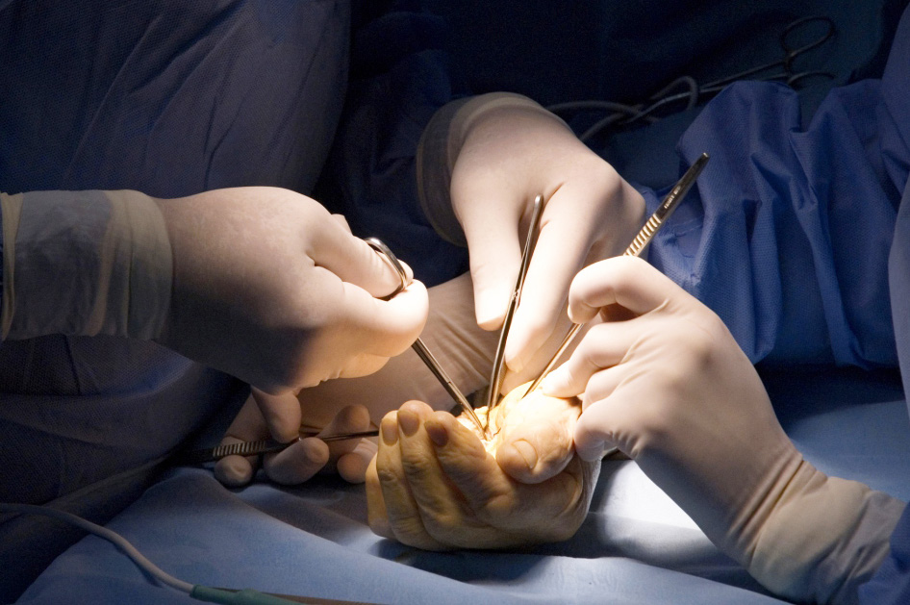
Global Hand Teaching Programme
Module 9.8
Paediatric hand fractures
CBDs

Slide 2
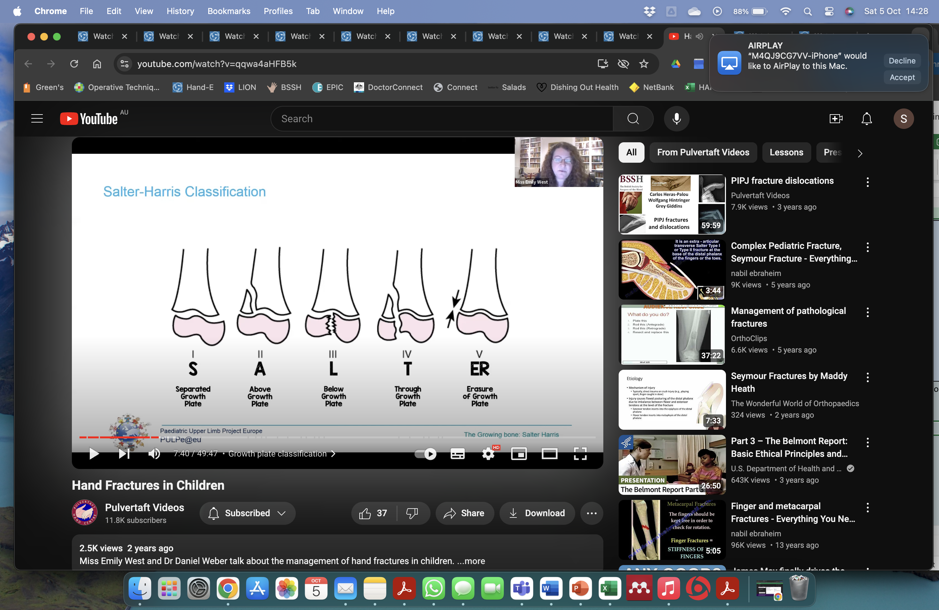

Case 1
Place pictures A – E in the correct order of the Salter-Harris classification
A
B
C
D
E
bssh.ac.uk

Slide 3
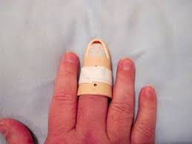
Case 2
A 5 year old child is referred to hand trauma clinic as having a a nail bed injury and mallet finger after trapped their finger in a door. Because the nail plate was still secure, ED have dressed it, applied a mallet splint and advised 6 weeks immobilisation for the tendon.
Is a mallet injury common in a 5 year old?
What do you suspect, and how would you assess and investigate the patient?
Assuming you are correct, how should this be managed?
bssh.ac.uk

Slide 4
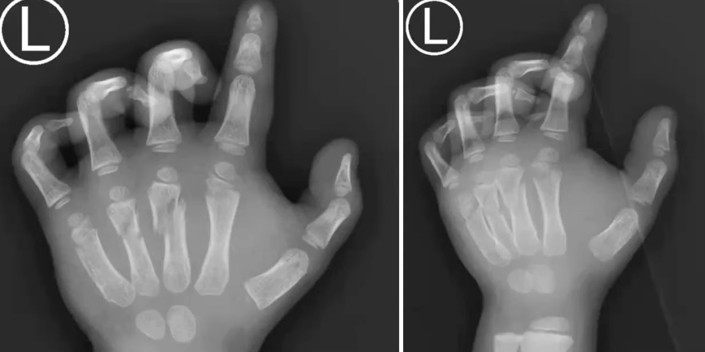
Case 3
A 4 year old child presents with a very painful, bruised, and swollen hand. Xrays reveal multiple metacarpal fractures. The parents describe the child knocking their hand against a door frame when running into the kitchen.
Does the mechanism described fit with this injury?
Discuss how you would assess this child?
bssh.ac.uk

Slide 5

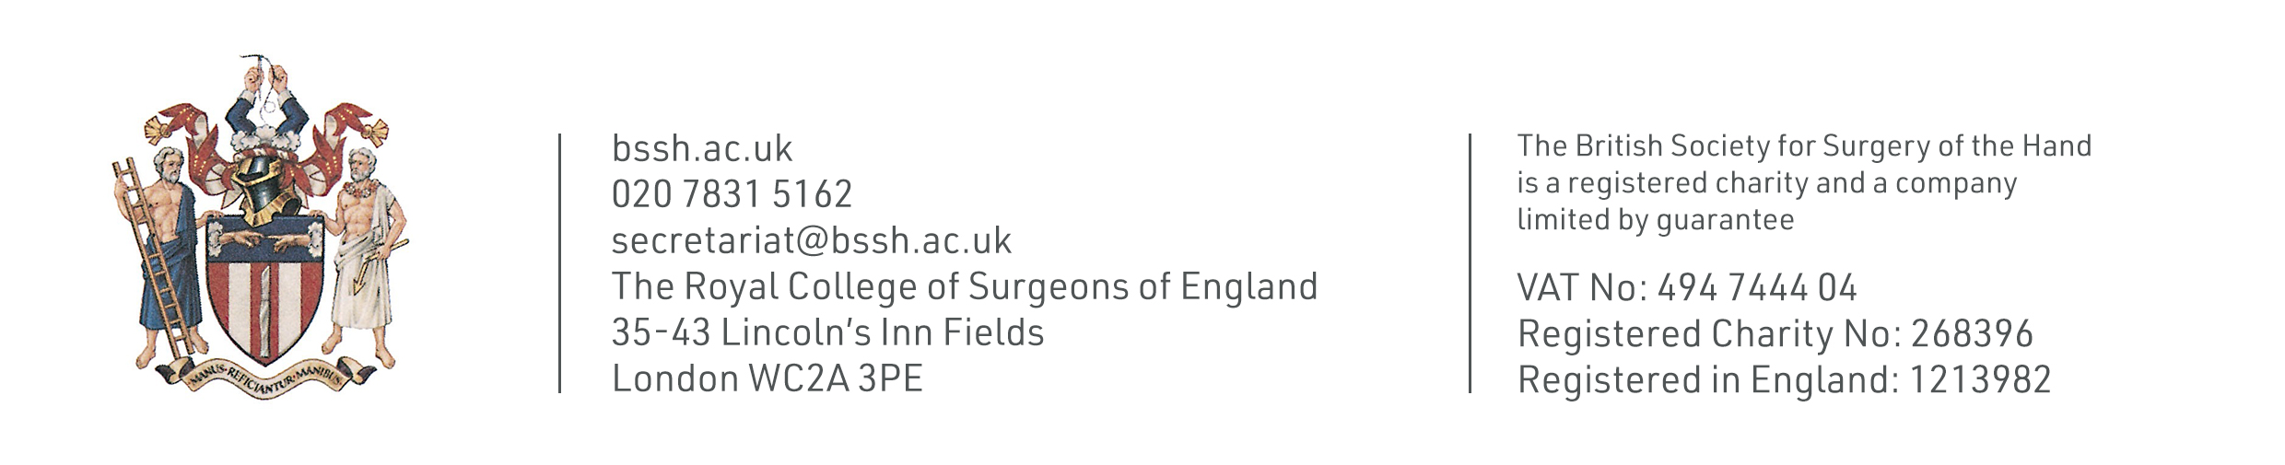
Questions?
For further information please ​
get in touch via the channels below:​

