Slide 1

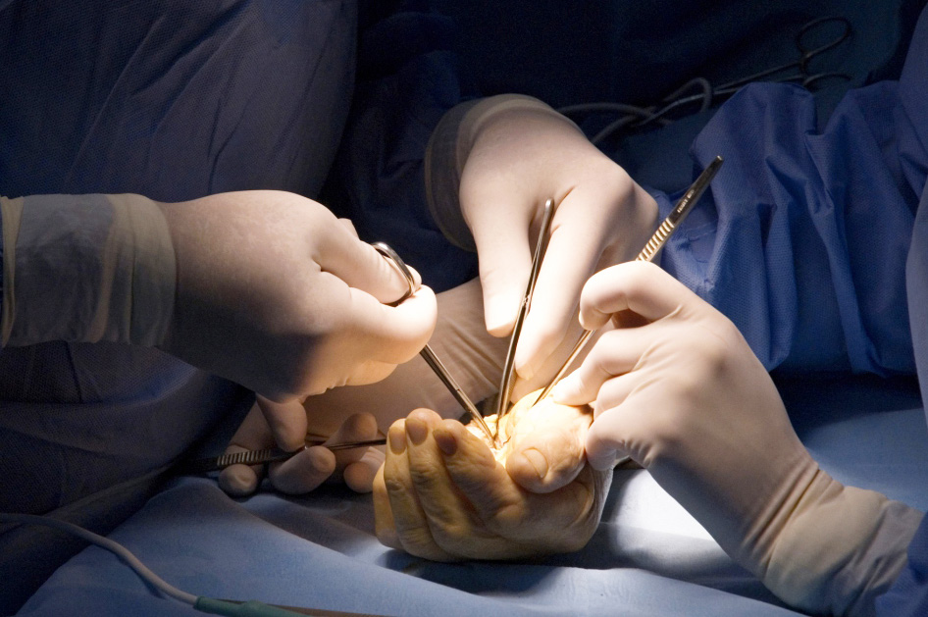
Global Hand Teaching Programme
Module 9.7
Vascular anomalies
CBDs

Slide 2
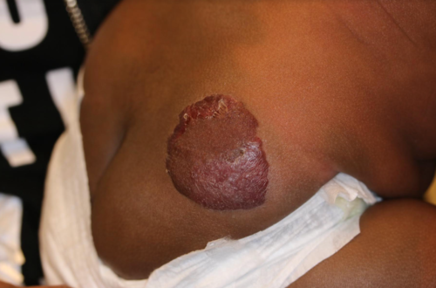

Case 1
A mother brings her 6 month old child to your clinic, with concerns over a soft red lesion which she thought was just a small bump at birth but which has been enlarging in size ever since. The child is otherwise well and happy.
Describe the appearances of the lesion
What is the most likely diagnosis?
How would you manage this patient, and how would you council the mother?
bssh.ac.uk

Slide 3
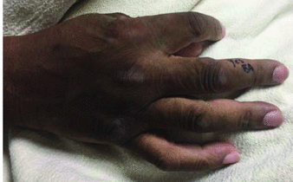
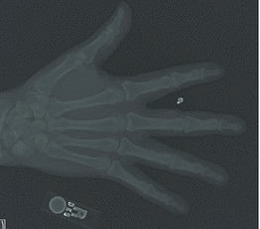
Case 2
61-year-old right-handed man presented with a 2.5-cm subcutaneous mass to the dorsal radial aspect of the right long finger at the proximal interphalangeal joint. The mass had been present for 7 years without appreciable change in size, but was associated with some pain and reduced joint movement. A small phlebolith is visible on xray.
What is your differential?
How would you investigate the patient?
You opt for surgical excision and histology suggests an AVM.
3. What histological features may be present?
bssh.ac.uk

Slide 4

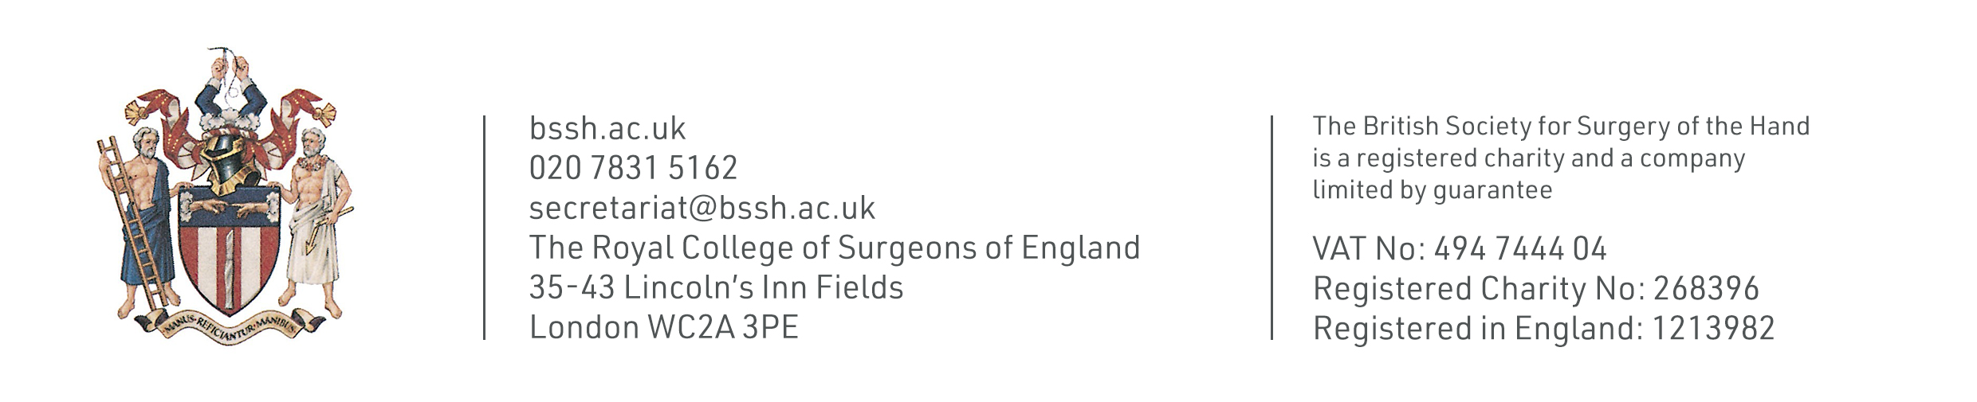
Questions?
For further information please ​
get in touch via the channels below:​

