Slide 1

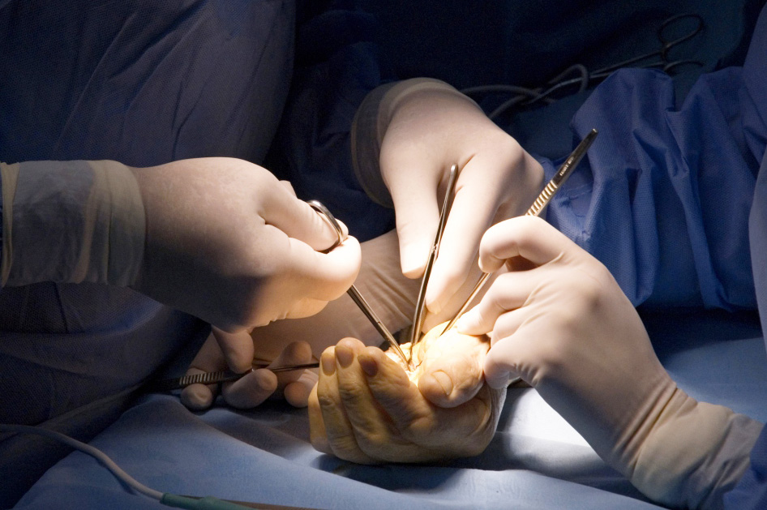
Global Hand Teaching Programme
Module 9.6 Congenital contractures and arthrogryposis
Case based discussions

Slide 2
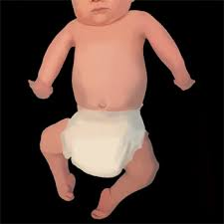

Case 1
You are asked to see a newborn with symmetrical contractures. On examination, the baby has extended elbows, flexed wrists, and bilateral clubfeet. His muscle bulk is reduced and replaced by fibrous tissue. There is no obvious facial or spine abnormalities. He had normal prenatal ultrasound scans but reduced fetal movements.
bssh.ac.uk

Slide 3
Case 1
How would you classify this?
What genetic / neurological workup is required?
What would be your first intervention?
bssh.ac.uk

Slide 4
Case 1
What is a dynamic extension splint and how do you prevent skin breakdown?
What is the role of occupational therapy in newborn feeding adaptation?
bssh.ac.uk

Slide 5
Case 2
A 2 year old patient was seen in clinic. He presents with clenched fists, vertical talus and facial grimacing. He has a family history of an autosomal dominant MYH3 mutation.
On examination, his fingers are flexed at the PIPJ and his thumbs are adducted. There is a rocker-bottom deformity affecting both feed, and limited mouth opening
bssh.ac.uk

Slide 6
Case 2
How does this differ from amyoplasia?
Would you operate on hands or feet first?
How might the MYH3 mutation alter prognosis?
bssh.ac.uk

Slide 7
Case 2
If the facial contractures are affecting feeding, what options are available to address this?
What is the role of tendon transfers in these hands?
How would you counsel the family about recurrence risk in future pregnancies?
bssh.ac.uk

Slide 8
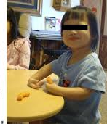
Case 3
A 3 year old girl presents with fixed elbow contracture that limits hand-to-mouth function. There does not seem to be any other joint involvement, and her genetics and EMG testing have been normal.
On examination of her elbow, there is no passive flexion beyond 30 degrees. She has normal range of movement of her forearm and hand but weak triceps
bssh.ac.uk

Slide 9
Case 3
How does this differ from AMC elbow contracture?
What surgical approach would you use?
  Discuss the options of anterior capsulotomy and triceps lengthening
  Discuss posterior release with V-Y plasty
bssh.ac.uk

Slide 10
Case 3
How do you prevent post-operative nerve palsy?
What non-surgical options are there if surgery fails?
How would you measure success?
bssh.ac.uk

Slide 11

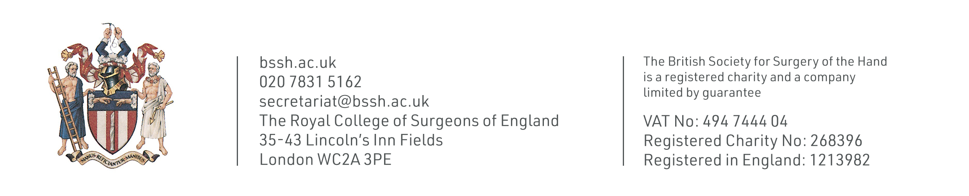
Questions?

Slide 12

Teaching feedback link M9.6
https://s.surveyplanet.com/wdqpcfwl

