Slide 1

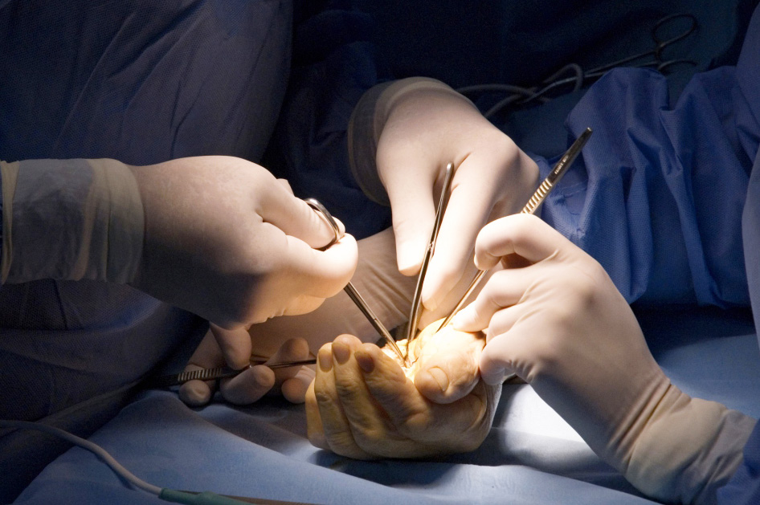
Global Hand Teaching Programme
Module 9.5 Radial aplasia
Case based discussions

Slide 2
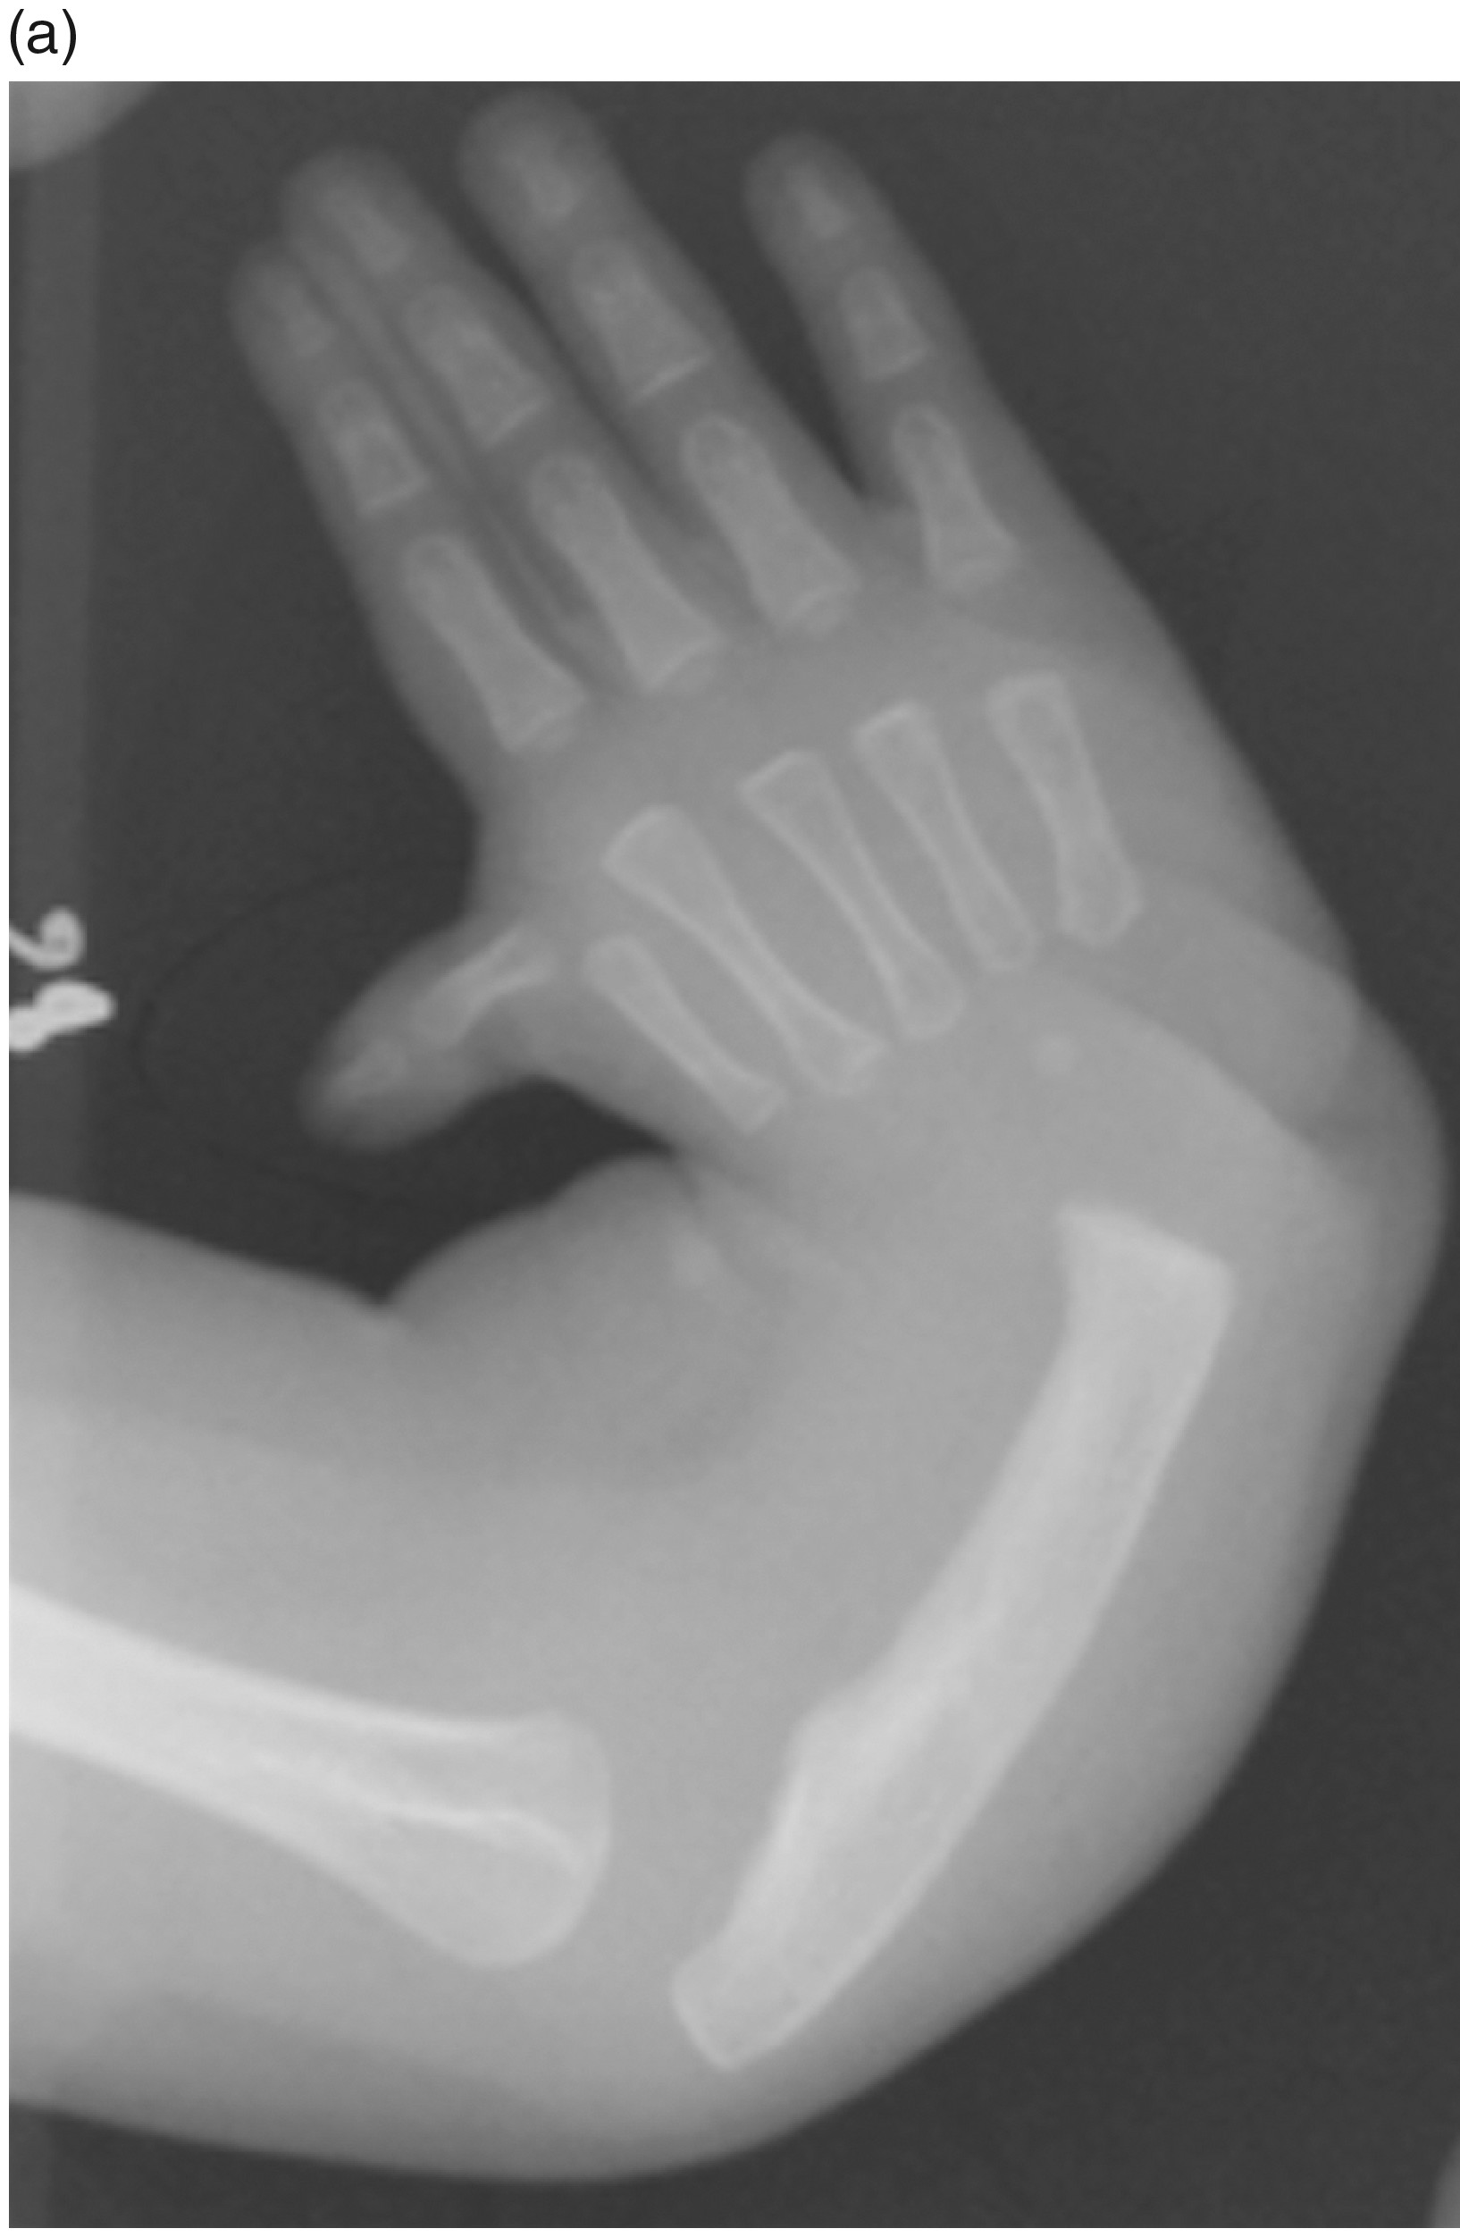

Case 1
A 3 month old baby presents with mild radial deviation of the right wrist and a hypoplastic but present thumb. There are no other anomalies noted on initial examination.
Describe the x-ray.
bssh.ac.uk

Slide 3
Case 1
What conditions are associated with this presentation and what organs do they affect?
What is the role of non-surgical management in this condition?
When would you consider surgery?
bssh.ac.uk

Slide 4
Case 1
How does the severity of radial aplasia impact on thumb function?
What is the classification system for thumb hypoplasia
bssh.ac.uk

Slide 5
Case 1
What are the options for thumb reconstruction?
Can thumb reconstruction be combined with radial aplasia surgery?
bssh.ac.uk

Slide 6
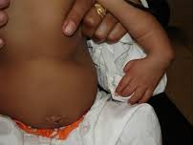
Case 2
A 6 month old baby presents with complete absence of the radius, severe wrist radial deviation and a history of neonatal thrombocytopenia.
His x-ray shows an absent radius, radially dislocated carpus and bowed ulna.
What syndrome does he have?
bssh.ac.uk

Slide 7
Case 2
How does TAR syndrome change your management priorities in terms of surgery?
What is the difference between centralisation and radialisation
bssh.ac.uk

Slide 8
Case 2
If the thumb is absent, what surgical options can be offered? How would you counsel the parents?
What intraoperative complication is unique to TAR?
bssh.ac.uk

Slide 9
Case 3
A 4 year old boy with radial aplasia previously treated with centralisation at age 1 now presents with progressive radial recurrence and ulnar growth arrest.
X-ray showed re-deviation of the carpus and ulnar physeal closure
bssh.ac.uk

Slide 10
Case 3
Why did recurrence occur?
What are the salvage options for ulnar growth arrest?
How would you revise the centralisation?
bssh.ac.uk

Slide 11
Case 3
What is the expected long-term functional outcome in this patient?
bssh.ac.uk

Slide 12


Questions?

Slide 13

Teaching feedback link M9.5
https://s.surveyplanet.com/kws34xhu

