Slide 1

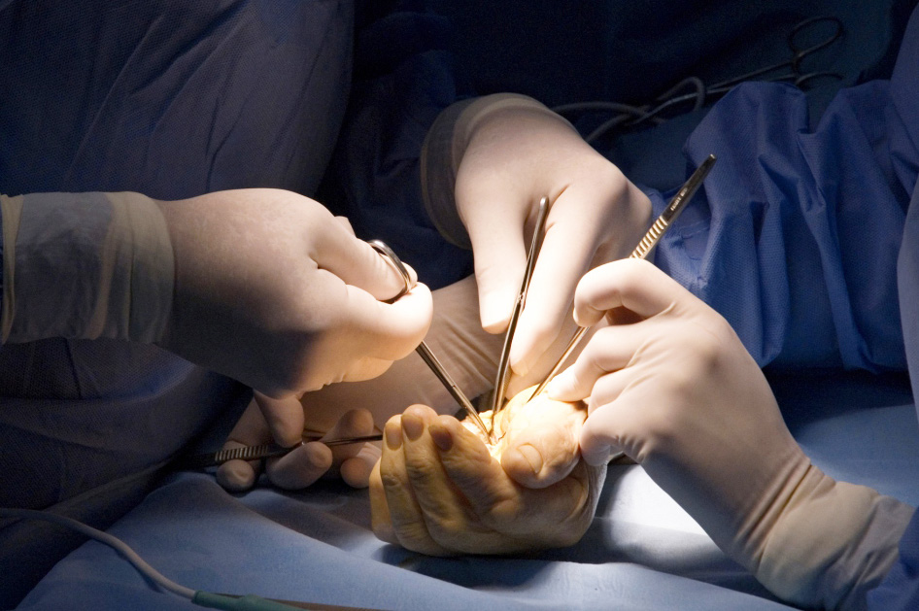
Global Hand Teaching Programme
Module 9.4 Polydactyly
Case based discussions

Slide 2
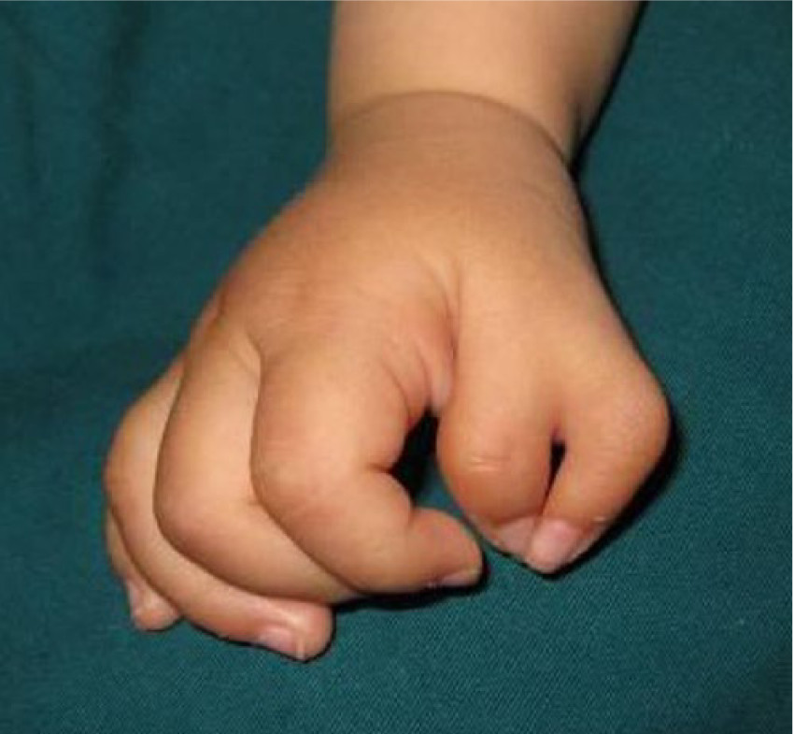

Case 1
A 7 month old baby presents with a duplicated right thumb. Both thumbs are hypoplastic, but the ulnar thumb is stronger on examination, but the radial thumb has a better nail.
How do you proceed?
bssh.ac.uk

Slide 3
Case 1
What imaging would you request?
What would you look for on examination?
bssh.ac.uk

Slide 4
Case 1
Which thumb would you choose to preserve? And why?
What are your goals of surgery?
How would you reconstruct the collateral ligaments?
What is the risk of growth arrest post-osteotomy?
bssh.ac.uk

Slide 5
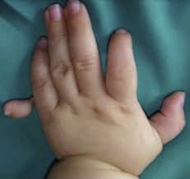
Case 2
A 2 year old child presents with a small, non-functional extra digit attached to the left liddle finger. It appears to be pedunculated with no bony connection. Parents ask if the removal is purely cosmetic.
On examination, the digit has a narrow pedicle with a tiny nail, with no active flexion or extension
bssh.ac.uk

Slide 6
Case 2
Is suture ligation appropriate here?
How would you handle the neurovascular bundle?
Are there any incidences that you would consider preserving the digit?
bssh.ac.uk

Slide 7
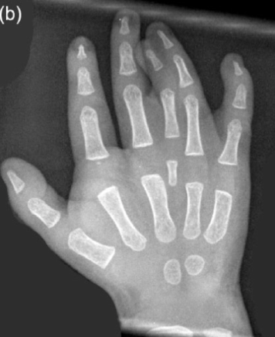
Case 3
A 6 month old baby presents with a duplicated ring finger that is fused to the ring and middle finger.
Describe the X-ray findings.
bssh.ac.uk

Slide 8
Case 3
How do you prioritise syndactyly release versus polydactyly reconstruction ?
What do you do if both duplicated digits are functional?
What techniques can you use to prevent postoperative scar contracture?
What syndromes are associated with synpolydactyly?
bssh.ac.uk

Slide 9

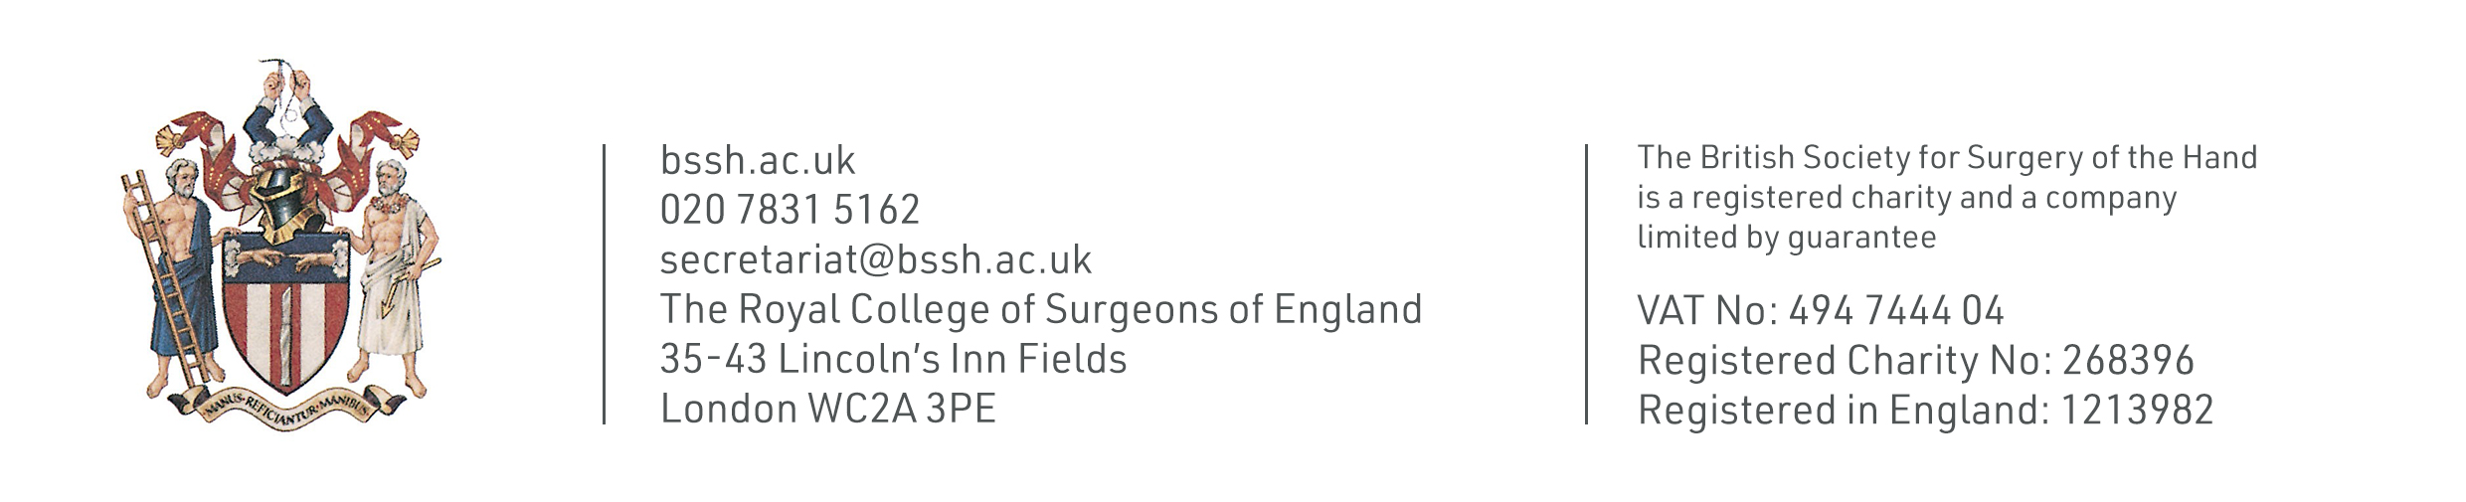
Questions?

Slide 10
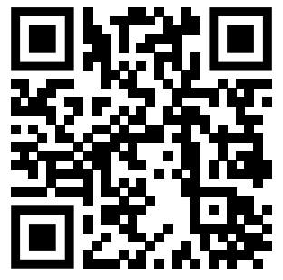
Teaching feedback link M9.4
https://s.surveyplanet.com/9tzhfr2l

