Slide 1
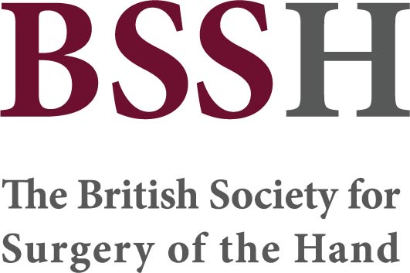
Module 9.10
Paediatric casting techniques
Objectives
Practice commonly used casting techniques in paediatric upper limb fractures, including:
  Above-elbow
  Below-elbow
  Ulnar gutter
  Thumb spica
  POSI slab

