Slide 1
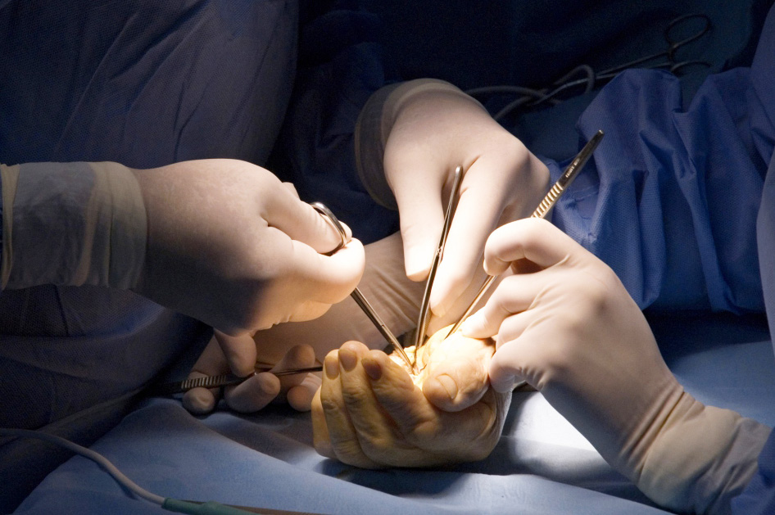

Consultation with the paediatric patient and their family
Objectives
To enhance one’s ability to interact with the paediatric patient and their family

