Slide 1
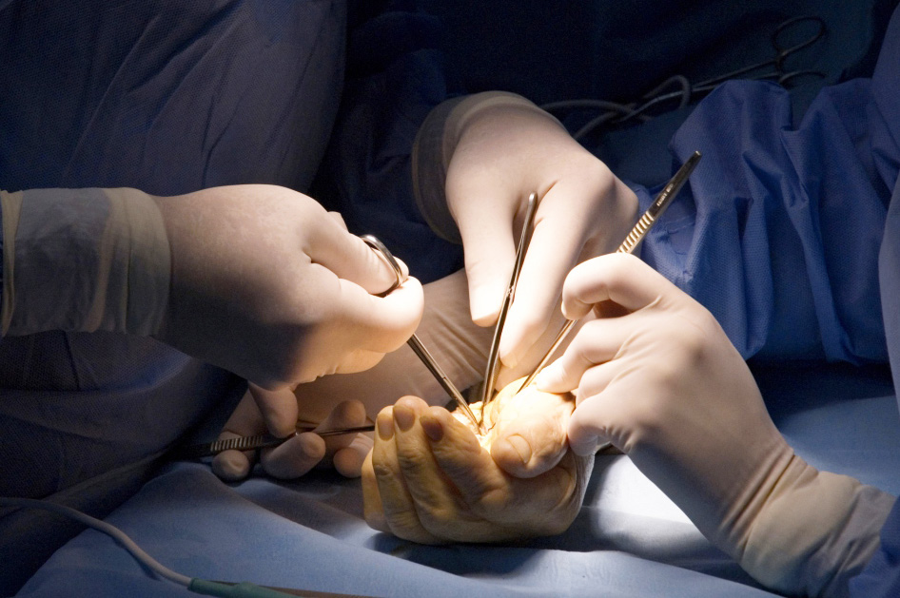

Embryology of the Hand
Objectives
To understand the key embryological pathways in the development of the hand

