Slide 1
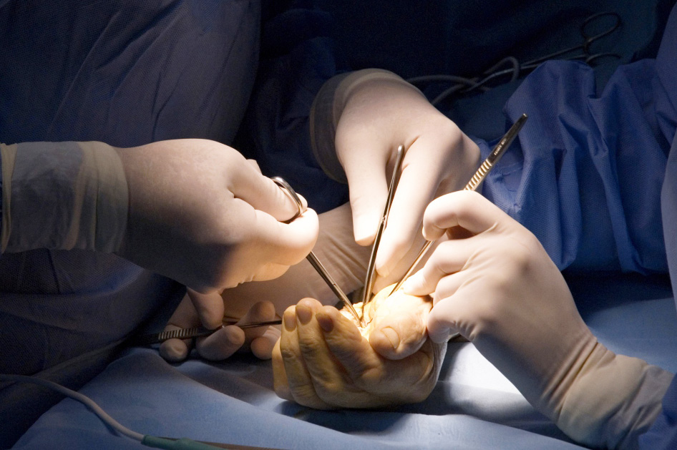

Global Hand Teaching Programme
Syndactyly and 1st web release workshop

Slide 2

Equipment
Gloves
Pens
bssh.ac.uk

Slide 3
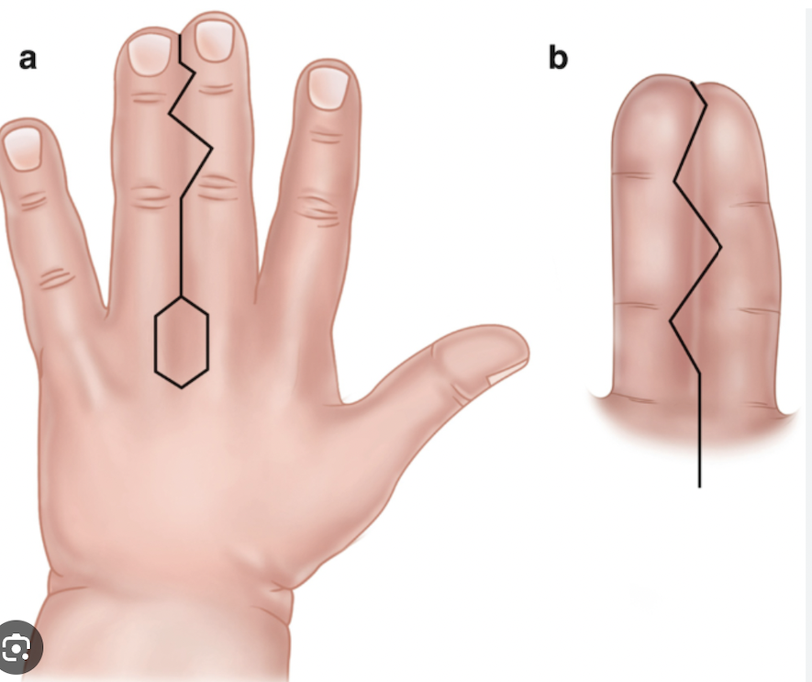
Case 1
Use a glove and draw on a colleague this classic syndactyly release
Tripodi, M.L., Bosio, S.T. (2024). Syndactyly. In: Slullitel, P., Rossi, L., Camino-Willhuber, G. (eds) Orthopaedics and Trauma. Springer, Cham. https://doi.org/10.1007/978-3-031-30518-4_68
bssh.ac.uk

Slide 4
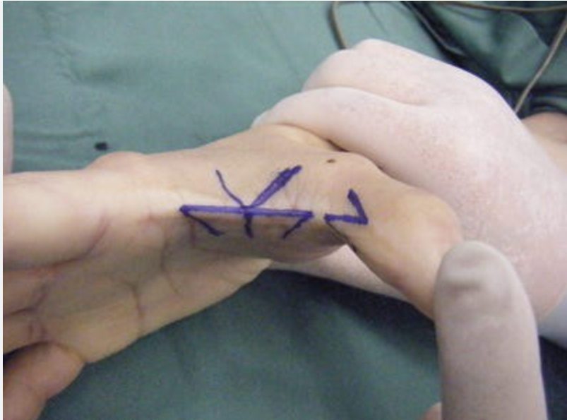
Case 2
Using a fresh glove draw some approaches to 1st web release
Hirase, Y. (2017). Reconstruction of First Web Space Area. In: Practical Techniques in Flap Surgery. Springer, Tokyo. https://doi.org/10.1007/978-4-431-56045-6_6
bssh.ac.uk

Slide 5

For further information please
get in touch via the channels below:

