Slide 1
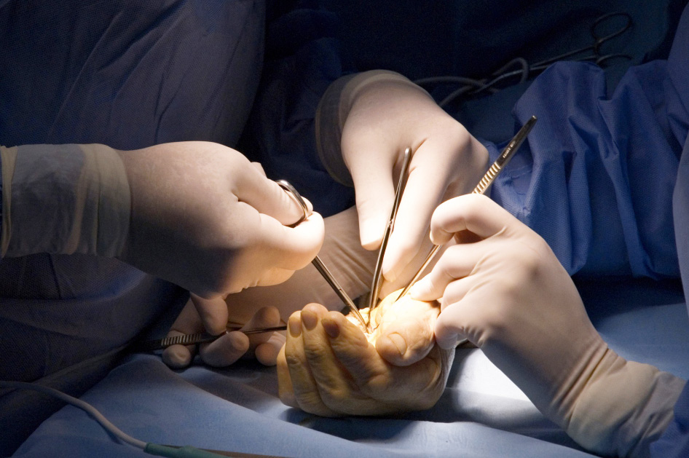

Global Hand Teaching Programme
Syndactyly

Slide 2
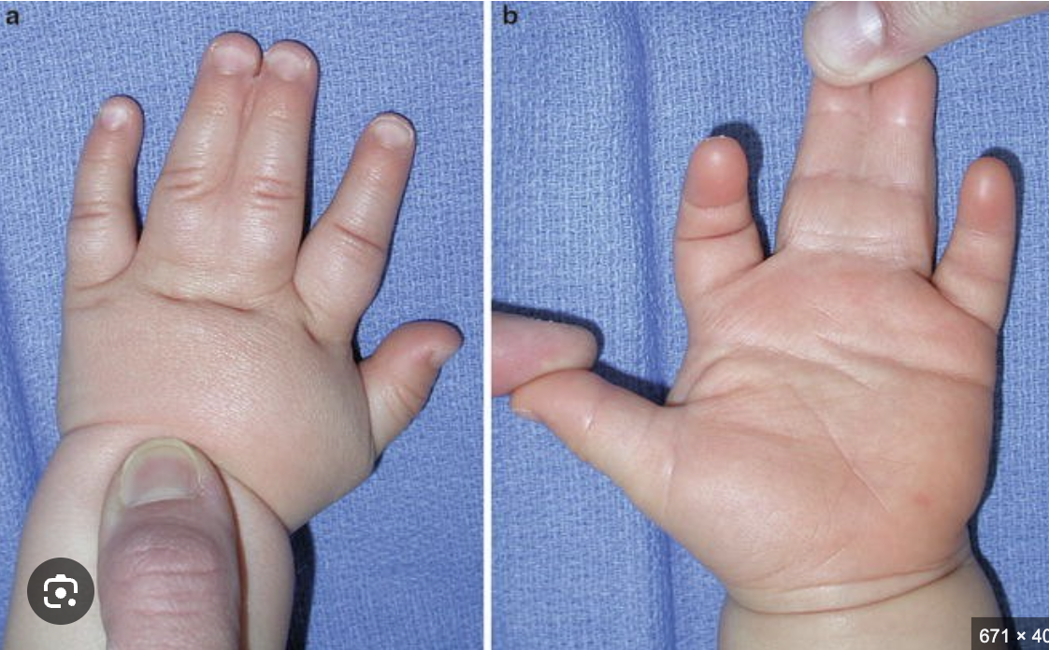

Case 1
Describe the pathogenesis of this condition?
What is the epidemiology? What syndromes is it associated with?
At what age would you surgically intervene?
Describe your classification of Syndactyly
Manske, M.C., Goldfarb, C.A. (2014). Syndactyly. In: Abzug, J., Kozin, S., Zlotolow, D. (eds) The Pediatric Upper Extremity. Springer, New York, NY. https://doi.org/10.1007/978-1-4614-8758-6_13-1
bssh.ac.uk

Slide 3
Case 2
Discuss the surgical approach to syndactyly release and the complications
Utilise the workshop to draw out your incisions
bssh.ac.uk

Slide 4

For further information please
get in touch via the channels below:

