Slide 1
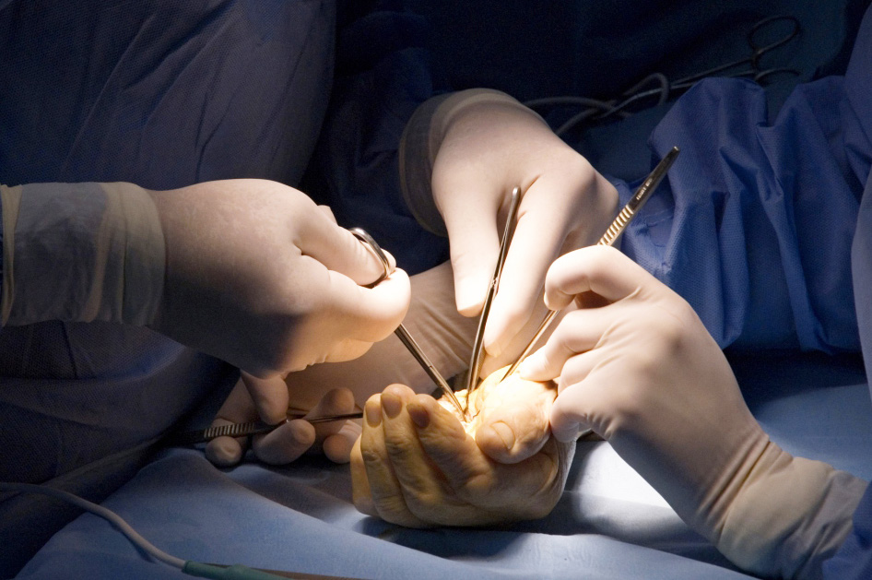

Global Hand Teaching Programme
Consultation with the paediatric patient and their family

Slide 2

Case 1
How does consulting with children differ from adults?
What members of the MDT can be useful in a children’s clinic?
What are the challenges in treating a child with a congenital hand condition if the child is happy without functional deficit but the parents are aiming for surgical correction?
How do you support parents who have a child born with a congenital hand anomaly?
What are the considerations around consent when managing a child with a congenital deformity and their parents?
bssh.ac.uk

Slide 3
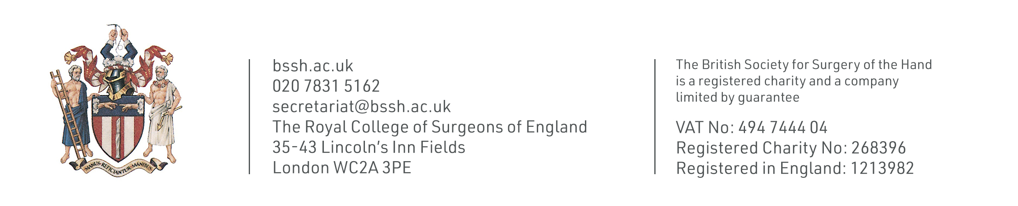
For further information please
get in touch via the channels below:

