Slide 1
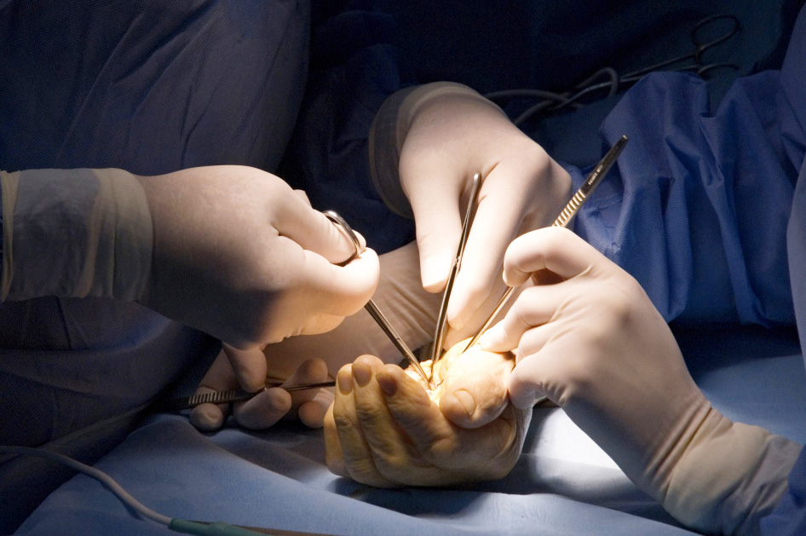
Global Hand Teaching Programme
Module 8.6 Combined nerve palsy and leprosy
Case based discussions

Slide 2
Case 1
A 45 year old man from a leprosy-endemic region presents with bilateral claw hands, which have been worsening over the past two years. He also reports painless ulcers on his fingertips. There is no history of trauma, but occasional episodes of fever.
bssh.ac.uk

Slide 3
Case 1
On examination, he has weak thumb opposition, absent FPL function.
He has positive Froment’s sign, Wartenberg’s signs and severe clawing.
There is glove-and-stocking anaesthesia, and thickened ulnar and median nerves felt on palpation.
He also has some hypopigmented skin patches with hair loss
bssh.ac.uk

Slide 4
Case 1
What investigations would you perform?
Why is this more likely to be leprosy than an entrapment neuropathy?
What drugs would you consider starting the patient on?
bssh.ac.uk

Slide 5
Case 1
Why would you not perform surgery immediately?
Which tendon transfers should you prioritise?
What medication can you use to reduce the risk of postoperative neuritis?
bssh.ac.uk

Slide 6
Case 2
A 30 year old labourer presents with wrist drop and numbness to the dorsum of the hand . This was previously treated as Saturday night palsy for four months with no improvement. He has a history of erythema nodosum leprosum.
On examination, he has no wrist nor finger extension, and a weakened brachioradialis. There is loss of sensation ove rthe first dorsal webspace. On palpation, there is a thickened radial nerve at the spiral groove.
bssh.ac.uk

Slide 7
Case 2
What is the diagnosis here?
bssh.ac.uk
Notes:
Leprous radial neuritis

Slide 8
Case 2
Why is this not a traumatic palsy?
What is the role of steroids in this?
Which tendon transfers may be useful for chronic palsy?
How do you monitor for reaction recurrence?
bssh.ac.uk
Notes:
Leprous radial neuritis

Slide 9
Case 2
What are the signs of leprous neuropathy?
Why should you avoid surgery during reaction flare-ups?
Discuss the role of infectious diseases and occupational therapy and the rehabilitation challenges that could be faced.
bssh.ac.uk
Notes:
Leprous radial neuritis

Slide 10
Questions?

Slide 11
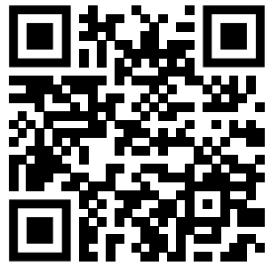
Teaching feedback link M8.6
https://s.surveyplanet.com/ytl2bg5c

