Slide 1

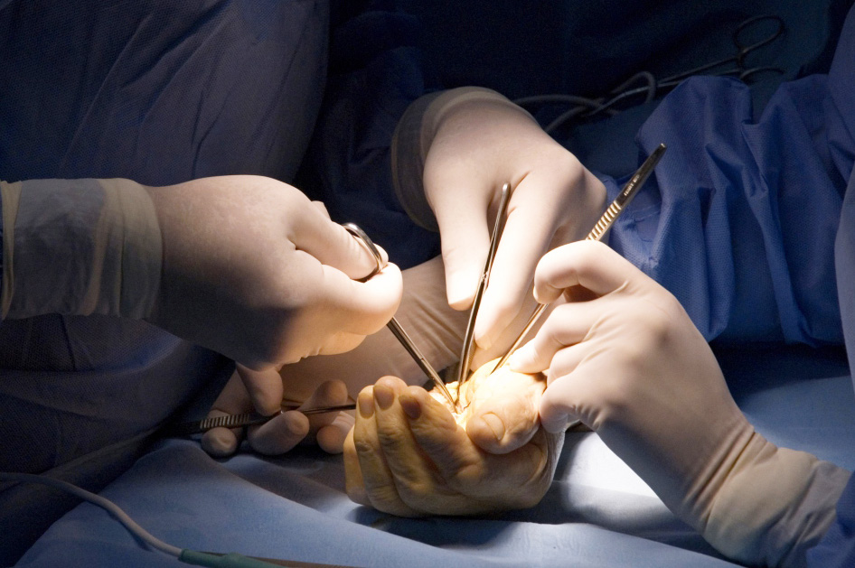
Global Hand Teaching Programme
Module 8.5 Median and ulnar nerve palsy
Case based discussions

Slide 2
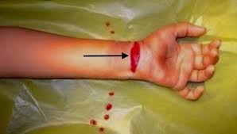

Case 1
A 24 year old construction worker sustains a laceration to his wrist from broken glass. There immediate loss of thumb opposition and numbness in the radial 3.5 thumb/fingers.
There is paralysis of the APB and OP, but weak FPL and FDP function to the index finger. There a 4cm wound to his distal wrist crease over the volar aspect.
bssh.ac.uk

Slide 3
Case 1
What would your surgical plan be?
Why should you preserve the palmar cutaneous branch?
In what situation would you consider a nerve graft? Where would you harvest this from? How does primary repair compare to a nerve graft?
bssh.ac.uk

Slide 4
Case 1
What is the hand therapy’s role in this injury?
If there is no functional recovery in a year post-injury, what procedure could you offer the patient?
bssh.ac.uk

Slide 5
Case 2
32 year old man presents with a crush injury to his proximal forearm from a motorcycle accident.
He can’t make an ‘ok’ sign with his thumb and index finger and cannot flex the thumb IP joint, but does not have any sensory loss.
What is the injury here?
bssh.ac.uk

Slide 6
Case 2
Why does the patient lack an ‘ok sign’ but have no sensory deficit?
How would you differentiate an AIN palsy from a flexor tendon rupture?
bssh.ac.uk

Slide 7
Case 2
What nerve transfer and tendon transfer options can you offer this patient?
Why would you combine a nerve and tendon transfer?
What alternative donors are there for nerve transfer?
bssh.ac.uk

Slide 8
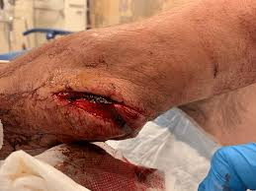
Case 3
40 year old woman who sustains a medial elbow laceration. She presented as she cannot cross fingers or grip tools.
On examination, there is positive Froment’s and Wartenberg’s signs, clawing of the ring and small fingers, and sensory loss of ulnar 1.5 fingers.
bssh.ac.uk

Slide 9
Case 3
What is Wartenberg’s sign?
What is Froment’s sign?
Intraoperatively, you find a 3cm ulnar nerve gap within a contaminated wound. How would you proceed?
bssh.ac.uk

Slide 10
Case 3
Discuss the timing of tendon transfer
What are the benefits of using a sural nerve graft as a donor?
During grafting, how do you ensure proper fascicular alignment?
The medial antebrachial cutaneous nerve is available – why would you still choose the sural nerve over MABCN?
bssh.ac.uk

Slide 11
Case 4
28 year old man presents with a stab wound to his hypothenar eminence. He has a weak key pinch but normal sensation otherwise.
On examination, he has paralysis of his adductor pollicis and weak interosseous, but no clawing. His sensation is normal.
bssh.ac.uk

Slide 12
Case 4
His ultrasound shows deep motor branch laceration at the level of the hook of hamate.
Why is there no clawing?
What position would you splint the patient post-operatively?
bssh.ac.uk

Slide 13

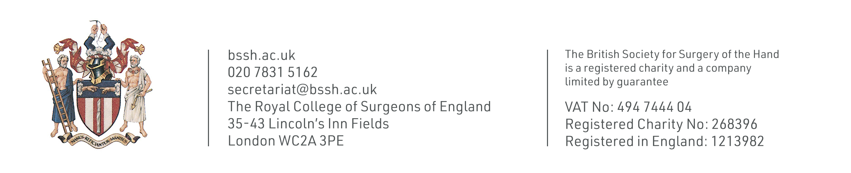
Questions?

Slide 14
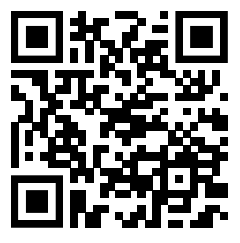
Teaching feedback link M8.5
https://s.surveyplanet.com/yjwiqh9m

