Slide 1
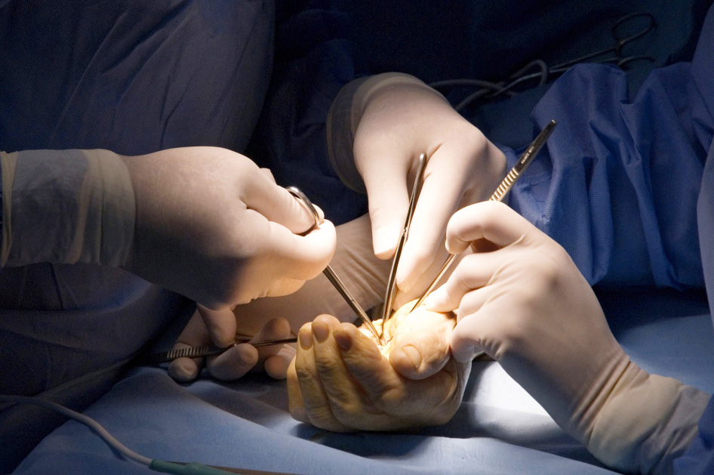
Global Hand Teaching Programme
Module 8.4
Radial nerve palsy
Case based discussions

Slide 2
Case 1
A 45 year old man presents with an inability to extend his fingers but can weakly extend his wrist radially. His symptoms began gradually over two weeks, with no preceding trauma. There is a mild ache in his proximal forearm.
On examination, he has weak finger extension over MCPJ, intact wrist extension, and no sensory deficits. There is however pain on resisted supination
bssh.ac.uk

Slide 3
Case 1
His MRI showed a lipoma compressing the PIN near the arcade of Frohse.
What is the diagnosis?
Why is there no wrist drop in PIN palsy?
How would you decompress the PIN?
bssh.ac.uk

Slide 4
Case 2
A 60 year old woman falls, sustaining a mid-shaft humerus fracture. She develops wrist drop, weak finger extension and numbness over the dorsum of the hand.
Her X-ray shows a displaced humeral fracture
What is the diagnosis?
bssh.ac.uk

Slide 5
Case 2
What would your management plan be?
What is the likelihood of spontaneous recovery?
If there is no recovery at six months, what tendon transfers would you choose?
How would you address the superficial radial nerve symptoms?
bssh.ac.uk

Slide 6
Case 3
A 35 year old man undergoes ORIF of a mid-shaft humerus fracture via a posterior approach. Post-operatively, he complains of complete wrist and finger drop with numbness over the dorsum of the hand.
bssh.ac.uk

Slide 7
Case 3
His examination findings are as follows:
Motor:
0/5 wrist extension (ECRL, ECRB, ECU absent)
0/5 finger extension (EDC, EIP, EDM absent)
0/5 thumb extension (EPL, EPB absent)
Weak supination
Sensory:
Loss over dorsal first web space
Special test:
Tinel’s sign positive at surgical scar
bssh.ac.uk

Slide 8
Case 3
What investigations can be performed?
What is the diagnosis?
How does a high radial nerve palsy differ from a low radial nerve palsy?
What are the possible mechanisms of injury during ORIF?
bssh.ac.uk

Slide 9
Case 3
When should the nerve be explored?
What surgical options are there for irreversible nerve injuries?
How would you counsel the patient?
bssh.ac.uk

Slide 10
Questions?

Slide 11
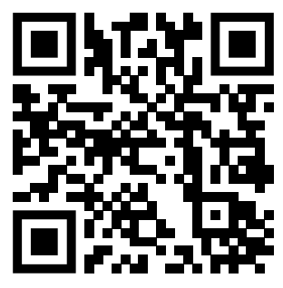
Teaching feedback link M8.4
https://s.surveyplanet.com/jk2jb43t

