Slide 1
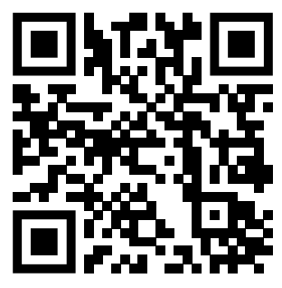
Teaching feedback link M8.4
https://s.surveyplanet.com/jk2jb43t

