Slide 1

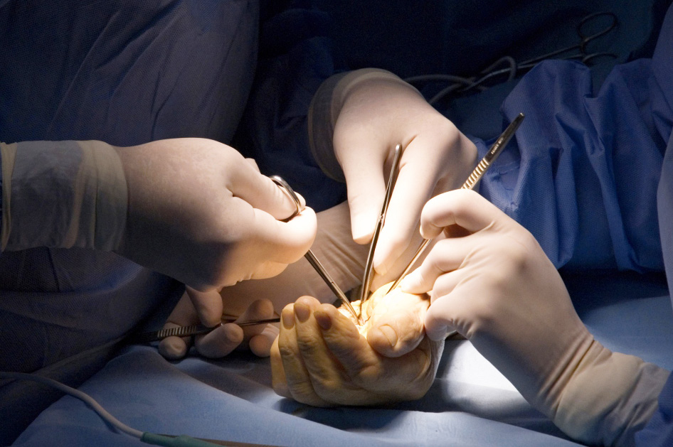
Global Hand Teaching Programme
Module 8.2
Bridging the nerve gap
CBDs

Slide 2
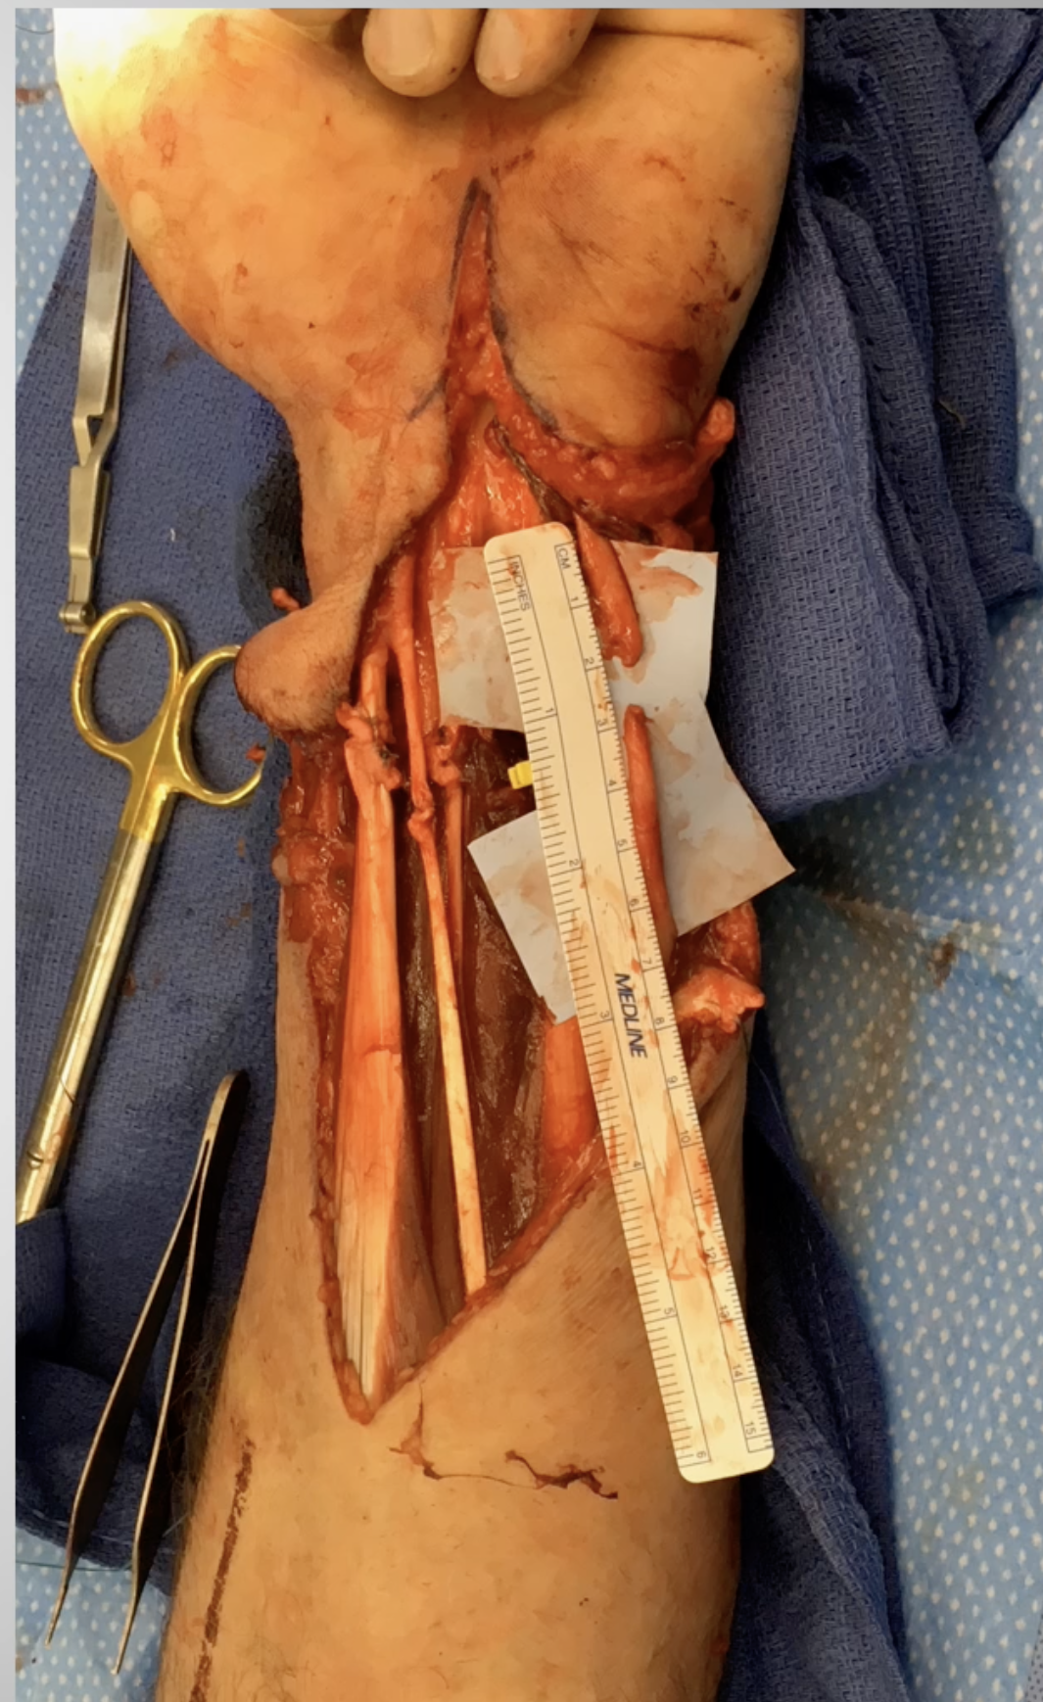

Case 1
Circular saw injury to the volar forearm. After exploration, debridement and repair of tendons, the ulnar nerve was found to have a gap of ~1cm.
What are your options in this scenario?
What may be the advantages or disadvantages of a conduit?
Describe some key technical tips of how to use/apply a conduit
bssh.ac.uk

Slide 3
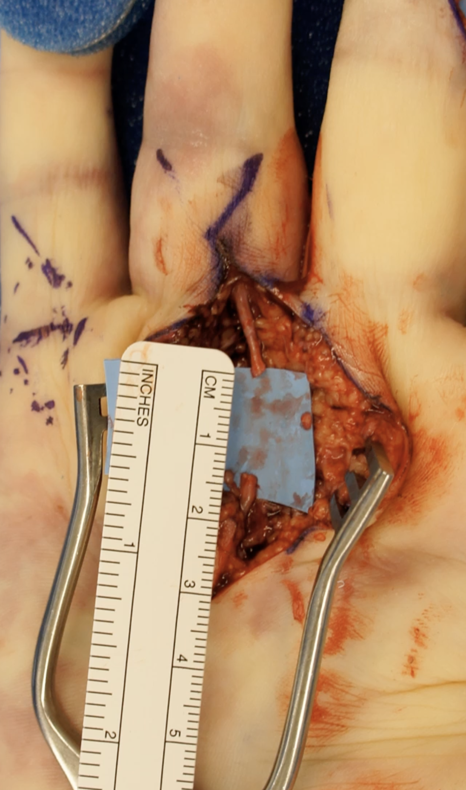
Case 2
The clinical photo demonstrates a digital nerve with a gap of 1.5cm.
Could a conduit still be appropriate here?
Alternative options?
What might be a good donor for this nerve if you wanted to use an autograft
bssh.ac.uk

Slide 4
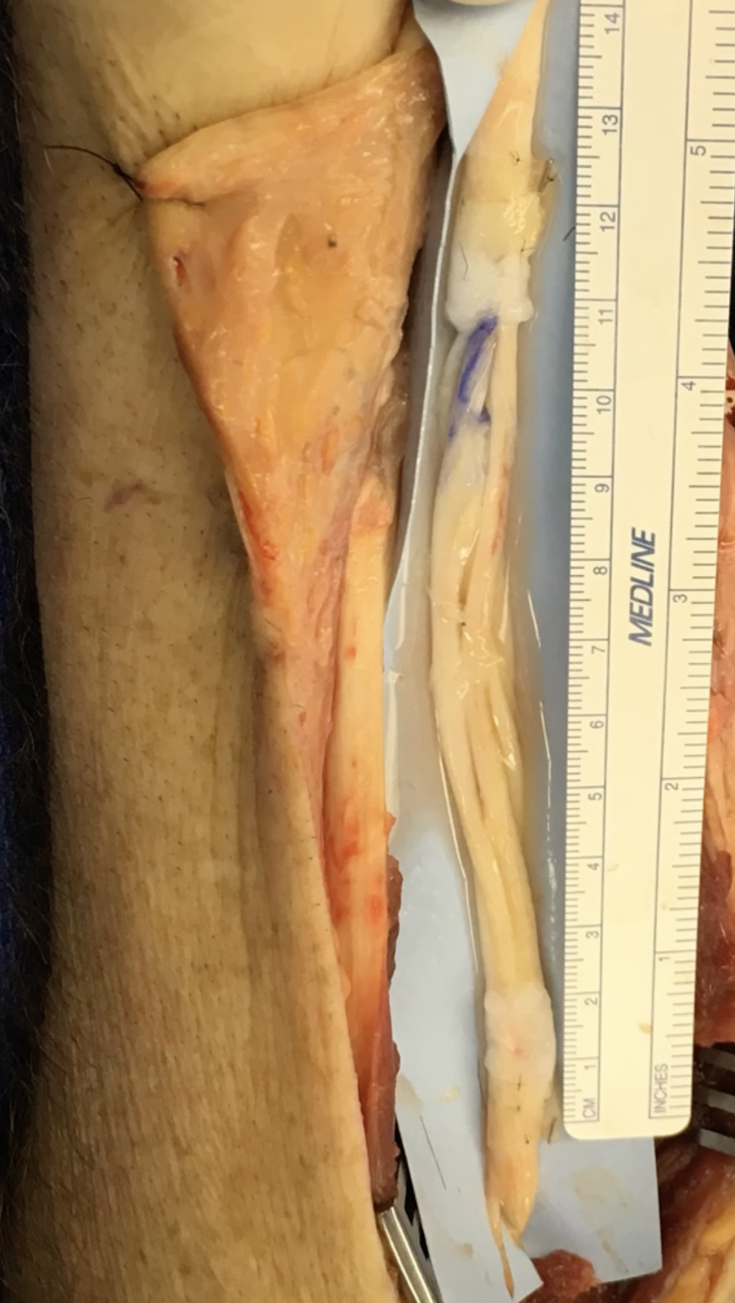
Case 3
What technique has been used in the reconstruction of this large median nerve defect?
What might be an appropriate donor nerve to achieve this?
What factors have an influence on patient outcome, apart from the technical aspects of the surgery?
bssh.ac.uk

Slide 5


Questions?
For further information please ​
get in touch via the channels below:​

