Slide 1
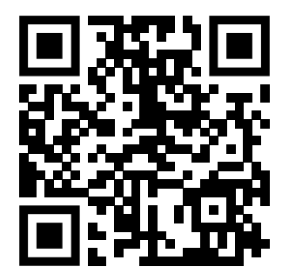
Teaching feedback link M8.11
https://s.surveyplanet.com/qweqd7o0

