Slide 1
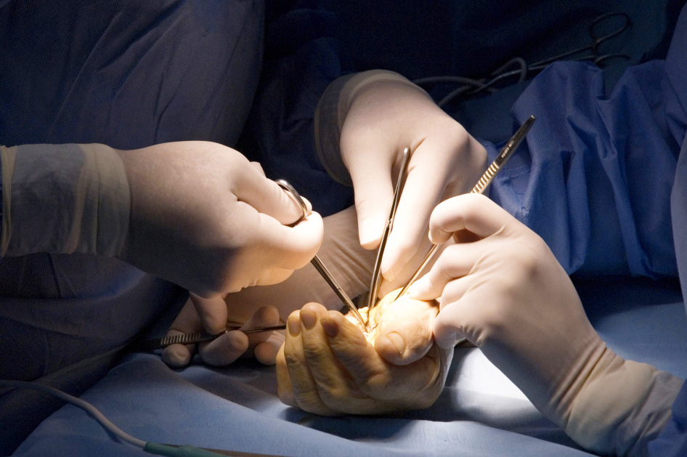
Global Hand Teaching Programme
Module 8.1
Nerve injury, repair and biology
CBDs

Slide 2
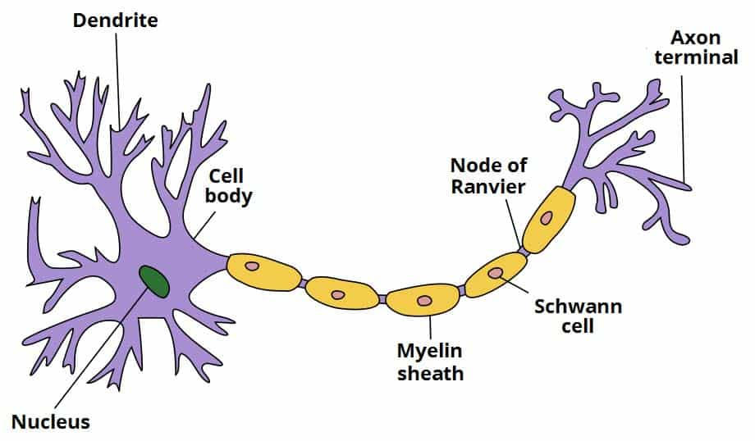
Case 1
Name the labelled components of a neuron
What is the influence of myelin to signal conduction?
What type of neurons are typically myelinated vs unmyelinated?
bssh.ac.uk

Slide 3
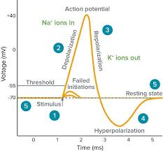
Case 2
Describe what’s happening at points 1 – 5 during the adjacent action potential
bssh.ac.uk

Slide 4
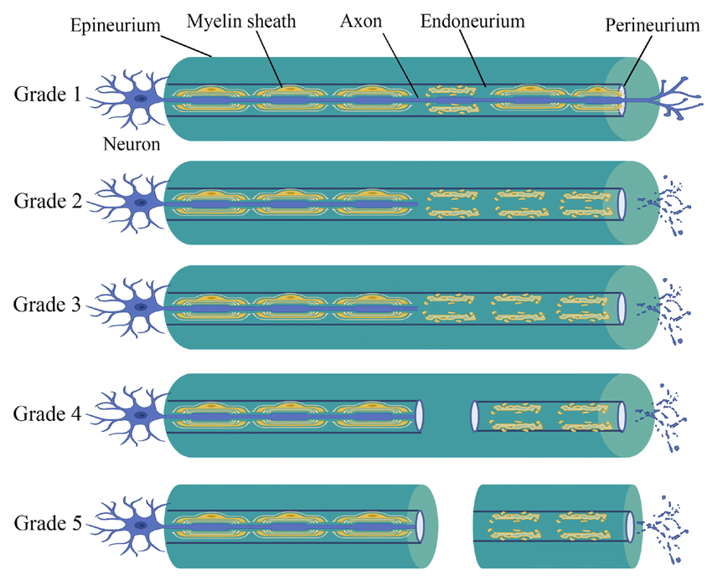
Case 3
Use the diagram to describe the pathophysiology behind the Seddon and Sunderland classification systems
bssh.ac.uk

Slide 5
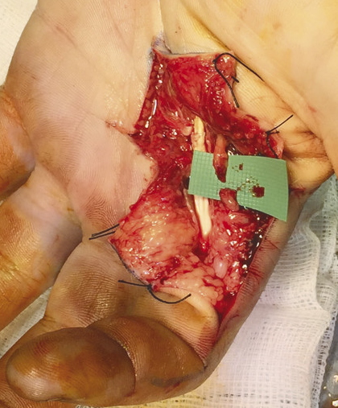
Case 4
You explore the wound of a 36 year old mechanic who sustained a lacerfation to the palm of his left hand. The Radial digital nerve to the index has been cut, and after debridement has approximately 8mm gap.
Describe your requirements to attempt direct repair
2. Suppose the nerve ends can’t be brought together without tension – what are your options?
bssh.ac.uk

Slide 6
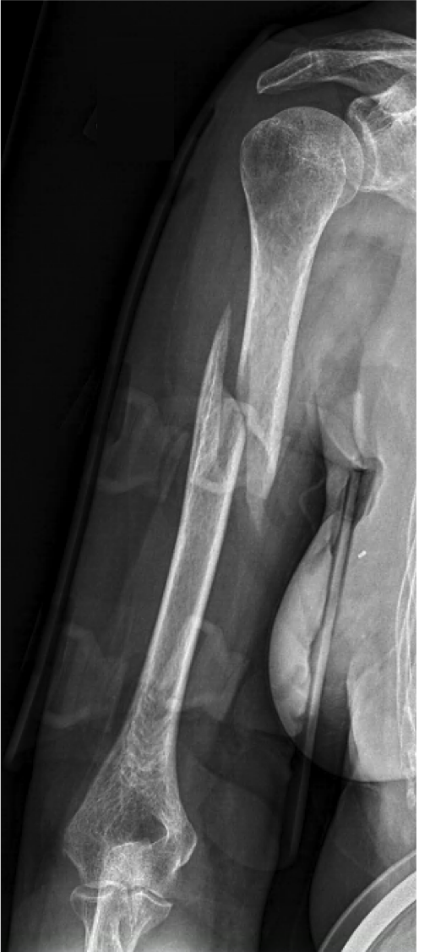
Case 5
A 58 year old woman has her arm pulled during an attempted robbery and sustains a spiral fracture to her humerus. She is comfortable in a humeral brace, but examination reveals difficulty with wrist and finger extension and altered sensation to the dorsum of the hand.
Which nerve is likely to have been affected?
What class of nerve injury is most likely in this scenario, and what is the expected outcome?
Does the presence of a nerve injury such as this affect your choice of management?
bssh.ac.uk

Slide 7
Questions?
For further information please ​
get in touch via the channels below:​

