Slide 1
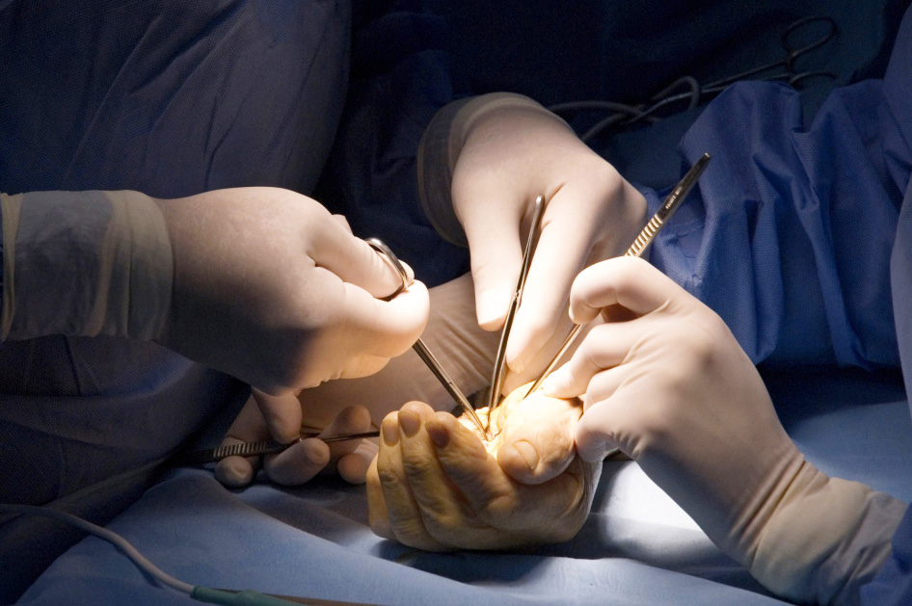
Global Hand Teaching Programme
Module 7.2
Electrical, chemical burns and frostbites
Case based discussions

Slide 2
Case 1
A 15 year old boy was brought into the emergency department. He accidentally touched a live wire whilst climbing and utility pole to retrieve his kite.
Assuming ATLS is normal and this is an isolated injury, how would you proceed?
bssh.ac.uk

Slide 3
Case 1
How does a high voltage electrical burn differ from a low voltage electrical burn?
What factors are you considering when you are examining his hand?
What are entry and exit points?
bssh.ac.uk

Slide 4
Case 1
What would your surgical management be?
What other investigations will be relevant in an electrical burn?
bssh.ac.uk

Slide 5
Case 2
A 40 year old worker in a herbicide factory presents with a painful index finger. She reports that she noticed a hole in her glove at the end of her shift and may have been exposed to hydrofluoric acid. She has had first aid.
bssh.ac.uk

Slide 6
Case 2
What is hydrofluoric acid how does it differ from other kinds of acid burns?
How would you manage this?
bssh.ac.uk

Slide 7
Case 2
What other kinds of investigation do you need?
bssh.ac.uk

Slide 8
Case 2
How do acid burns differ from alkaline burns?
Name the naturalisation agents for these components:
Cement
Phenol
Chrmic acid
Sulphuric acid
bssh.ac.uk

Slide 9
Case 3
A 54 year old homeless man was brought into the emergency department following a particularly cold winter night.
How does frostbite happen? What is the pathophysiology behind it?
bssh.ac.uk

Slide 10
Case 3
How would you assess and treat this?
How would you rewarm the patient?
If the necrosis has already set in? How would you manage this?
bssh.ac.uk

Slide 11
Questions?

Slide 12
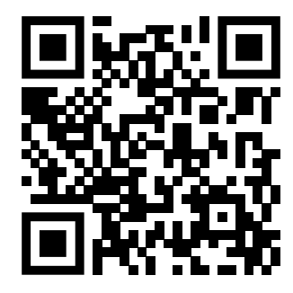
Teaching feedback link M7.2
https://s.surveyplanet.com/p4dexuqz

