Slide 1

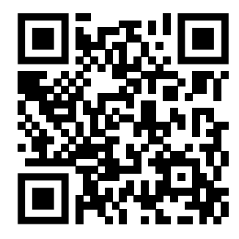
Teaching feedback link M7.2
https://s.surveyplanet.com/p4dexuqz

