Slide 1
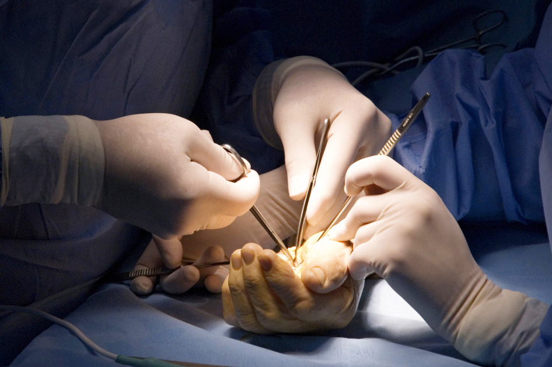
Global Hand Teaching Programme
Module 7.1
The acutely burned hand
Case based discussions

Slide 2
Case 1
A 30 year old chef presents to your department with a burn injury following spilling hot oil onto his hand an hour ago. There are no other injuries identified.
What key features would you try to illicit from the history?
bssh.ac.uk
Notes:
Timing of injury
Temperature of oil
First aid – for how long

Slide 3
Case 1
What first aid would you provide him with?
bssh.ac.uk
Notes:
Timing of injury
Temperature of oil
First aid – for how long

Slide 4
Case 1
What are looking for on focused examination of the hand?
How do you assess for the depth of the burn?
How do you assess for the surface area of the burn? What principles are you familiar with?
bssh.ac.uk

Slide 5
Case 2
A 2 year old girl was brought in by her parents with a burn to her left hand. They reported that the girl had touched a hot iron.
Describe the photograph
bssh.ac.uk

Slide 6
Case 2
What anatomical characteristics of the hand make them different from skin in the rest of the body?
How does volar and dorsal skin differ?
What function of the hand may be compromised with a burn of this depth?
bssh.ac.uk

Slide 7
Case 2
What would you ask the parents as part of the history?
What else would you be concerned about?
bssh.ac.uk

Slide 8
Case 3
A 20 year old student was in a housefire an hour ago. He was brought in to your department with the following injuries.
How would you manage this?
bssh.ac.uk

Slide 9
Case 3
Discuss ATLS and EMSB principles in relation to this injury
How would you calculate his resuscitation fluids, assuming that he is 70kg, and that his burn is 30% TBSA. How would you assess the adequacy of resuscitation?
bssh.ac.uk

Slide 10
Case 3
What are the indications for fasciotomies / escharotomies? What is the difference between the two?
bssh.ac.uk

Slide 11
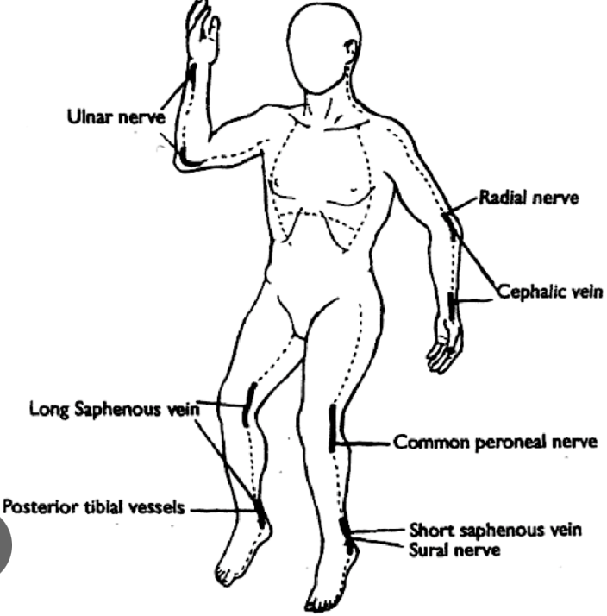

Slide 12
Case 3
Discuss the role of the multi-disciplinary team in the ongoing management of patients with severe burns – nurses, dietician, physiotherapists, occupational therapists, psychologists
bssh.ac.uk

Slide 13
Questions?

Slide 14
Teaching feedback link M7.1
https://s.surveyplanet.com/6vwh0i66

