Slide 1
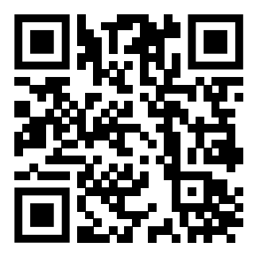
Teaching feedback link M7.1
https://s.surveyplanet.com/6vwh0i66

