Slide 1
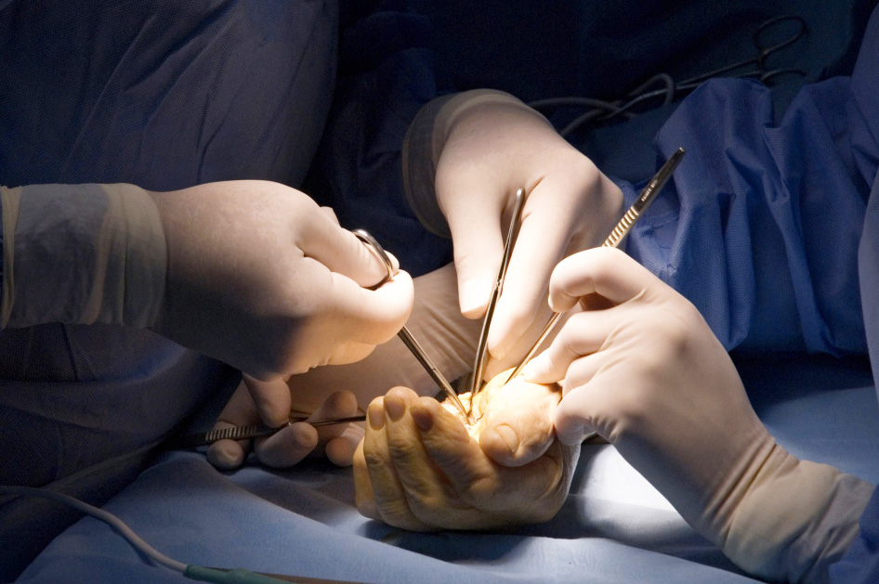
Global Hand Teaching Programme
Kienbock’s and vascular disorders of the carpal bones

Slide 2
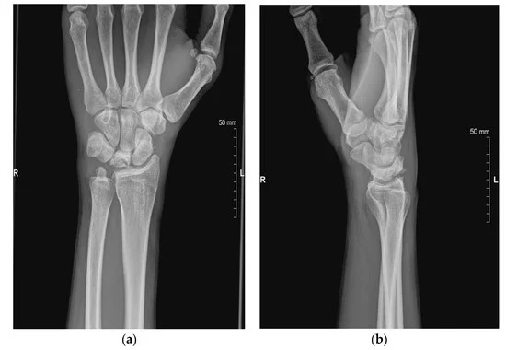
Case 1
Describe the XR, what features are present which increase the risk of Kienbock’s?
Do you know any classifications which can be used to stage this condition radiologically?
What is the typical presentation of such cases?
What is the gold standard investigation
What are the treatment options?
Chojnowski, K.; Opiełka, M.; Piotrowicz, M.; Sobocki, B.K.; Napora, J.; Dąbrowski, F.; Piotrowski, M.; Mazurek, T. Recent Advances in Assessment and Treatment in Kienböck’s Disease. J. Clin. Med. 2022, 11, 664.
bssh.ac.uk

Slide 3
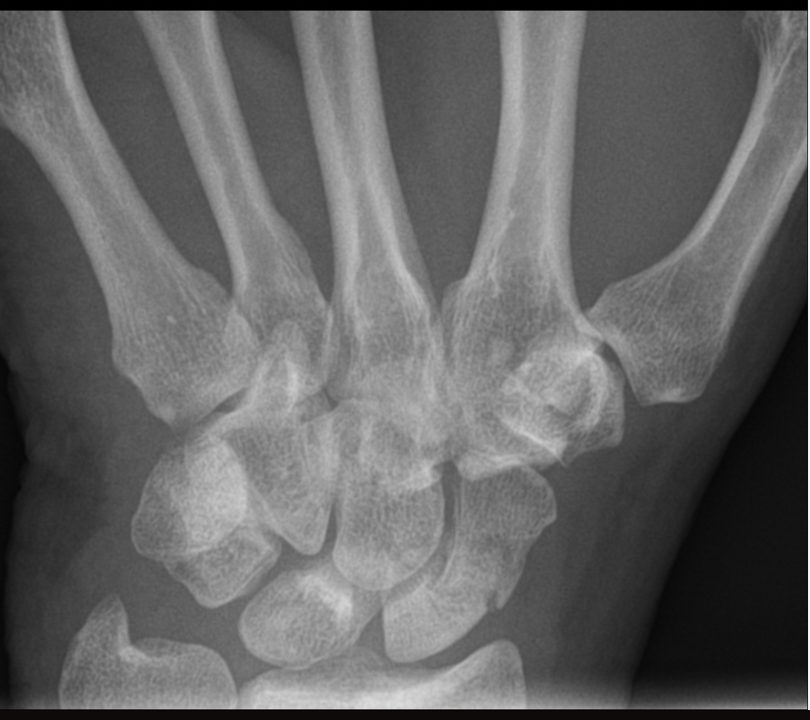
Case 1
What are the findings of the XR?
Explain the blood supply to the bone in question and explain why avascular necrosis is a risk
What is the typical presentation of such cases?
If the initial XR was normal and the second XR 2 weeks later did not show a conclusive scaphoid fracture but the patient still had pain at the snuffbox what investigation would you order?
What are the treatment options acutely and for avascular necrosis?
What is the eponymous name for idiopathic avascular necrosis of the scaphoid?
Available at https://radiopaedia.org/cases/scaphoid-avascular-necrosis-1
bssh.ac.uk

Slide 4
For further information please
get in touch via the channels below:

