Slide 1

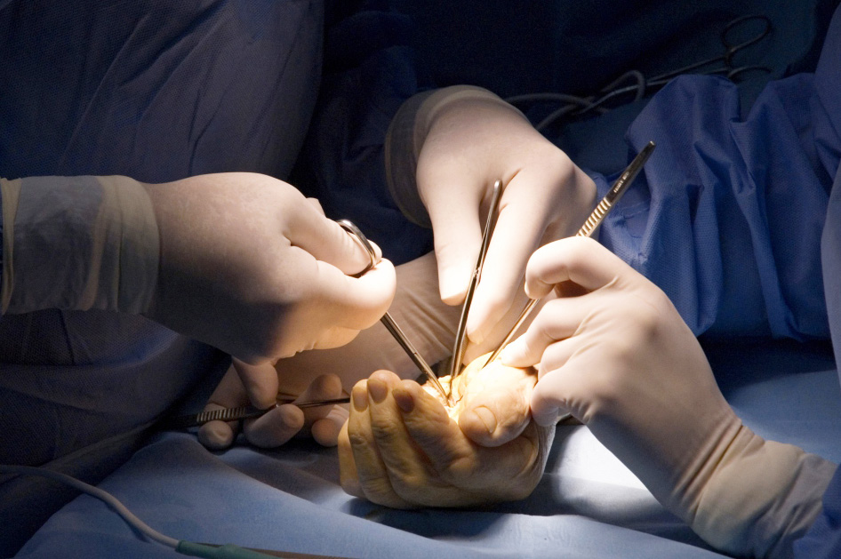
Global Hand Teaching Programme
Module 6.8
Chronic elbow dislocations
Case based discussions

Slide 2
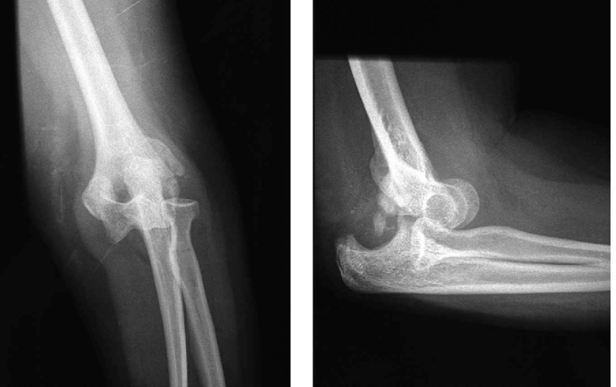

Case 1
A 25 year old man presented with a 6 month old injury to his elbow. This was managed non-operatively at the time. He complains that he is still unable to move his elbow and that his elbow is painful.
bssh.ac.uk

Slide 3
Case 1
How does the elbow dislocate? What structures contribute to the stability of the elbow?
What are static stabilisers? What are dynamic stabilisers?
How do you examine for elbow stability?
bssh.ac.uk

Slide 4
Case 1
What kind of pre-operative workup would you do for a patient with an unstable elbow? What imaging would be useful?
What is the role of the lateral collateral ligament complex?
What is the role of the coronoid and radial head?
bssh.ac.uk

Slide 5
Case 1
What kind of pre-operative workup would you do for a patient with an unstable elbow? What imaging would be useful?
What is the role of the lateral collateral ligament complex?
What is the role of the coronoid and radial head?
bssh.ac.uk

Slide 6
Case 1
Please discuss the patterns of elbow instability.
How do you reconstruct the lateral collateral ligament complex?
What are the complications associated with poorly managed elbow instability?
bssh.ac.uk

Slide 7

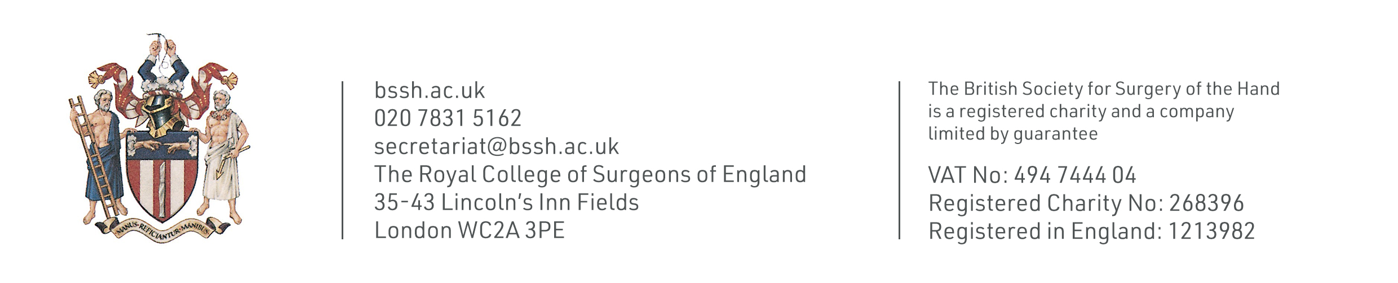
Questions?

Slide 8

Teaching feedback link M6.8
https://s.surveyplanet.com/ue8vxryo

