Slide 1

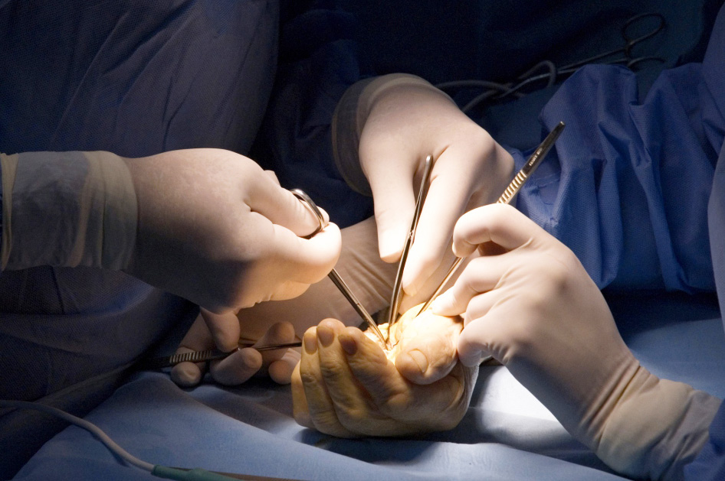
Global Hand Teaching Programme
Module 6.7
Monteggia and Essex-Lopresti injuries
Case based discussions

Slide 2
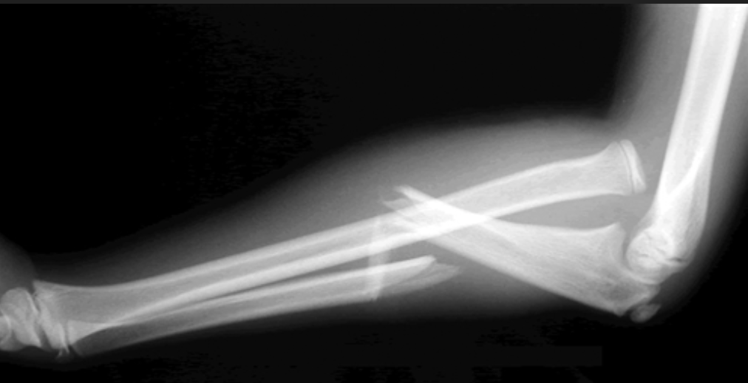

Case 1
An 8 year old boy presented to the emergency department after falling off a slide.
Please discuss the radiograph shown.
bssh.ac.uk

Slide 3
Case 1
What is the definition of a Monteggia fracture?
What other injuries area associated with Monteggia fractures?
What classification systems are used in Monteggia fractures?
bssh.ac.uk

Slide 4
Case 1
What key neurovascular examination is needed when patients presents with Monteggia fracture?
What operative techniques can be used to treat this injury?
What complications are associated with this injury?
bssh.ac.uk

Slide 5
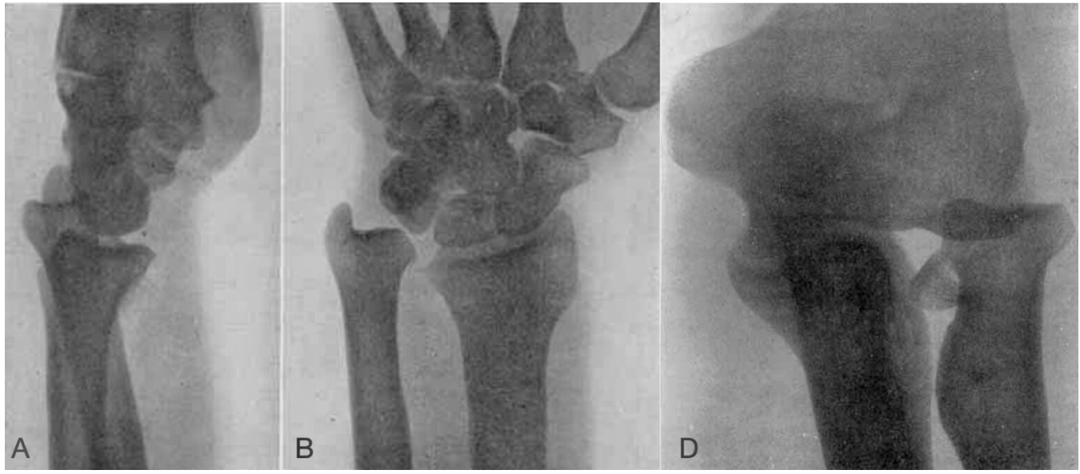
Case 2
A 30 year old woman presents with a fall down a flight on stairs onto an outstretched hand.
bssh.ac.uk

Slide 6
Case 2
What are the features of an Essex-Lopresti injury?
How do these injuries often present?
What is the pathology of the injury?
bssh.ac.uk

Slide 7
Case 2
How do you classify these injuries? How does the classification system alter management?
bssh.ac.uk

Slide 8


Questions?

Slide 9

Teaching feedback link M6.7
https://s.surveyplanet.com/gwjnvl16

