Slide 1
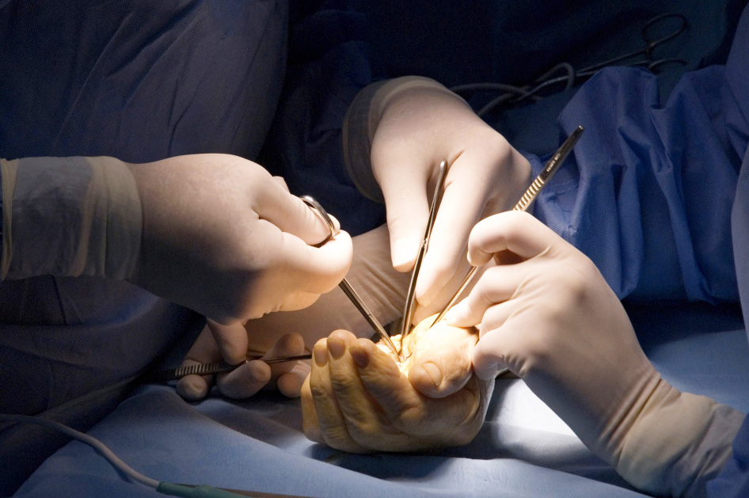
Global Hand Teaching Programme
Module 6.14
TFCC anatomy and injuries
CBDs

Slide 2
Case 1
Name the components of the TFCC
Describe the radioulnar ligaments and their variable importance in DRUJ stability relative to forearm position (pronation and supination)
How much does the bony articulation contribute to DRUJ stability?
bssh.ac.uk

Slide 3
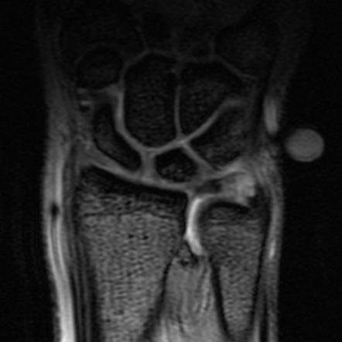
Case 2
35-year old male sustains a forced extension injury to his right wrist when he fell from his bicycle. He has suffered with ulnar sided wrist pain since. Xray is equivocal. MRI depicts an injury to his TFCC.
What examination features might you expect to find associated with an injury to the TFCC?
How would you clinically assess DRUJ stability?
The radiologist reports this as a type 1B tear. What components of the TFCC are injured?
How might you anticipate managing this kind of injury?
bssh.ac.uk

Slide 4
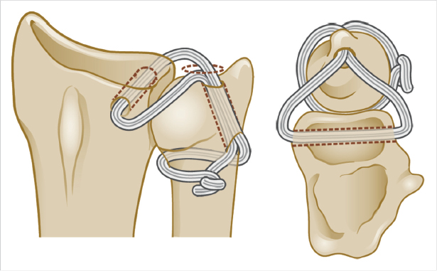
Case 3
What operation is demonstrated in this schematic?
When might you consider using it (indications)?
What are your graft options?
bssh.ac.uk

Slide 5
Case 4
65-year old woman presents with a longstanding history of ulnar sided wrist pain. She particularly notices when carrying heavy shopping bags, or wringing a cloth. She is tender in the region of the TFCC, and has positive ulnocarpal impingement signs.
Describe the xray
You carry out an arthroscopy to assess the degree of damage – what you might expect to find based on the xrays and history provided?
What therapeutic interventions could be made at the time of the arthroscopy?
bssh.ac.uk

Slide 6
Questions?
For further information please ​
get in touch via the channels below:​

