Slide 1

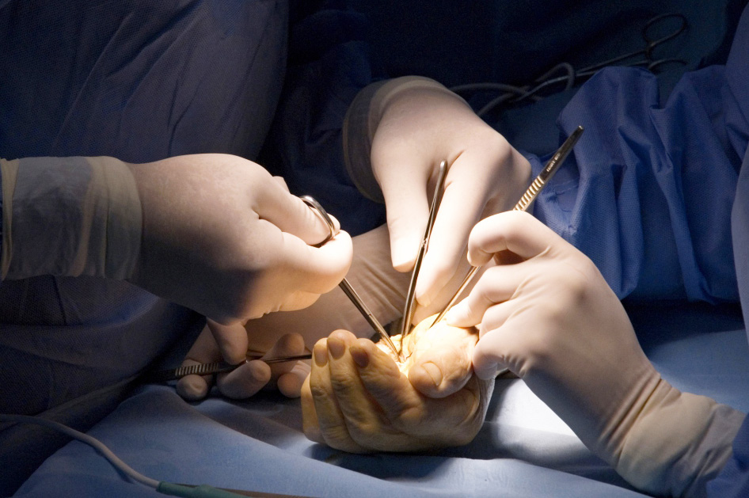
Global Hand Teaching Programme
Module 6.13
DRUJ Anatomy, Instability and Arthritis
CBDs

Slide 2
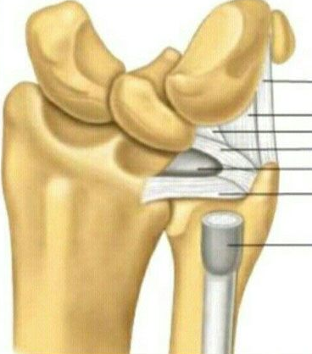

Case 1
Name the components of the TFCC
Describe the radioulnar ligaments and their variable importance in DRUJ stability relative to forearm position (pronation and supination)
How much does the bony articulation contribute to DRUJ stability?
bssh.ac.uk

Slide 3
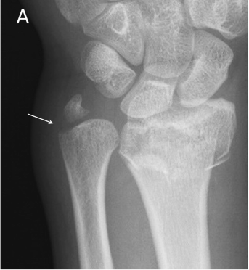
Case 2
38-year old farmer sustained a fall on some rocks causing this closed injury to his left wrist.
Describe the xray appearances
You elect to manage this surgically – how would you fix the distal radius fracture?
What are your thoughts with regard to the ulnar styloid - does this need fixing?
You decide to fix the styloid – what fixation options could you use?
bssh.ac.uk

Slide 4
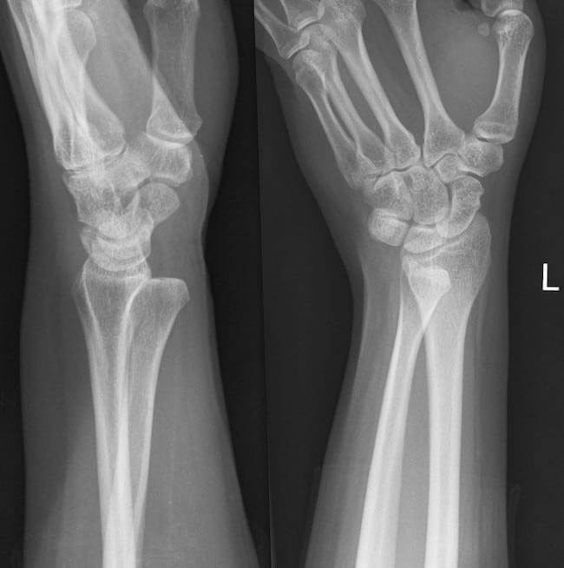
Case 3
22-year old university student had his wrist knocked from behind whilst playing rugby. He felt a click and immediate pain.
Describe the xray appearances
How would you manage this in ED?
Suppose you couldn’t reduce it – what might be in the way, and how would you approach it surgically?
bssh.ac.uk

Slide 5
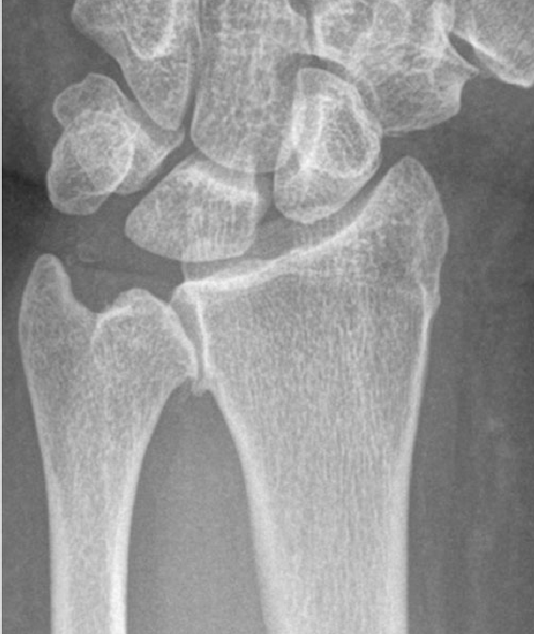
Case 4
65-year old woman present with ulnar sided wrist pain and a “grinding: sesnsation when ringing out laundry, turning a key in a door and opening jars. She tells you she had a wrist fracture a few years ago managed with a cast.
Describe the xray
Discuss differential diagnoses, and how you might examine her wrist
Presume your examination points toward the DRUJ as the main driver of pain – how might you help confirm this?
Non-operative treatment options?
Operative treatment options?
bssh.ac.uk

Slide 6


Questions?
For further information please ​
get in touch via the channels below:​

