Slide 1

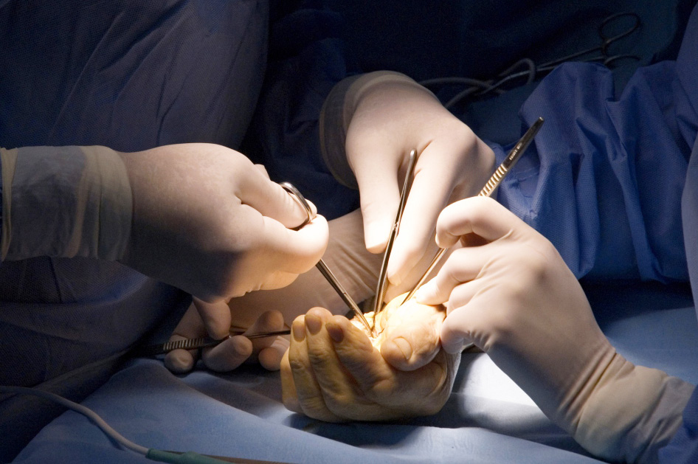
Global Hand Teaching Programme
Module 5.6
Mal-union and non-union
CBDs

Slide 2
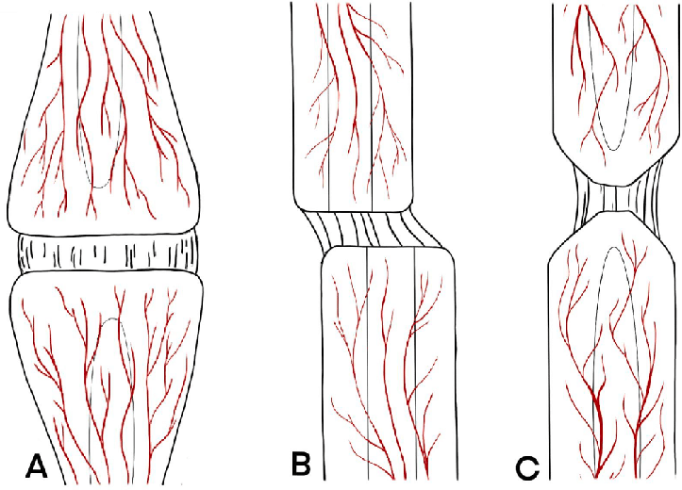

Case 1
Discuss these three different patterns of non-union and how they differ in terms of mechanics and/or biology
How might your management principles differ for each?
bssh.ac.uk

Slide 3
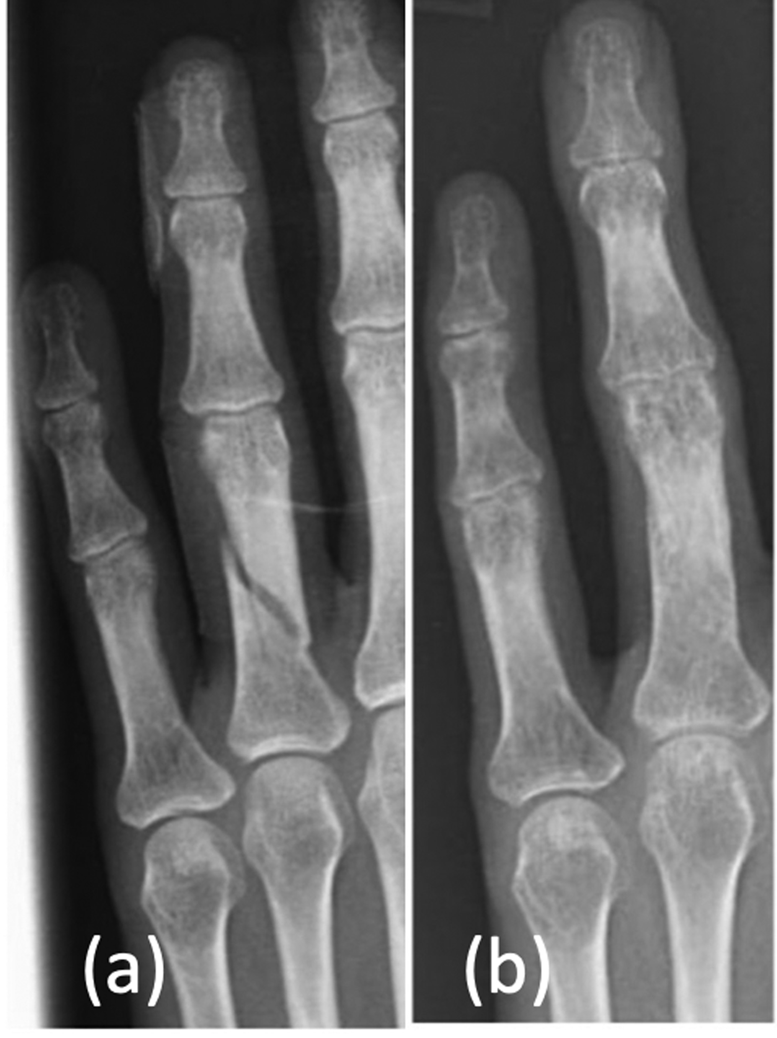
Case 2
35 year old male caught his ring finger in his friends T-shirt while playing football sustaining the above injury 6 months ago. He had the fingers strapped at the time and the xray shows they have healed reasonably straight, but he is struggling with function, particularly making a fist.
How would you describe this fracture?
What functional problem would you envisage him having?
How might you address this for him?
bssh.ac.uk

Slide 4
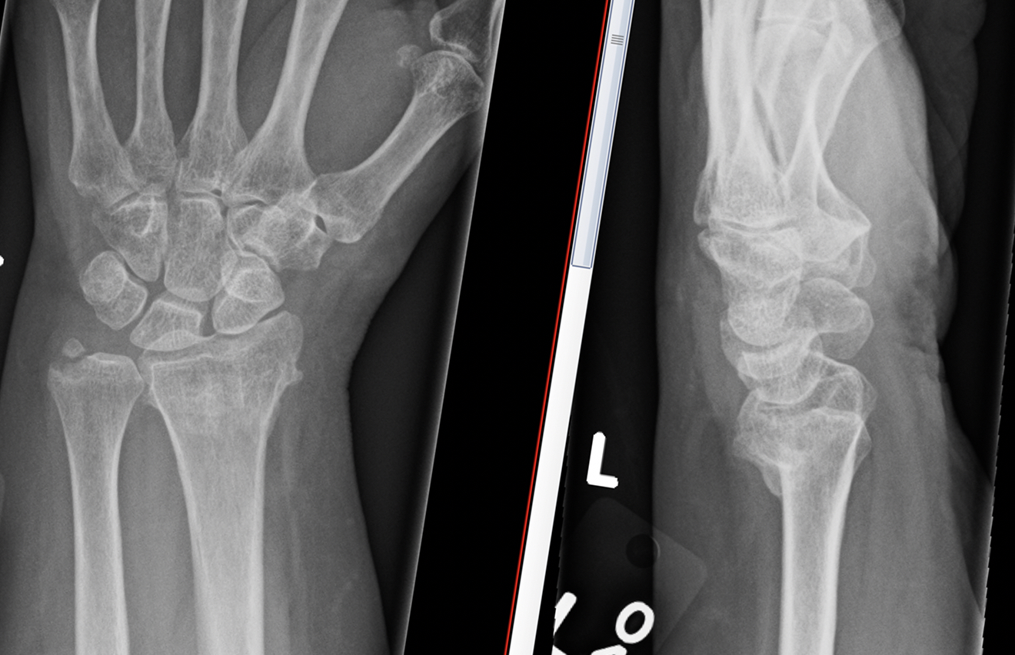
Case 3
45 female sustained a fall and the adjacent injury. She was managed with cast immobilisation. She struggles with wrist flexion and pronosupination, which is limiting her ability to work.
What type and pattern of fracture is this?
How might you propose to address her issue?
What surgical approach/technique would you use?
bssh.ac.uk

Slide 5
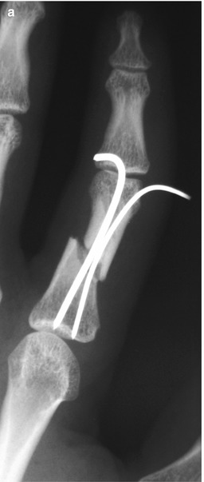
Case 4
25 year old male sustained an fracture to his index finger proximal phalanx. It was a closed injury. He had this stabilised with wires but at 6 weeks it is still quite painful – xray shown.
What is going on here?
What xray changes might you expect to see in a healing fracture?
Discuss the choice of stabilisation method
How might you manage him from here?
bssh.ac.uk

Slide 6

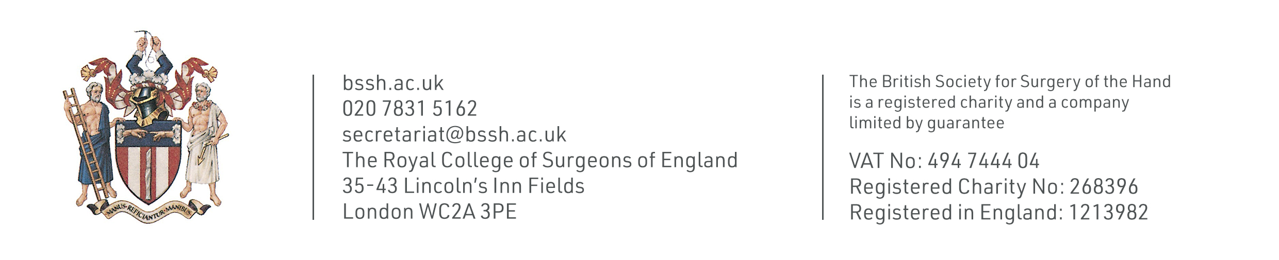
Questions?
For further information please ​
get in touch via the channels below:​

