Slide 1

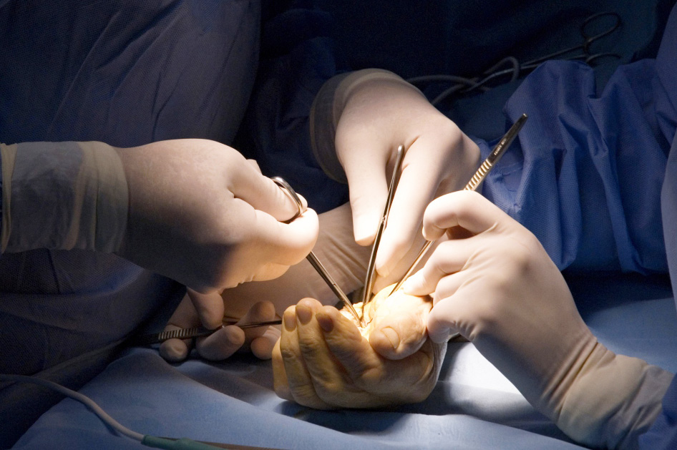
Global Hand Teaching Programme
Module 5.5
Osteomyelitis & Infective Non-union
CBDs

Slide 2
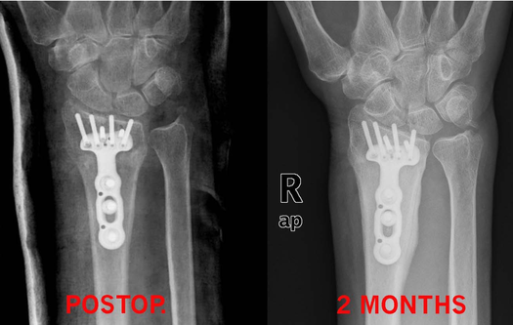

Case 1
2 months following an open reduction internal fixation of a distal radius fracture, the patient returns with persistent pain and swelling around the wrist with a healed wound.
Could this be normal at this stage following surgery?
What differentials would you consider?
Do any changes on the xray raise your suspicion of infection?
How would you approach managing this case?
bssh.ac.uk

Slide 3
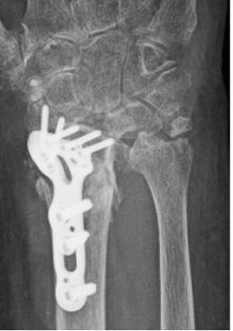
Case 2
72-year-old female with a history of rheumatoid arthritis on Methotrexate and Prednisone treated with ORIF for an intra-articular distal radius fracture. 19 days after surgery she presented with possible cellulitis and was given a course of oral abx, but 3 weeks later her condition was deteriorating and CT failed to show evidence of healing.
Discuss the principles you would apply in managing this problem
How would you manage patient expectations in this instance?
bssh.ac.uk

Slide 4
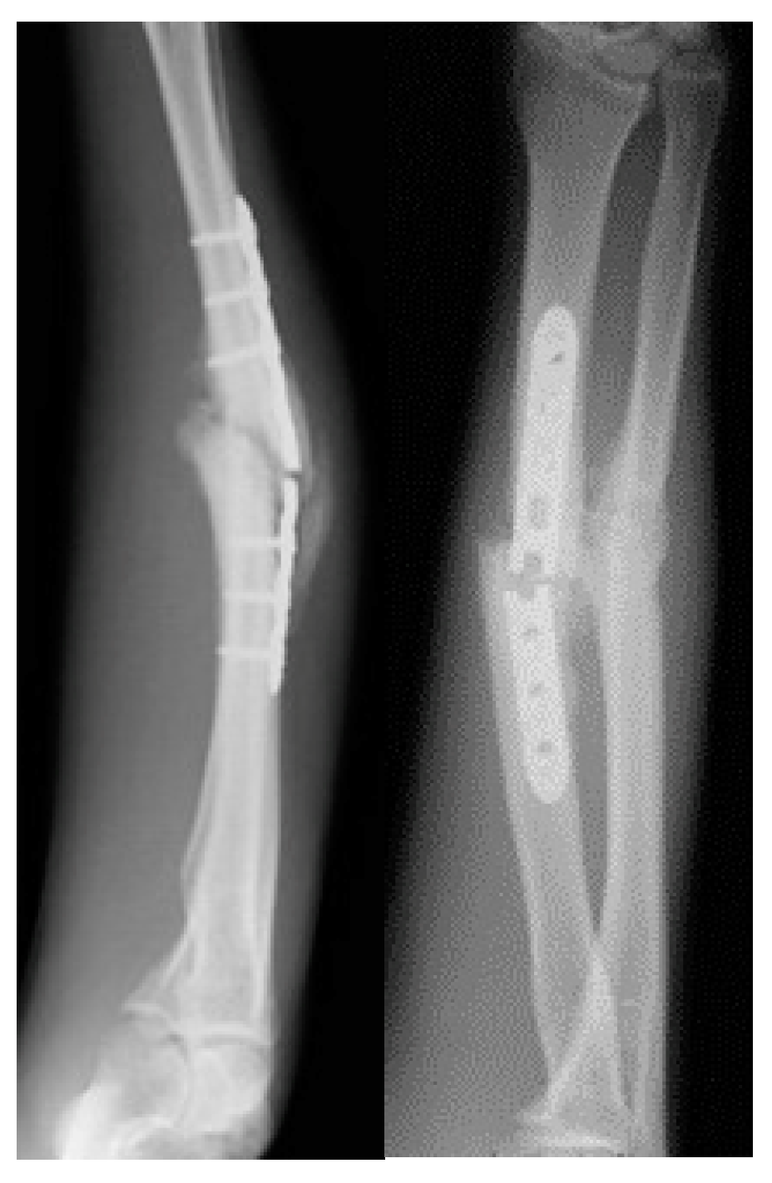
Case 3
38 year old male presented at 9 months with a symptomatic non-union of his both bone forearm fracture. Surgical biopsies were carried out and demonstrate a staph aureus infection.
What process has led to fracture of his plate?
How would you manage this case in the knowledge of the presence of infection?
bssh.ac.uk

Slide 5

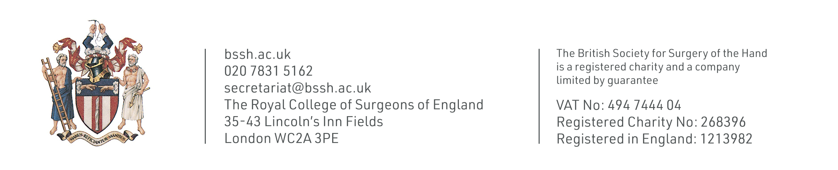
Questions?
For further information please ​
get in touch via the channels below:​

