Slide 1

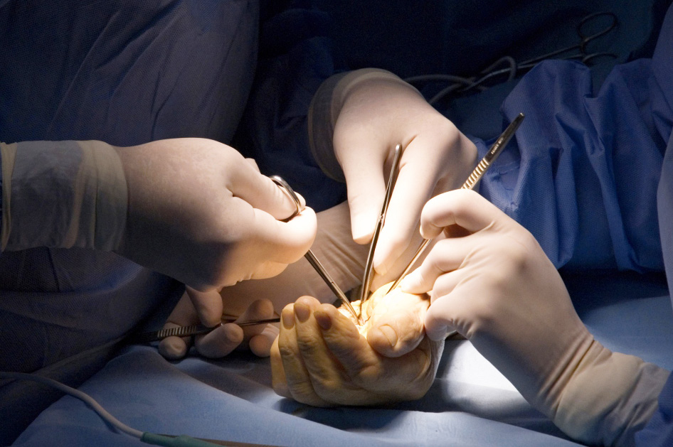
Global Hand Teaching Programme
Module 5.4
Stiffness
CBDs

Slide 2
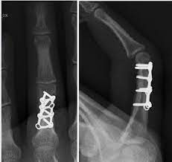

Case 1
Proximal phalanx fracture treated with open reduction internal fixation. 3 months after surgery, the patient is struggling with extension at the PIPJ. Passively you are able to achieve near-full extension.
What do you think may be happening and why?
How would you propose to treat this problem now?
If you were unable to straighten the PIPJ passively, would this change your approach?
bssh.ac.uk

Slide 3
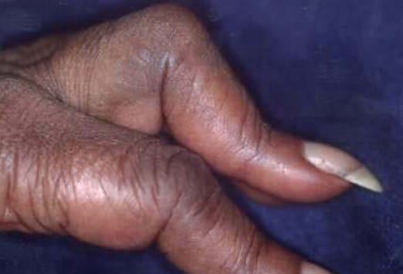
Case 2
62-year-old woman presents with a stiff middle finger. She may have injured it a few months ago but doesn’t recall exactly. She is able to flex at the PIPJ but lacks active and passive extension, and also displays tightness in the DIPj. Movements are pain free.
What do you think may be happening and why?
What is the typically name for this pattern of deformity?
How might you manage this case?
If an xray demonstrated degenerative change in the PIPJ with pain, what salvage options could be considered?
bssh.ac.uk

Slide 4
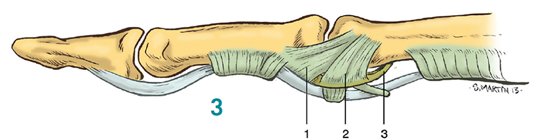
Case 3
Name the structures labelled 1 – 3
How to these contribute to joint stability?
How do they differ at the MCPJ?
bssh.ac.uk

Slide 5

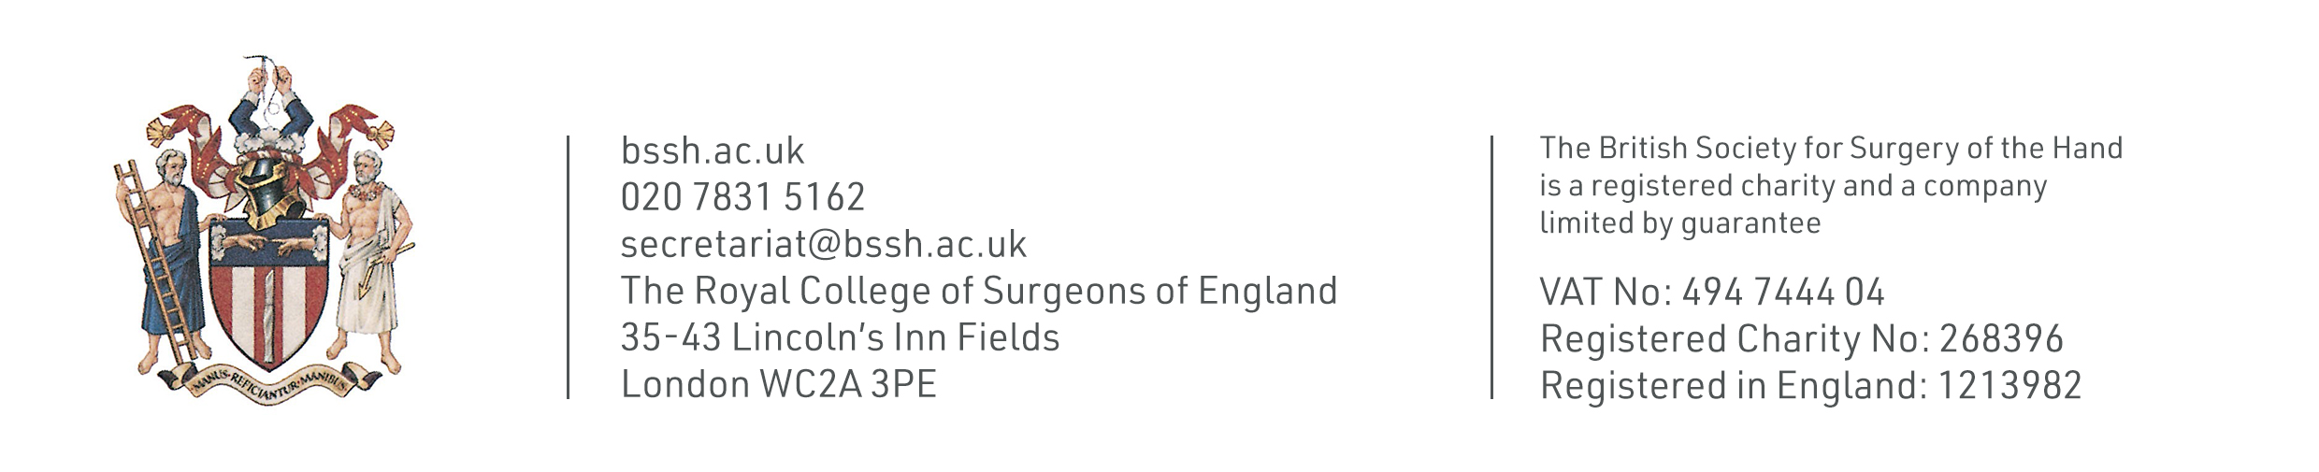
Questions?
For further information please ​
get in touch via the channels below:​

