Slide 1

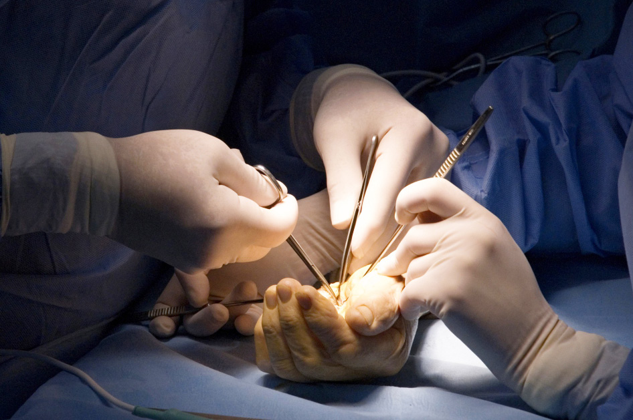
Global Hand Teaching Programme
Module 5.11
Rheumatoid arthritis: conservative and surgical
Case based discussions

Slide 2
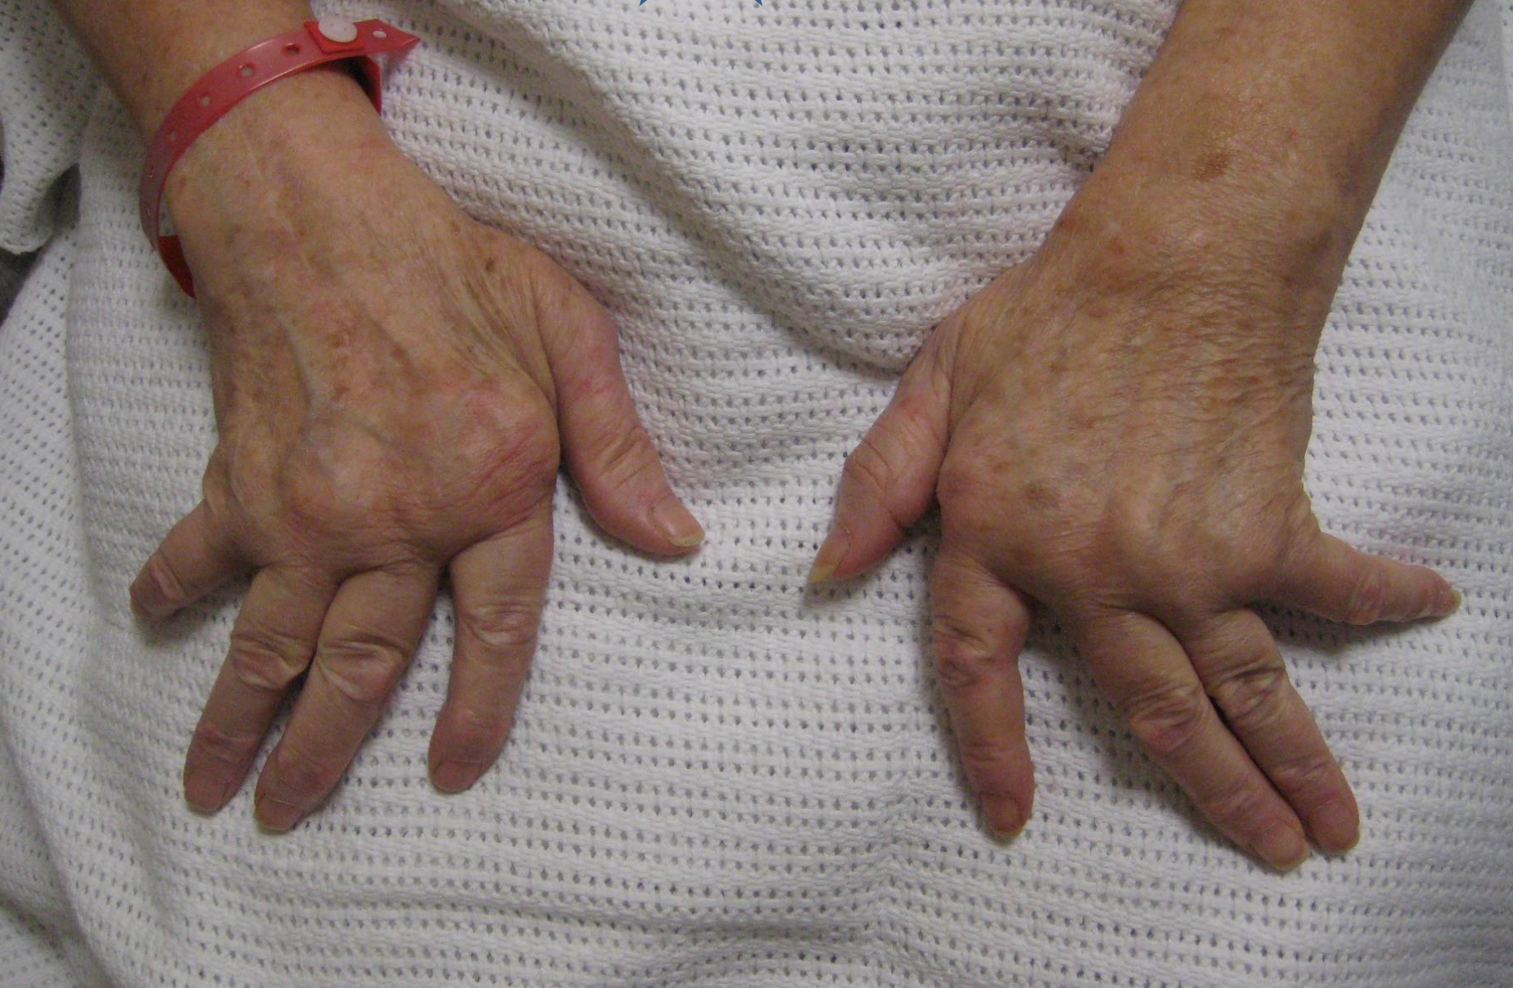

Case 1
A 74 year old woman presents to your clinic with painful joints of the hand.
bssh.ac.uk

Slide 3
Case 1
Describe the features seen in the photograph
How does rheumatoid arthritis commonly present?
What are the diagnostic criteria for rheumatoid arthritis as described by the American College of Rheumatology in 1987?
bssh.ac.uk

Slide 4
Case 1
What specific features are you looking for on clinical examination of a patient that you suspect has rheumatoid arthritis?
How do you perform a functional assessment for the patient?
What patient reported outcome measures can be helpful?
bssh.ac.uk

Slide 5
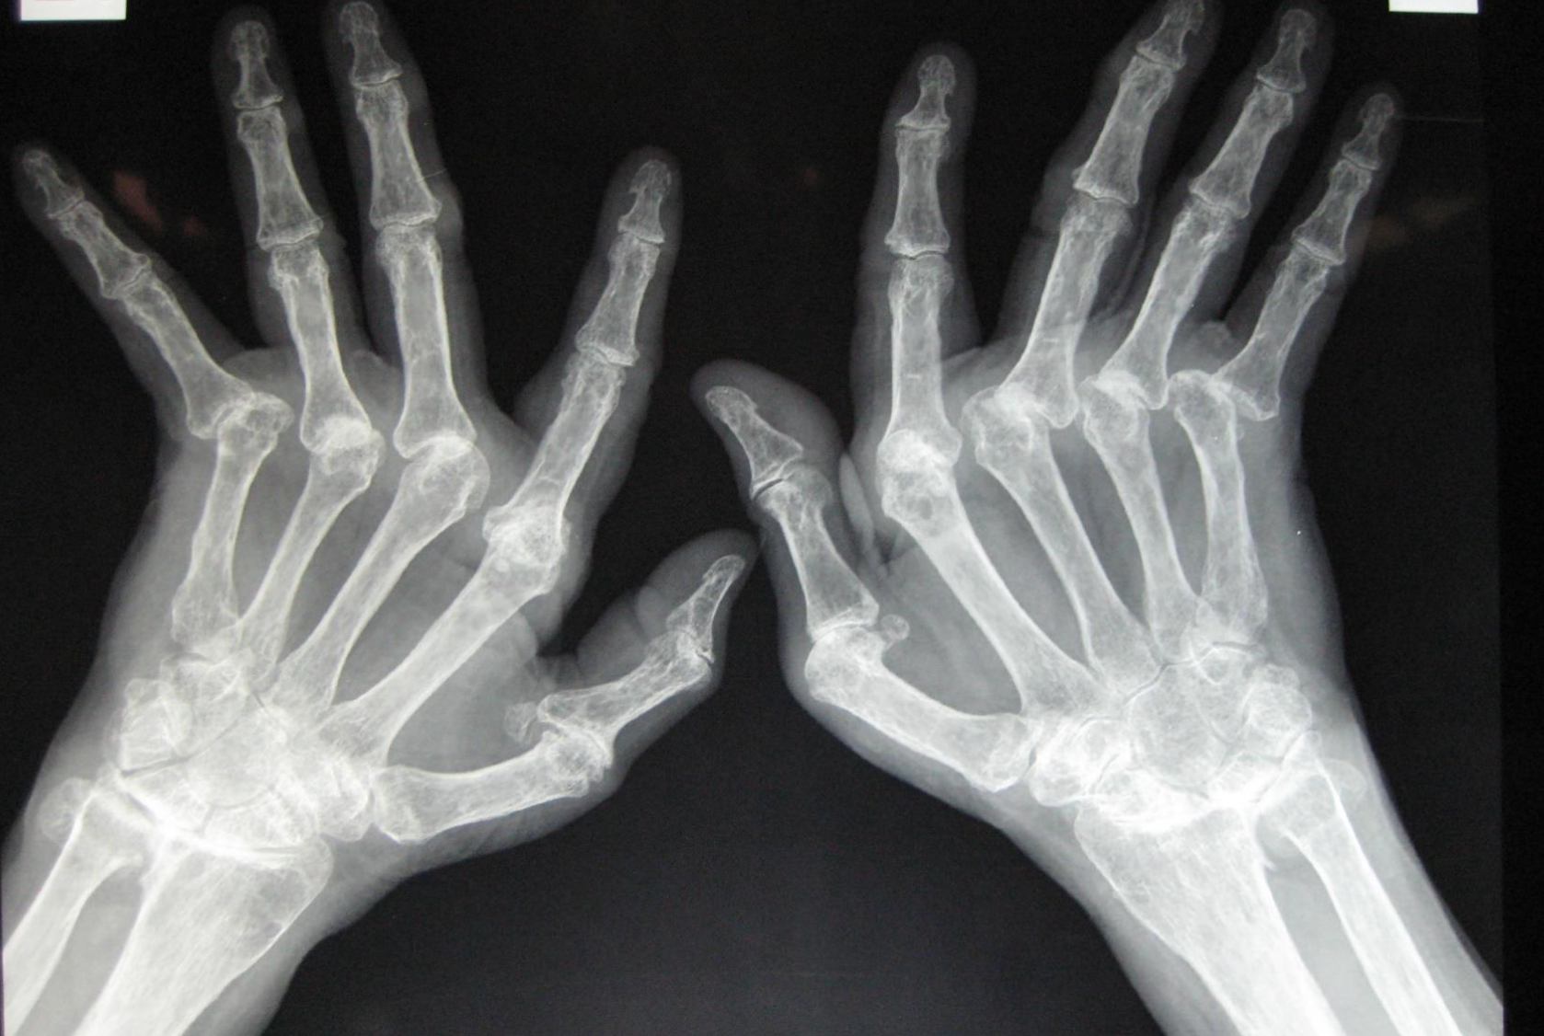
Case 1
What extra-articular diseases are associated with rheumatoid arthritis?
What are the radiographic findings specific to rheumatoid arthritis?
bssh.ac.uk

Slide 6
Case 1
What are the pathological stages of rheumatoid arthritis?
bssh.ac.uk

Slide 7
Case 1
What are the pharmacological management options for rheumatoid arthritis?
  Symptomatic
  Disease modifying
In more advanced cases, what surgical options can be useful to address joint destruction or defromities?
bssh.ac.uk

Slide 8
Case 1
What are the principles of surgery specific for rheumatoid arthritis?
  Synovitis
  Tendons – trigger fingers, extensor tendons
  Joints
bssh.ac.uk

Slide 9
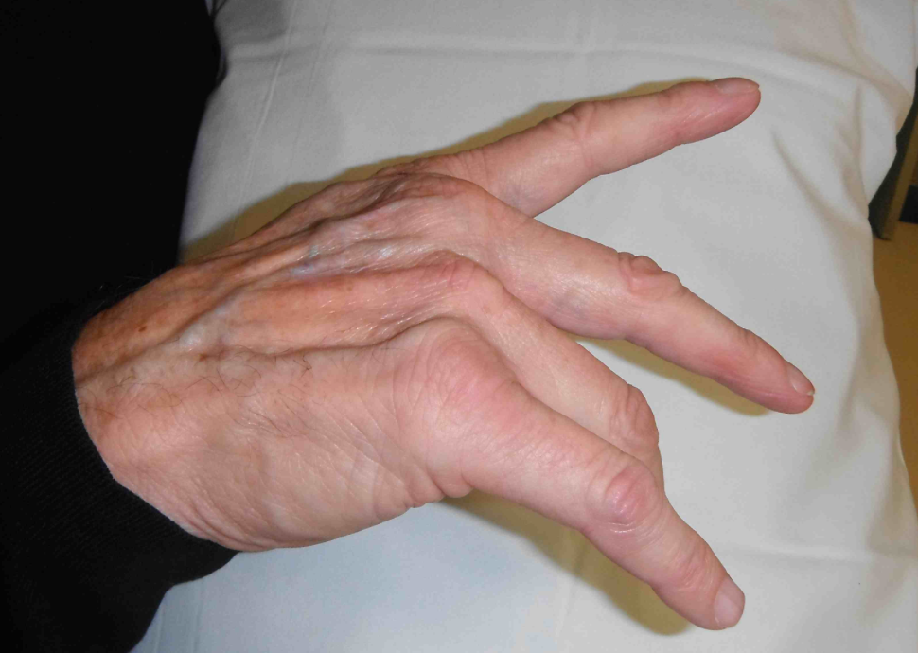
Case 1
What are the differentials for dropped fingers?
bssh.ac.uk

Slide 10
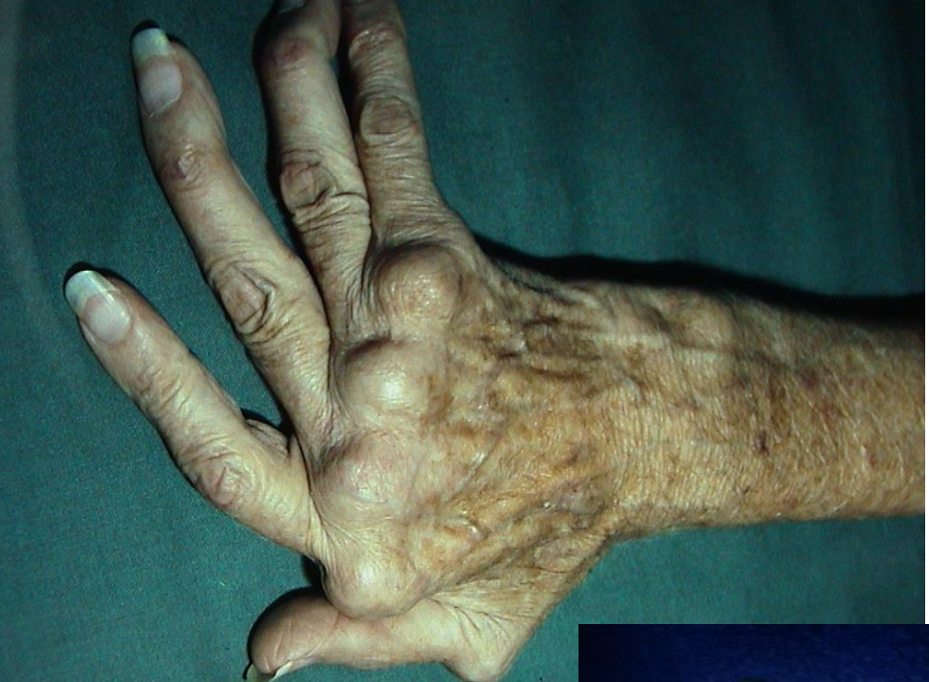
Case 1
What is the indication for MCPJ synovectomy and soft tissue reconstruction?
What prosthesis would you choose for MCPJ replacement in patients with rheumatoid arthritis?
bssh.ac.uk

Slide 11


Questions?

Slide 12
