Slide 1

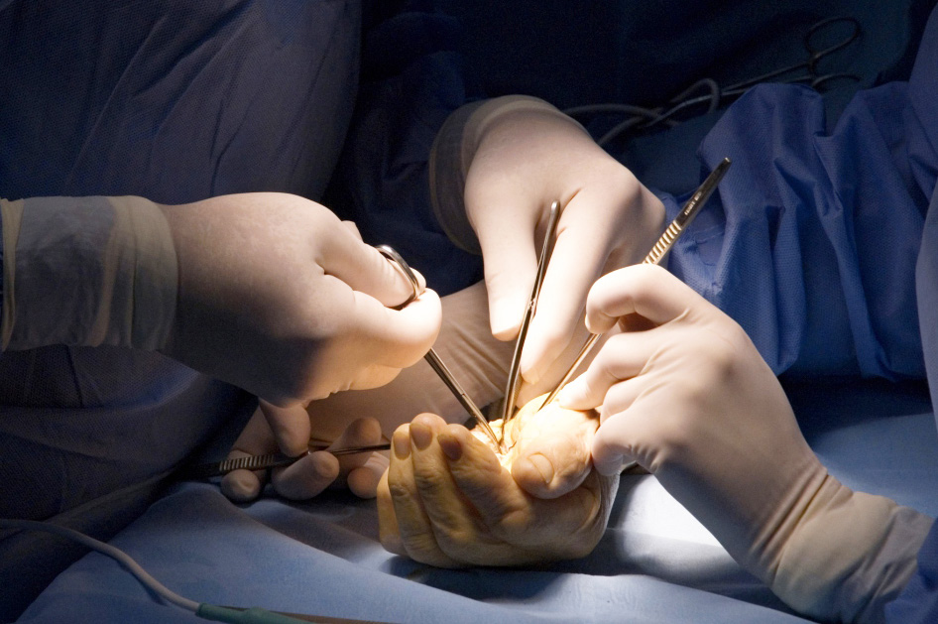
Global Hand Teaching Programme
Module 4.3
Osteomyelitis
CBDs

Slide 2
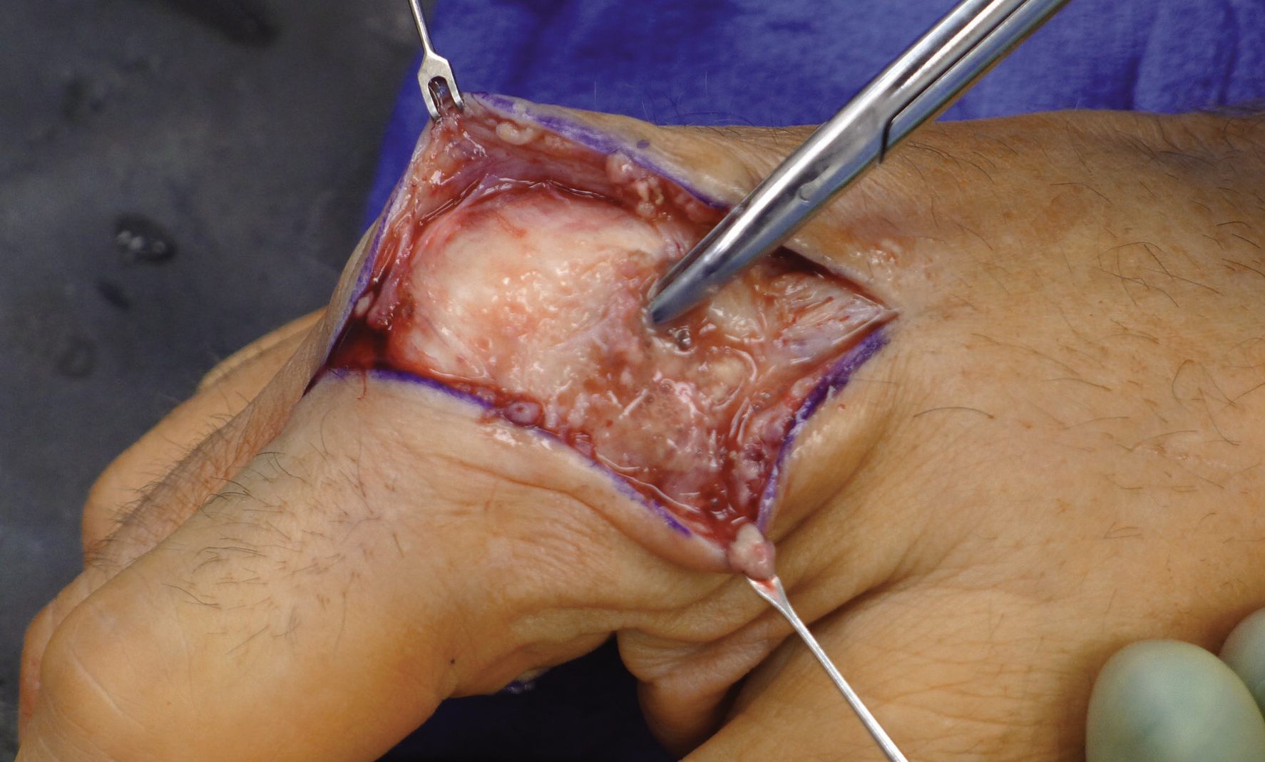

Case 1
24-year old male presented 4 week after a untreated fight bite injury. He had persistent pain and swelling at the index MCPJ with a small discharging sinus, but felt well in himself. Xray revealed a lytic lesion in the MC head.
What changes might you expect to find on xray?
The clinical photograph demonstrates a clip easily penetrating the metacarpal head. Describe the surgery that might be caried out here.
bssh.ac.uk

Slide 3
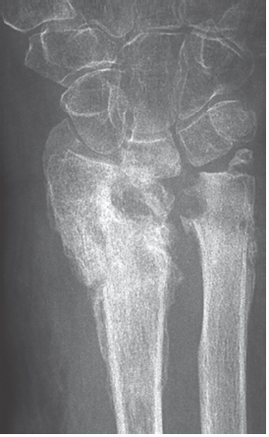
Case 2
This patient had an open fracture of their distal radius and ulnar. Unfortunately they come from far and were unable to attend for follow up. They now present several months later with pain and swelling throughout the wrist.
What changes are demonstrated on xray?
How would you approach the management of this complex problem?
What issues do you envisage, particularly with in light of how the problem initially developed.
bssh.ac.uk

Slide 4
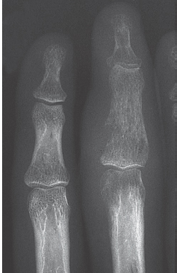
Case 3
42 year old presents with pain and swelling associated with their middle finger. They report no history of trauma. On closer questioning, they reveal they have also been waiting several months to see a dentist regarding a dental abscess.
What might be going on here?
What features do you see on the xray?
What is your approach to management?
bssh.ac.uk

Slide 5

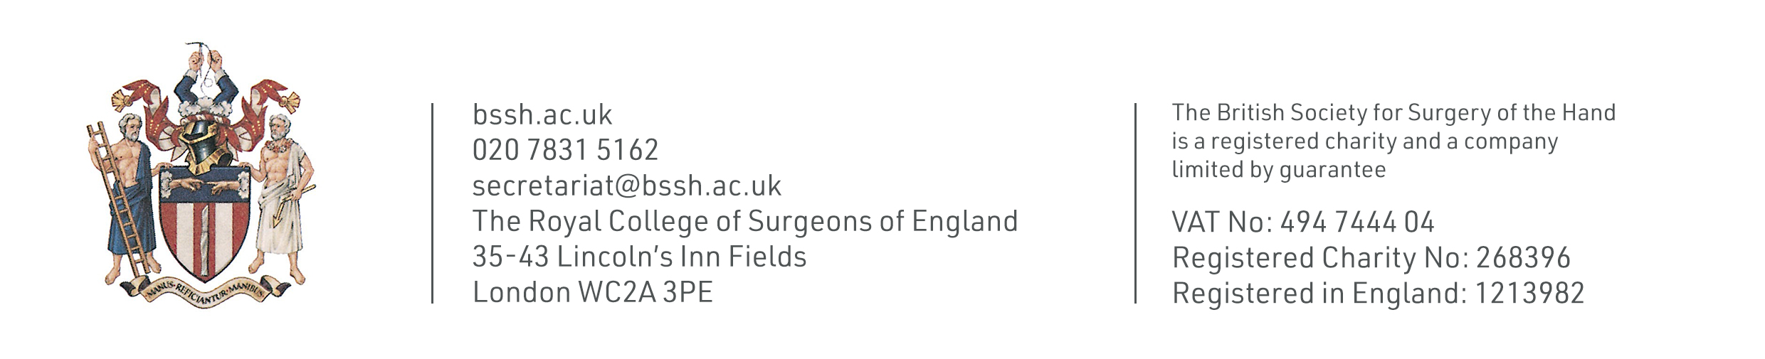
Questions?
For further information please ​
get in touch via the channels below:​

