Slide 1

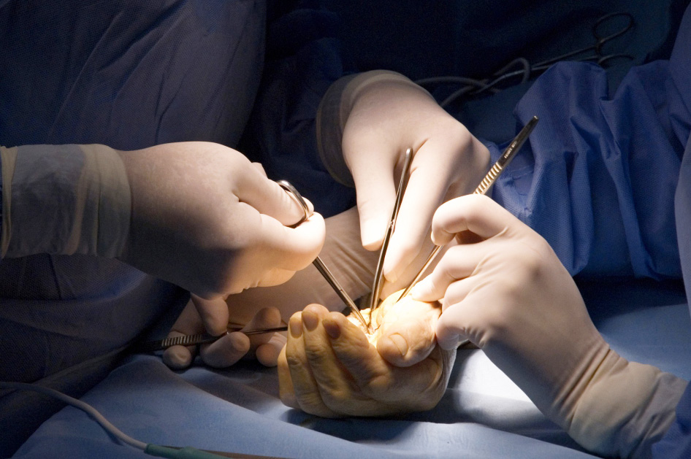
Global Hand Teaching Programme
Module 4.12
Injection injuries

Slide 2
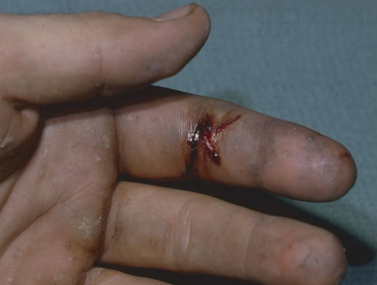

Case 1
A 22 year old oil rig worker presented with an injury to his left index finger from a hydraulic oil pump.
What are the salient points in the history that you need to ascertain?
bssh.ac.uk

Slide 3
Case 1
A 22 year old oil rig worker presented with an injury to his left index finger from a hydraulic oil pump.
What are you looking for on clinical examination?
What are you most worried about?
bssh.ac.uk

Slide 4
Case 1
A 22 year old oil rig worker presented with an injury to his left index finger from a hydraulic oil pump.
What is the definition of high pressure injection injuries?
How does high pressure injection injuries cause extensive soft tissue damage?
bssh.ac.uk

Slide 5
Case 1
A 22 year old oil rig worker presented with an injury to his left index finger from a hydraulic oil pump.
What would the management be?
How would you plan the procedure?
bssh.ac.uk

Slide 6
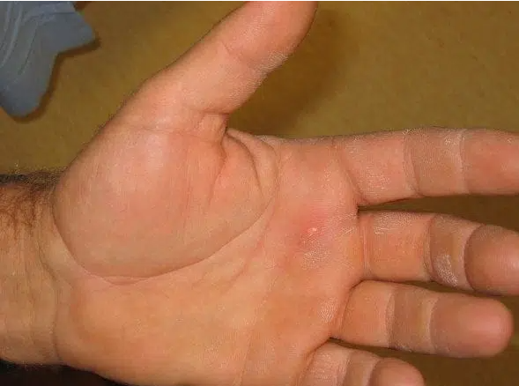
Case 2
A 43 year old chicken farmer presents to the emergency department. 2 hours ago he sustained an injection injury to his left palm whilst administering vaccines to his chickens.
Describe what you see from the photograph.
bssh.ac.uk

Slide 7
Case 2
A 43 year old chicken farmer presents to the emergency department. 2 hours ago he sustained an injection injury to his left palm whilst administering vaccines to his chickens.
What are the common agents that cause high pressure injection injuries?
bssh.ac.uk

Slide 8
Case 2
A 43 year old chicken farmer presents to the emergency department. 2 hours ago he sustained an injection injury to his left palm whilst administering vaccines to his chickens.
What investigations would you request?
bssh.ac.uk

Slide 9
Case 2
A 43 year old chicken farmer presents to the emergency department. 2 hours ago he sustained an injection injury to his left palm whilst administering vaccines to his chickens.
What are the non-operative treatment options available?
bssh.ac.uk

Slide 10
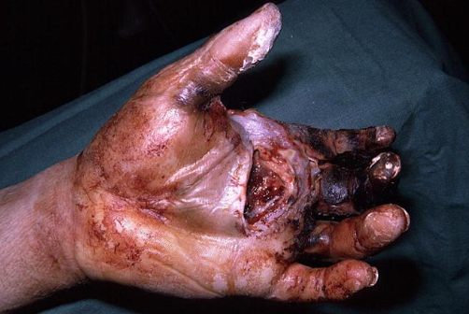
Case 3
A 42-year-old industrial worker was brought in to your hospital 5 hours after sustaining an injury to his left hand from operating a high-pressure paint jet.
The nozzle accidentally opened and momentarily came into contact with his left hand.
Describe what you see from the photograph.
bssh.ac.uk

Slide 11
Case 3
A 42-year-old industrial worker was brought in to your hospital 5 hours after sustaining an injury to his left hand from operating a high-pressure paint jet.
The nozzle accidentally opened and momentarily came into contact with his left hand.
What is the likely management plan?
bssh.ac.uk

Slide 12
Case 3
A 42-year-old industrial worker was brought in to your hospital 5 hours after sustaining an injury to his left hand from operating a high-pressure paint jet.
The nozzle accidentally opened and momentarily came into contact with his left hand.
What is the rate of limb loss / amputation in high pressure injection injuries?
bssh.ac.uk

Slide 13
Case 3
A 42-year-old industrial worker was brought in to your hospital 5 hours after sustaining an injury to his left hand from operating a high-pressure paint jet.
The nozzle accidentally opened and momentarily came into contact with his left hand.
What prognostic variables will help you determine the likelihood of amputation?
bssh.ac.uk

Slide 14


Questions?

Slide 15

Teaching feedback link Module 4.12
https://s.surveyplanet.com/yncbv69l

