Slide 1

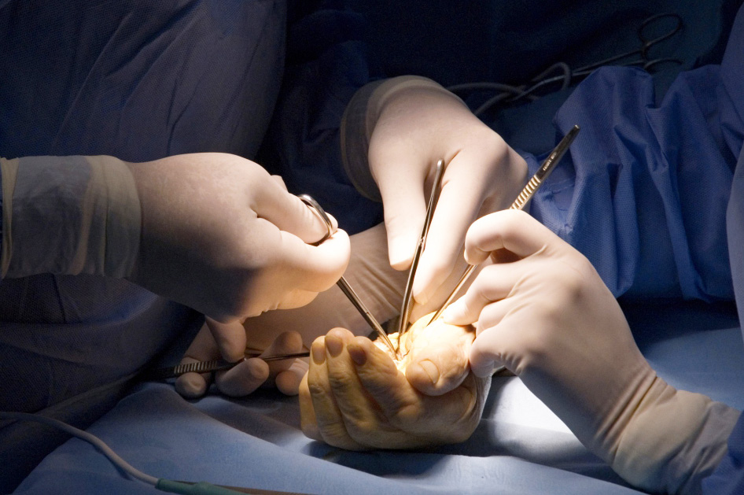
Global Hand Teaching Programme
Module 10.4 Safe surgical practice, quality improvement, GIRFT
Case based discussions

Slide 2
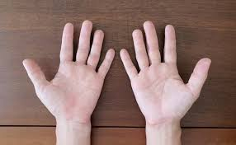

Case 1
A 67 year old woman is scheduled for a carpal tunnel release on the right hand. In the pre-op holding area, she mentions to a nurse that her symptoms are actually worse on the left. The nurse raises a concern to the operating team.
bssh.ac.uk

Slide 3
Case 1
Discuss what went right in this case?
What should have been done differently during the consent and marking process?
How could the WHO surgical safety checklist have prevented harm?
What can you do to empower team members to speak up?
bssh.ac.uk

Slide 4
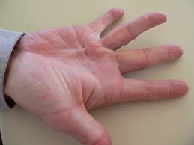
Case 2
A departmental audit reveals that the reoperation rate for Dupuytren’s contracture surgery in your hospital is significantly higher than the national average.
On review of the notes, you note that the documentation of operation notes is inconsistent across surgeons
bssh.ac.uk

Slide 5
Case 2
How could you investigate this variation?
How could GIRFT methodology help here?
  Benchmarking
  Best practice pathways
Would you consider standardising practice? What would the risks and benefits be?
How should data be used to inform but not shame clinical practice?
bssh.ac.uk

Slide 6
Case 3
A 52 year old man undergoes tendon repair. He presnts to the emergency department 5 days later with redness and discharge, which is initially misdiagnosed as cellulitis. He returns 48 hours later with a deep space infection requiring washout.
bssh.ac.uk

Slide 7
Case 3
What factors may have led to the delayed diagnosis?
What system-level issues may have played a role (handover, discharge instructions, access)
How would you design a QI project to address this? And what steps are involved in a QI project?
How would you evaluate the impact of your QI project?
bssh.ac.uk

Slide 8


Questions?

Slide 9
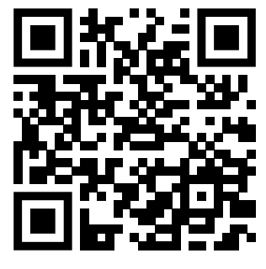
Teaching feedback link M10.4
https://s.surveyplanet.com/3moc6pyo

