Slide 1

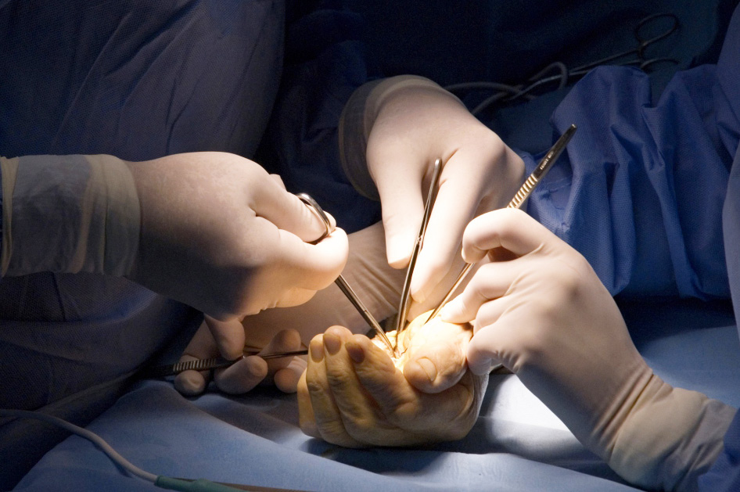
Global Hand Teaching Programme
Module 10.3 The psychological impact of injuries and strategies to cope
Case based discussions

Slide 2


Case 1
A 34 year old concert pianist sustains a complex injury to the right hand from a car door.
Although the surgery was successful, she becomes withdrawn, misses follow up appointment, and expresses hopelessness about her future
bssh.ac.uk

Slide 3
Case 1
Discuss the emotional impact of identity loss
Discuss the risk of depression, anxiety and post-traumatic stress disorder
What is the role of early psychological support and reassurance?
bssh.ac.uk

Slide 4

Case 2
A 45 year old mechanic presents with a partial finger amputation and exhibits excessive concern over minimal swelling and repeatedly asks if he’ll ever ‘be normal again’. He refuses to touch the injured hand and insists that the surgery was a failure, despite good functional results.
Discuss signs of maladaptive coping
bssh.ac.uk

Slide 5
Case 2
How would you differentiate normal stress from a clinical concern?
When and how would you refer him to a mental health professional?
bssh.ac.uk

Slide 6

Case 3
A senior surgeon describes increasing emotional fatigue after handling multiple traumatic amputations and difficult conversations with distressed families.
bssh.ac.uk

Slide 7
Case 3
Discuss the signs of burnout and compassion fatigue
Discuss the value of peer support, debriefing and mental wellness in surgical practice
Discuss the importance of communication with patients and families – on delivering realistic information and understanding how words can shape behaviour and recovery outlook.
bssh.ac.uk

Slide 8


Questions?

Slide 9
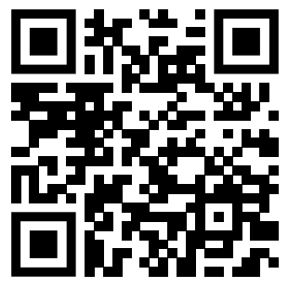
Teaching feedback link M10.3
https://s.surveyplanet.com/ad3tjky7

