Slide 1

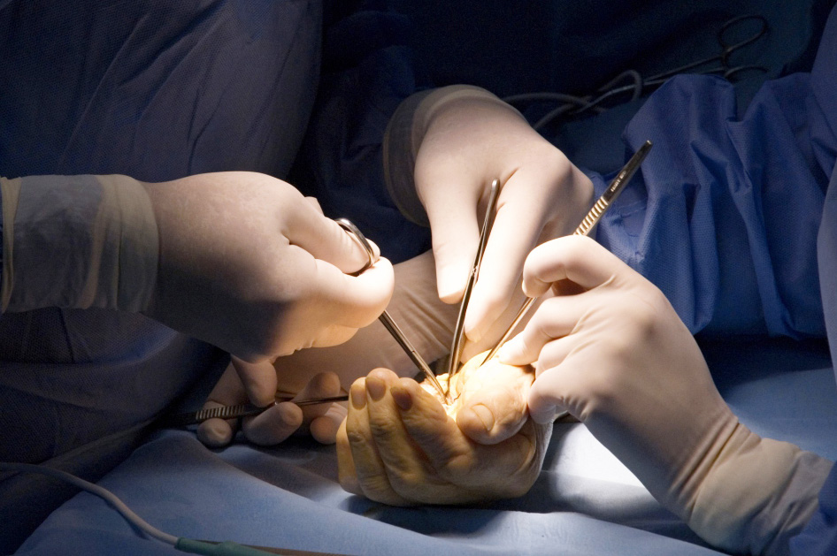
Global Hand Teaching Programme
Module 10.2
CRPS - rehabilitation strategies
CBDs

Slide 2
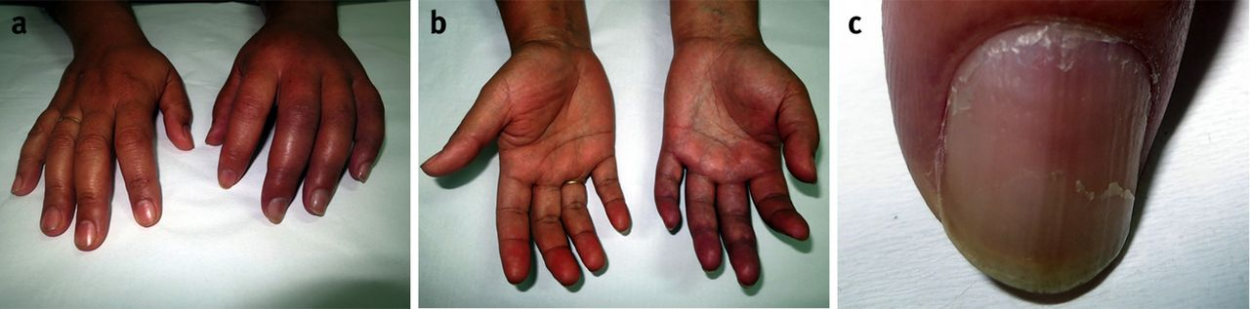

Case 1
36F sustained a crush injury to her left hand 2 months ago. She has been in agonising pain since, unable to use the hand for even sunple tasks. Thorough examination and investigation has failed to identify a structural cause for her symptoms. You suspect complex regional pain syndrome.
What features in the clinical photo may be consistent with this diagnosis?
Describe your approach to management
Consider your local resources – what allied health professionals do you have that may be able to assist in her care?
bssh.ac.uk

Slide 3
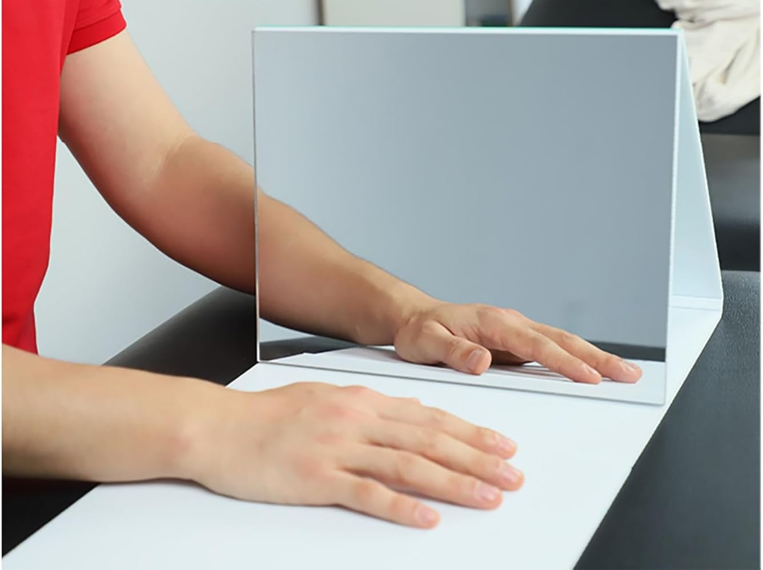
Case 2
1. What is being demonstrated in the photo?
2. Describe how this is used in the treatment of CRPS.
3. Consider how you might access, or perhaps create, a similar device and incorporate it into you treatment for CRPS patients
bssh.ac.uk

Slide 4


Questions?
For further information please ​
get in touch via the channels below:​

