Slide 1
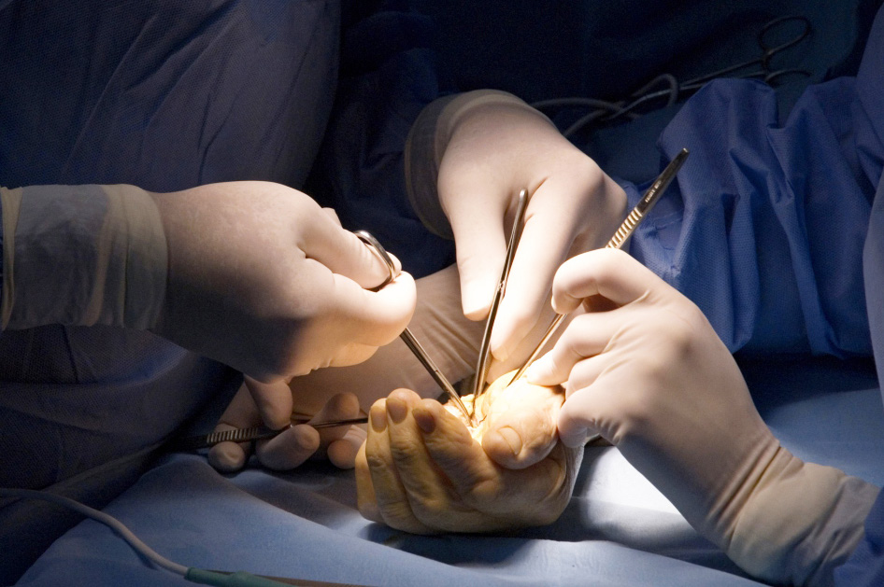

Building a Team
Objectives
What is the importance of teamwork?
What makes a good team?
What is the difference between leadership and management?

