Slide 1
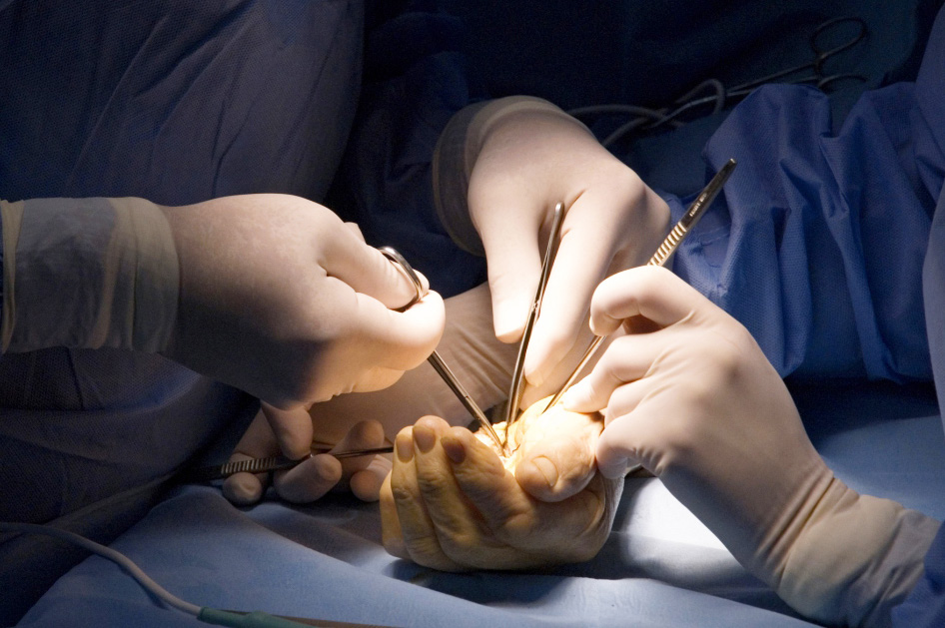

Confidentiality and Consent
Objectives
Understand the principles of confidentiality
Understand the principles of capacity
Understand the principles of consent and how it differs across age groups

