Slide 1
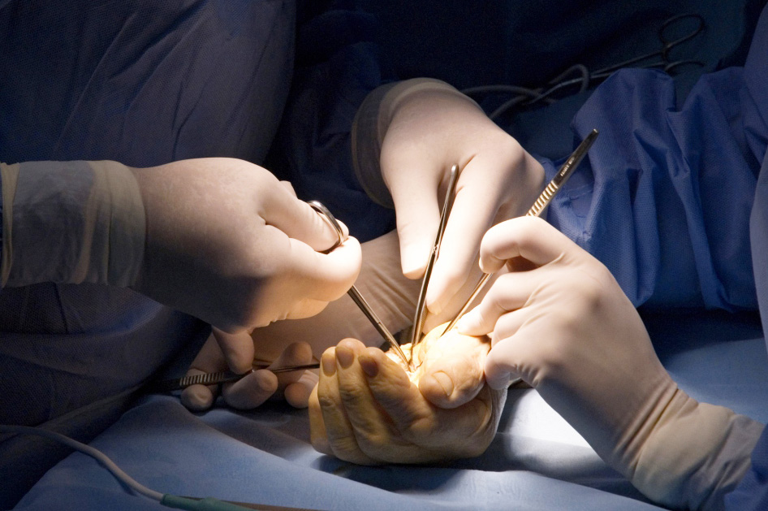

Global Hand Teaching Programme
Building a Team

Slide 2

Case 1
You are managing an acute paediatric hand trauma patient in the hospital
Who will be involved in the team throughout this patient’s journey?
What makes a good team?
What makes a good leader?
What do you understand by the term non operative technical skills?
Whats the difference between leadership and management?
bssh.ac.uk

Slide 3

For further information please
get in touch via the channels below:

