Slide 1
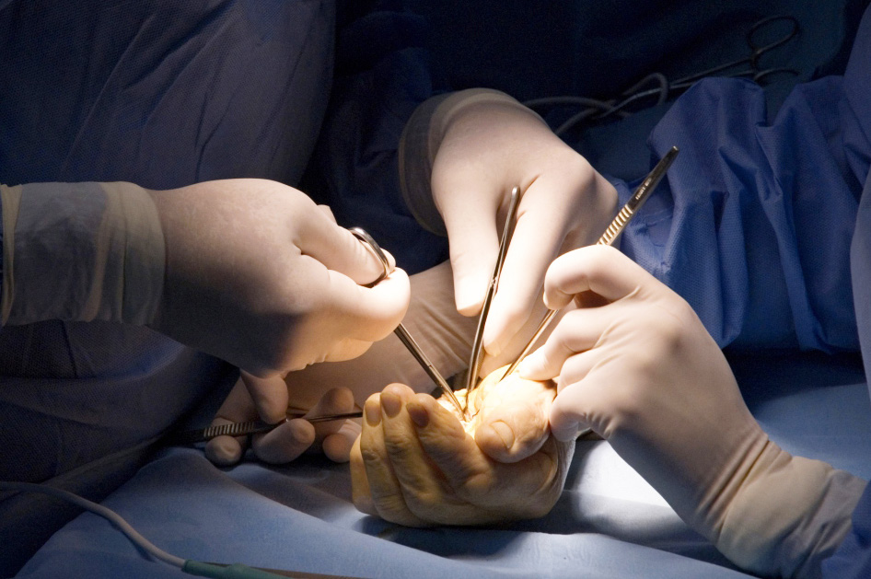

Global Hand Teaching Programme
Confidentiality and Consent

Slide 2

Case 1
You find a handover sheet in the hospital canteen with patient details on.
How do you manage this situation?
Why is confidentiality Important?
When can you break confidentiality?
bssh.ac.uk

Slide 3
Case 2
A 14 year old girl attends alone with a finger fracture to hospital. It needs surgical fixation.
How do you approach the patient in terms of capacity and consent?
What is Gilick competence?
What are the key principles of capacity in adults and children?
What is the difference between consent and assent?
bssh.ac.uk

Slide 4

For further information please
get in touch via the channels below:

