Slide 1

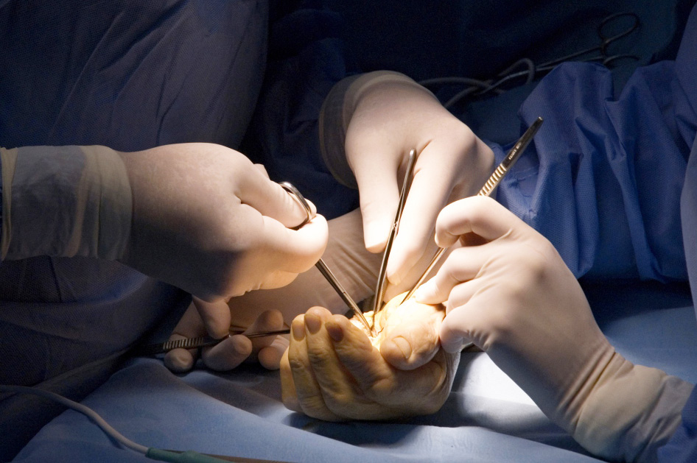
Global Hand Teaching Programme
Module 3.4
Finger tip and nail injuries
CBDs
Source: Wide Awake Hand Surgery (Donald Lalonde)

Slide 2
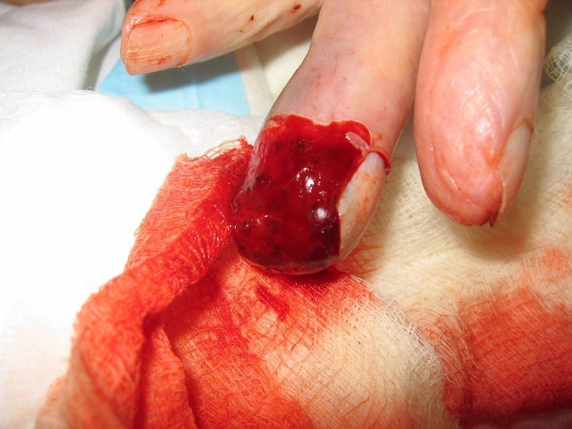

Case 1
A young female teenage patient presents to clinic after sustaining the injury on the right, having caught her fingertip in a car door.
In ED the pulp was sutured, however, now the skin has necrosed.
Describe the key relevant anatomy.
How would you assess this patient?
What are the options for management?
bssh.ac.uk
Notes:
Image:
https://litfl.com/fingertip-injury/
Relevant anatomy:
At DIPJ level: digital artery & nerve trifurcate. Volar skin protects underlying bone. Sensation crucial. Thus soft tissue cover and fingertip pulp bulk should be restored for optimum function.
Management options?
Small fingertip wounds: healing by secondary intention. (<1 cm2 - may heal with daily dressings)
If entire pulp involved: innervated cross-finger flap from the dorsum of the adjacent finger, homodigital island flap and a thenar flap.

Slide 3
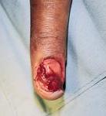
Case 2
A patient presents to the emergency department with a nailbed crush injury. How would you assess this patient?
What workup would this patient require?
Discuss the relevant anatomy of the nailbed and surrounding tissue. What are the components of the nail matrix?
If the patient had an isolated subungual haematoma, what are the treatment options?
In this patient with a nailbed laceration what is the most appropriate treatment?
What complications may arise from nailbed injury and repair?
bssh.ac.uk
Notes:
Image:
https://www.orthobullets.com/shoulder-and-elbow/3082/lateral-epicondylitis-tennis-elbow
Complications:
Hook nail – advancement of matrix to obtain coverage without adequate bony support
Split nail – scarring of matrix following injury

Slide 4
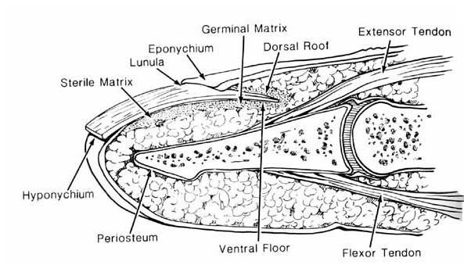
Notes:
https://www.orthobullets.com/hand/6109/nail-bed-injury

Slide 5
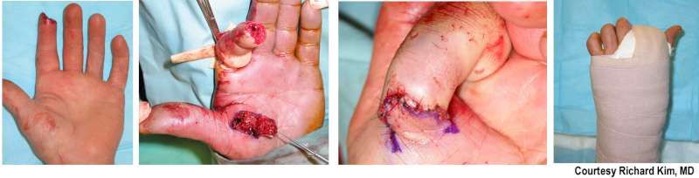
Case 3
A 38 year old male patient presents to the emergency department with a fingertip laceration injury. How would you assess this patient?
What workup would this patient require?
His clinical photographs are included on the right. What are the treatment options? What option do these photographs demonstrate?
What reconstructive options may be available for this patient?
bssh.ac.uk
Notes:
Image:
https://www.orthobullets.com/hand/6060/fingertip-amputations-and-finger-flaps
Treatment:
Non-op – secondary intention healing
Primary closure – revision amputation
Full thickness skin grafting from (hypo)thenar region
Flap reconstruction: exposed bone or tendon where rongeuring bone proximally is not an option
Flaps available:
Straight or Dorsal Oblique laceration:
V-Y Advancement flap
Digital island artery
Volar Oblique laceration
Cross finger flap (if > 30 yrs)
Thenar flap (if< 30 yrs)
Digital island artery
reverse cross finger (for nail bed sterile matrix and eponychial fold losses)

Slide 6
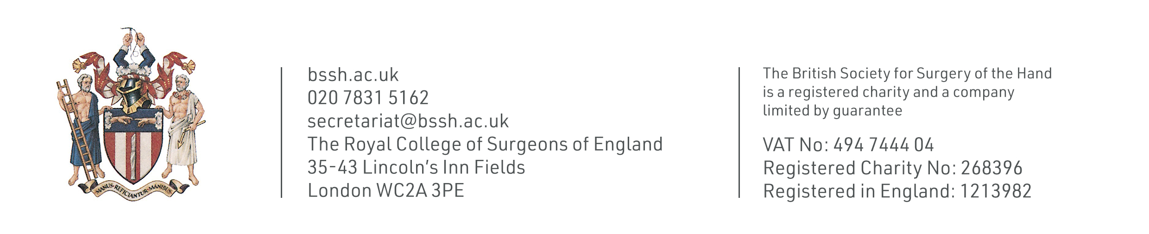
For further information please
get in touch via the channels below:

