Slide 1

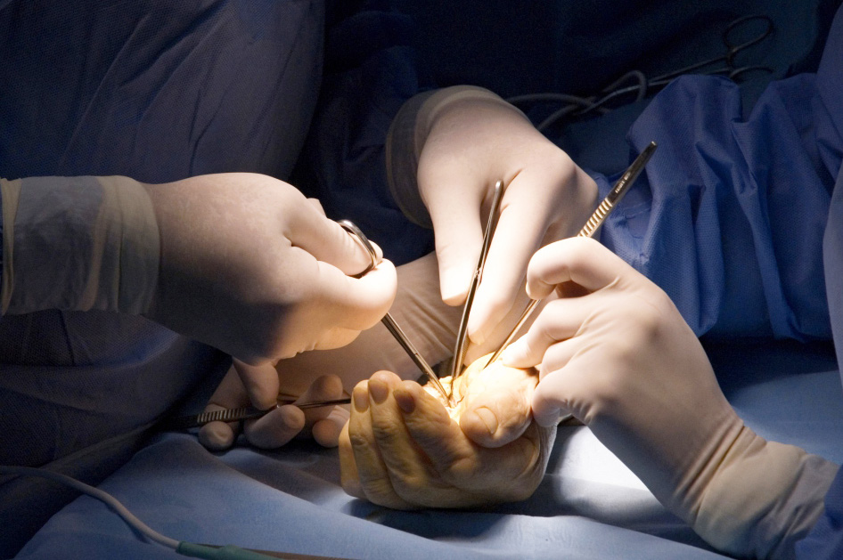
Global Hand Teaching Programme
Module 2.9
De Quervain’s tenosynovitis, trigger finger, intersection syndrome, etc
Cases

Slide 2


Case 1
A 60 year old man with type 2 diabetes presents with a 2 month history of painful clicking and locking of his right ring finger. He does not recall any trauma. Occasionally he has to passively extend his finger to alleviate the fixed position.
What is the most likely diagnosis?
What treatment options are available for this condition?
bssh.ac.uk
Notes:
Triggering of the finger, due to a size mismatch between the A1 pulley and the tendons gliding beneath it. It can be associated with subtle digital swelling or a proximal interphalangeal joint flexion deformity, along with a volar retinacular ganglion cyst. Other differentials include: giant cell tumour of the tendon sheath, epidermal inclusion cyst, neurofibroma, schwannoma.
Steroid injections, splinting in extension, surgical decompression of the A1 Pulley, or percutaneous release with a needle (not suitable for all cases / all digits). Long-term blood glucose control should be sought in diabetics.

Slide 3
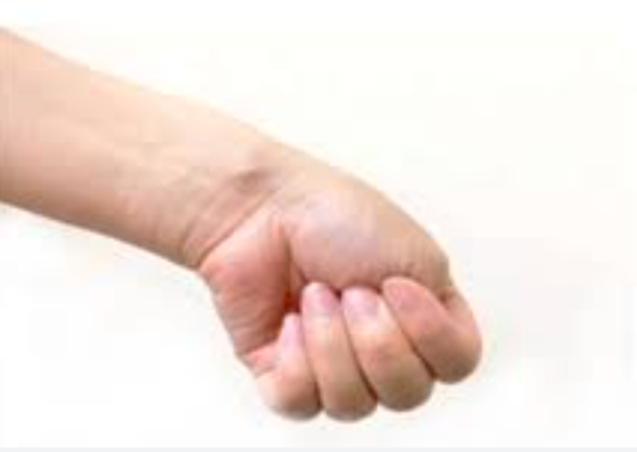
Case 2
A 24 year old woman presents to clinic with a 3 month history of wrist pain with lifting her baby. On examination, she has marked radial-sided wrist pain with forced ulnar deviation of the wrist
What is the most likely diagnosis?
What is the test that is pathognomonic for this condition?
What are the treatment options available?
bssh.ac.uk
Notes:
De Quervain tenosynovitis is a condition in which the first dorsal extensor compartment tendons (Abductor pollicis longus APL and extensor pollicis brevis EPB) are inflammed as they run through the tight extensor compartment. This is common in young mothers who lift their babies for feeding / changing nappies.
Finkelstein test – thumb is grasped by the examiner and the wrist passively ulnarly deviated, causing tenderness along the extensor tendons just proximal to the radial styloid.
First line of treatment will be a steroid injection into the first dorsal compartment combined with activitiy modification. In majority of patients this is a self-limiting condition. Surgical release of the extensor retinaculum of the first dorsal compartment can be performed as a last resort (beware of the superficial radial nerve)

Slide 4
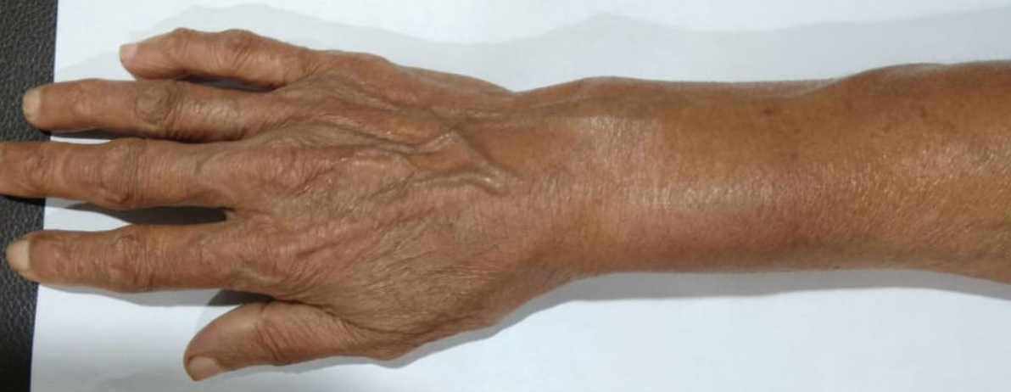
Case 3
A 70 year old woman presents with a 2 week history of distal forearm pain. She also complains of swelling and crepitus over her distal forearm. On examination there is redness and oedema involving the distal forearm along the radial aspect.
What is the most likely diagnosis?
What are contents of the
extensor compartments?
What are the treatment options available?
What would be the findings on an MRI scan?
bssh.ac.uk
Notes:
What is intersection syndrome? Tenosynovitis of the second dorsal compartment
It is due to inflammation due to tendon friction at the intersection between the first and second dorsal compartments, 4cm proximal to the wrist
Treatment:
Conservative - rest, NSAIDs, extension splint, steroid injections
Surgical – second compartment release, synovectomy at the intersection joint
MRI can be used to confirm diagnosis when clinical findings are unclear. Most characteristic finding would be peritendinous oedema or fluid surrounding the first and second extensor compartments. Could also show tendinosis, muscle oedema, tendon thickening, loss of the normal comma shape of the tendon, and juxtacortical oedema.

Slide 5
Case 4
A 50 year old avid golfer presents with ulnar-sided wrist pain since the past 2 months. It is most painful during wrist pronation and supination, and complains of a sensation of a ‘click’
Which compartment does the ECU tendon run in?
What happens in ECU subluxation?
What are the layers of the dorsal extensor retinaculum of the wrist? How does this differ in the ECU compartment?
What are the treatment options available?
bssh.ac.uk
Notes:
6th dorsal compartment
ECU subluxation occurs when the separate subsheath of the sixth dorsal compartment is torn / attenuated. Incompetence of the ECU subsheath permits subluxation / dislocation of the ECU tendon out of the ulnar groove of the ulna, often with a painful click noted on resisted supination, ulnar deviation and mild palmar flexion.
The dorsal extensor retinaculum of the wrist is composed of two primary layers – the supratendinous retinaculum and the infratendinous retinaculum. The ECU lies in its own separate fibro-osseous subsheath, which is a duplication of the infratendinous retinaculum. The subsheath of the sixth extensor compartment represents a component of the dorsal peripheral TFCC. Disruption can result in the static instability of the DRUJ.
The initial management of ECU disorders is generally nonoperative. For patients with tenosynovitis, discontinuing the offending activity is the first step. Standard nonsurgical options include an immobilising wrist splint, anti-inflammatory medication, hand therapy. Steroid injections can be beneficial. Surgical repair involves an ECU tendon release, tenosynovectomy, deepening the groove that the ECU tendon sits in, and the ECU sheath is reattached to the bone.

Slide 6


Questions?

Slide 7

Teaching feedback link
https://s.surveyplanet.com/wwkrxb70

