Slide 1

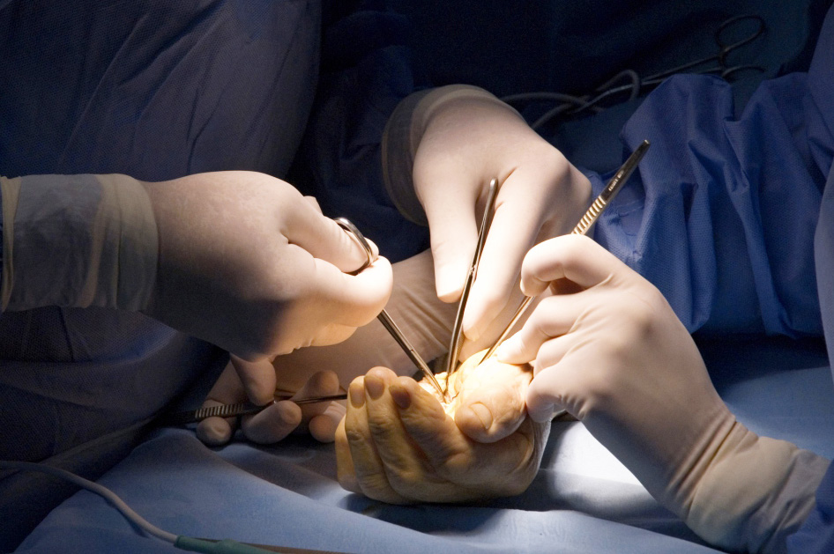
Global Hand Teaching Programme
Module 2.2
Flexor tendon repair
Cases

Slide 2
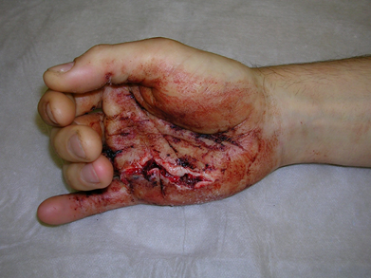

Case 1
A 19 year old boy presents with a laceration on the right palm from a knife attach which was 1 hour ago.
Describe the injury you see?
How will you manage this condition?
On exploration you find that both FDS and FDP tendons have been divided just proximal to the A1 pulley. What zone of injury is this and how will you go about your repair?
How will you rehabilitate the patient after repair?
bssh.ac.uk

Slide 3
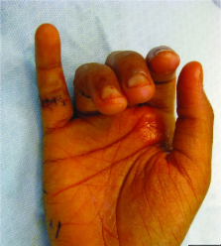
Case 2
Your next patient is a 40 year old chef who slipped cutting vegetables, plunging the knife into his little finger at the level of the PIPJ.
Describe the injury you see?
What structures are at risk and how do you examine them?
What zone is a flexor tendon injury likely to be in? Does the position of the finger at time of injury make any difference?
Discuss techniques and controversies of flexor tendon repair. In this zone.
bssh.ac.uk

Slide 4
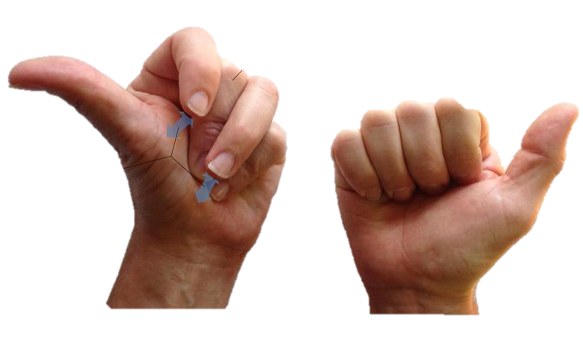
Case 3
A patient presents 1 year after FDP repair of the right middle finger, complaining of weak grip and difficulty flexing the adjacent fingers.
Describe what you see.
What is this phenomenon called?
Why does it occur?
What treatment options may be considered?
bssh.ac.uk

Slide 5

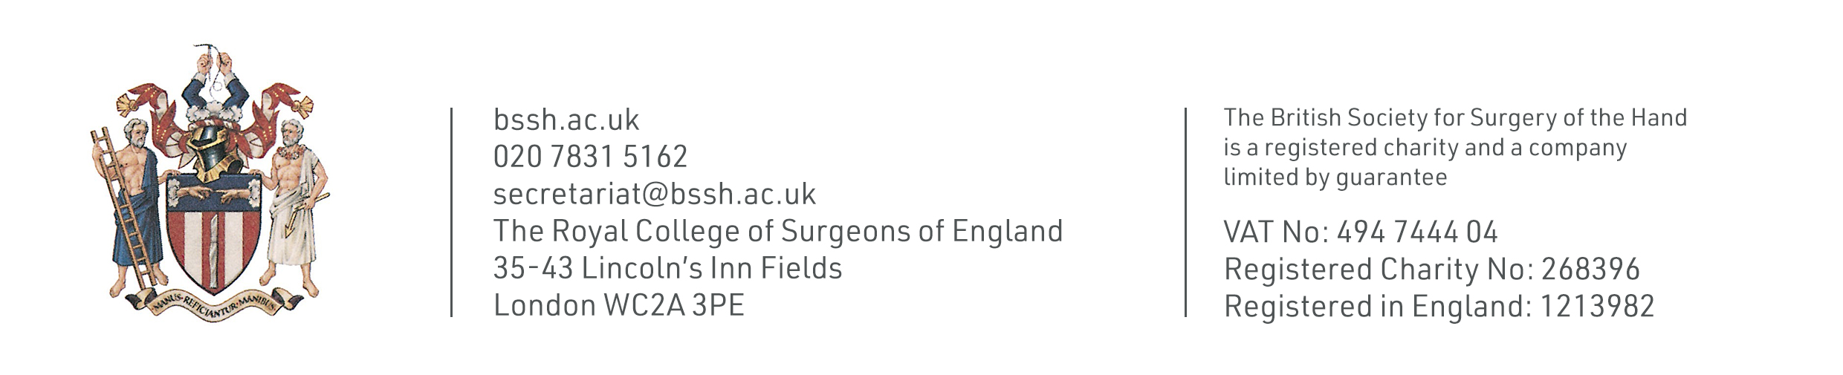
Questions?
For further information please ​
get in touch via the channels below:​

