Slide 1

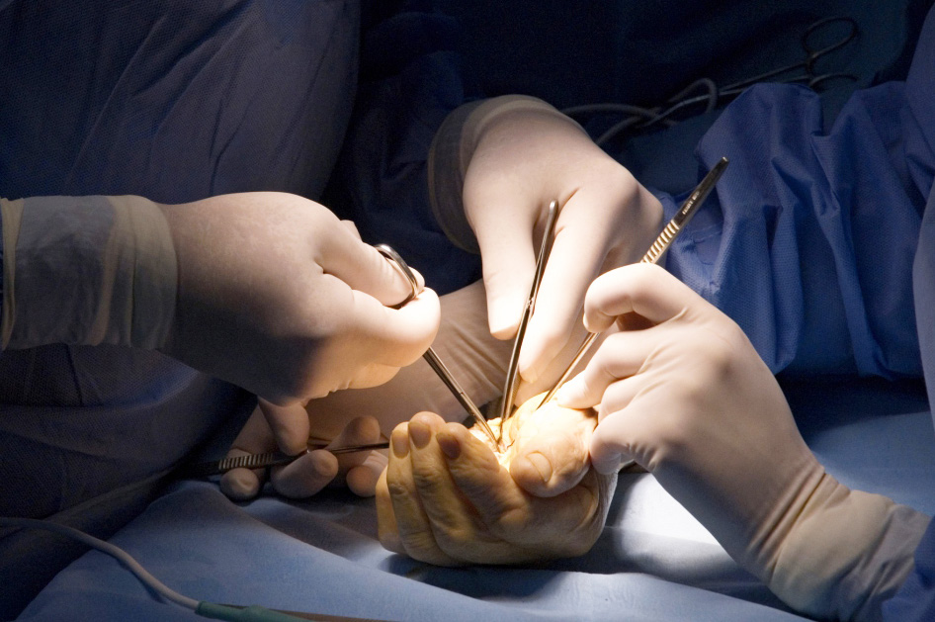
Global Hand Teaching Programme
Module 2.1
Tendon anatomy & healing
CBDs

Slide 2
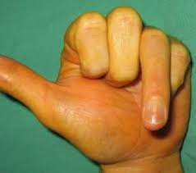

Case 1
3 weeks after zone 2 FDP repair of the ring finger, your patient had to return to work as a mechanic as he was losing income. The therapists are concerned that the repair may have failed.
Describe what you see?
What stage of healing was he in at 3 weeks?
Why might the repair have failed?
How would you counsel a patient prior to embarking on a flexor tendon repair?
bssh.ac.uk

Slide 3
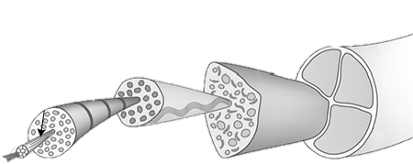
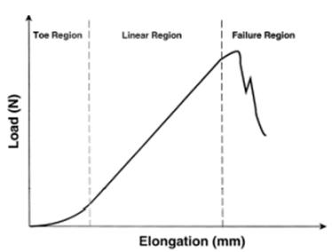
Case 2
Describe the basic structure of a tendon
What is a tendon composed of?
Explain what is happening in the various regions of the tendon stress-strain curve
bssh.ac.uk

Slide 4
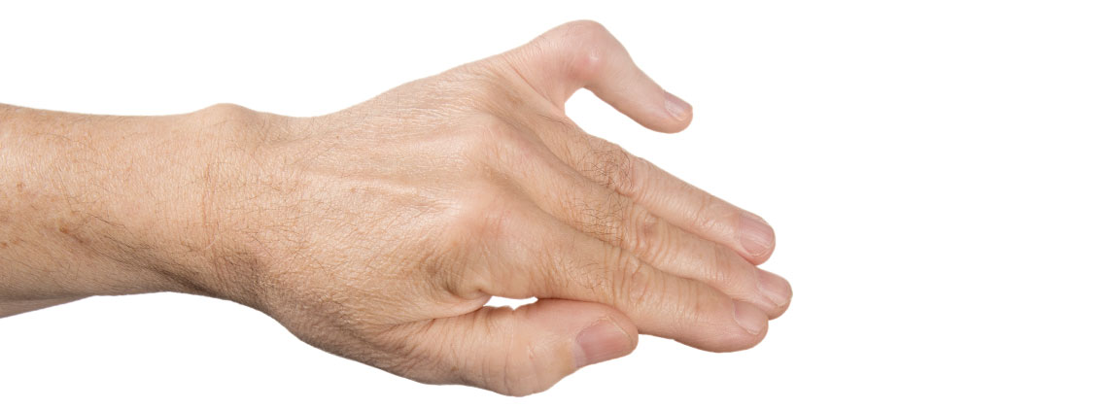
Case 3
A 30 year man sustained an impact to his little finger whilst playing basketball 4 months ago. He initially strapped it himself assuming it would get better, but now presents with difficult extending the PIPJ and flexing the DIPJ.
Describe the deformity
What injury is this patient likely to have sustained?
What “zone” has been affected
Draw the extensor hood and use this to describe the mechanics of this deformity
bssh.ac.uk

Slide 5


Questions?
For further information please ​
get in touch via the channels below:​

