Slide 1
Principles of Hand Therapy
BSSH Global Hand Surgery/ Therapy Teaching Programme
Module 1 Basic Science of the Upper Limb
Week

Slide 2

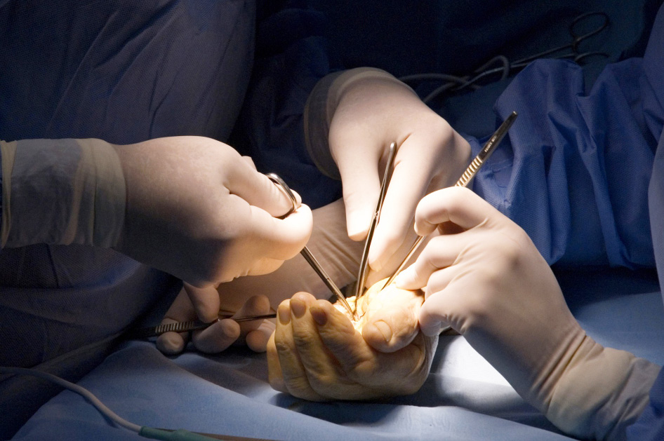
Global Hand Teaching Programme
Cases for Principles of Hand Therapy
Date: Subtitle Calibri Regular 16pt

Slide 3
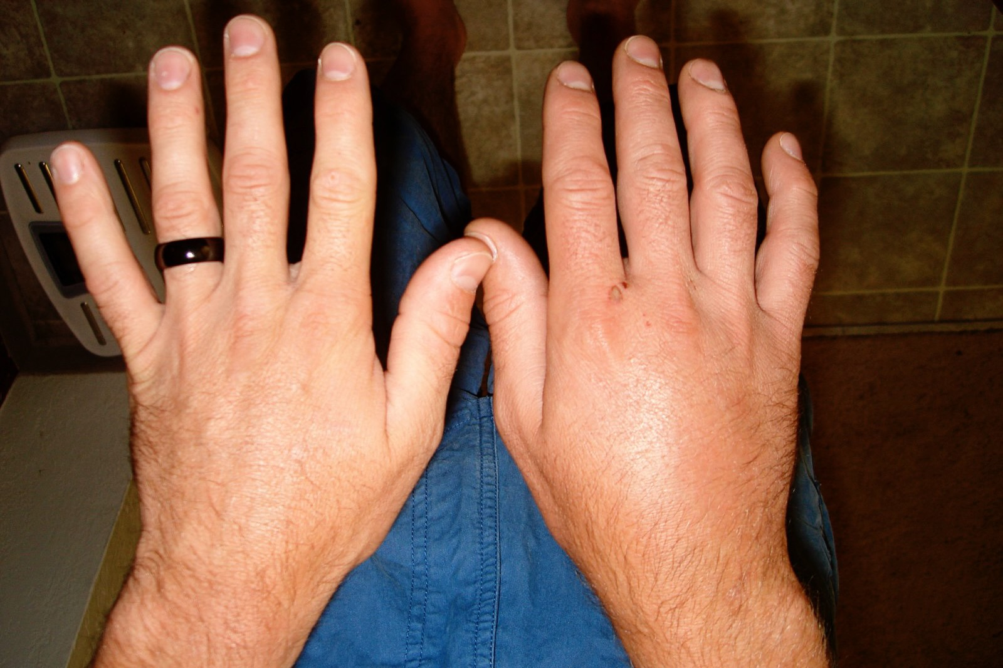

Case 1
35 year old man presents after suffering a stable metacarpal fracture 3 weeks ago
Describe the features observed.
What aspects would you assess to help your clinical reasoning?
How would you assess these?
bssh.ac.uk

Slide 4
Case 1
What are the main complications likely to be for this patient at this stage?
What therapy modalities might you use to treat this patient?
Why would you prioritise them for this patient?
bssh.ac.uk

Slide 5
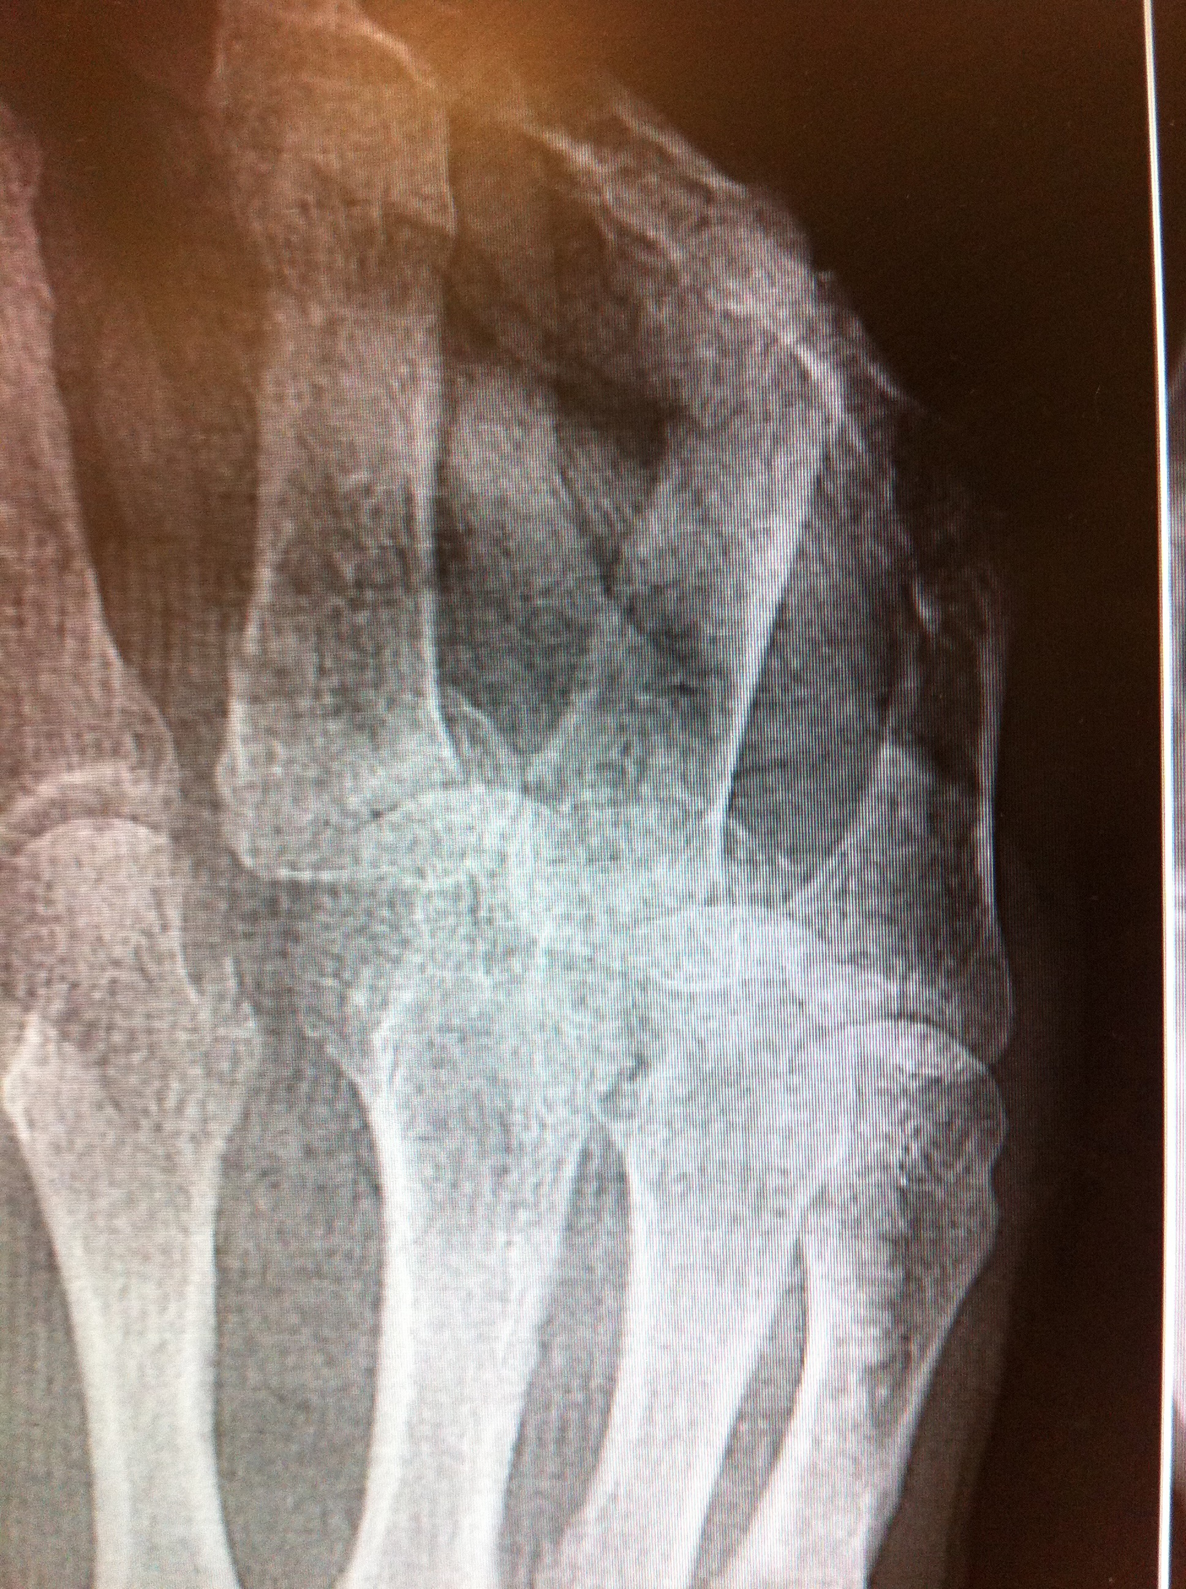
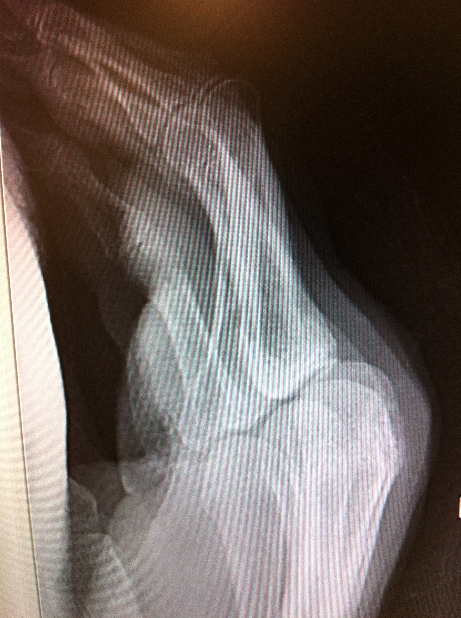
Case 2
62 year old man presents after having a heavy weight fall on his hand
What do you see on the Xray?
How stable are these fractures?
Discuss operative and non-operative options
bssh.ac.uk

Slide 6
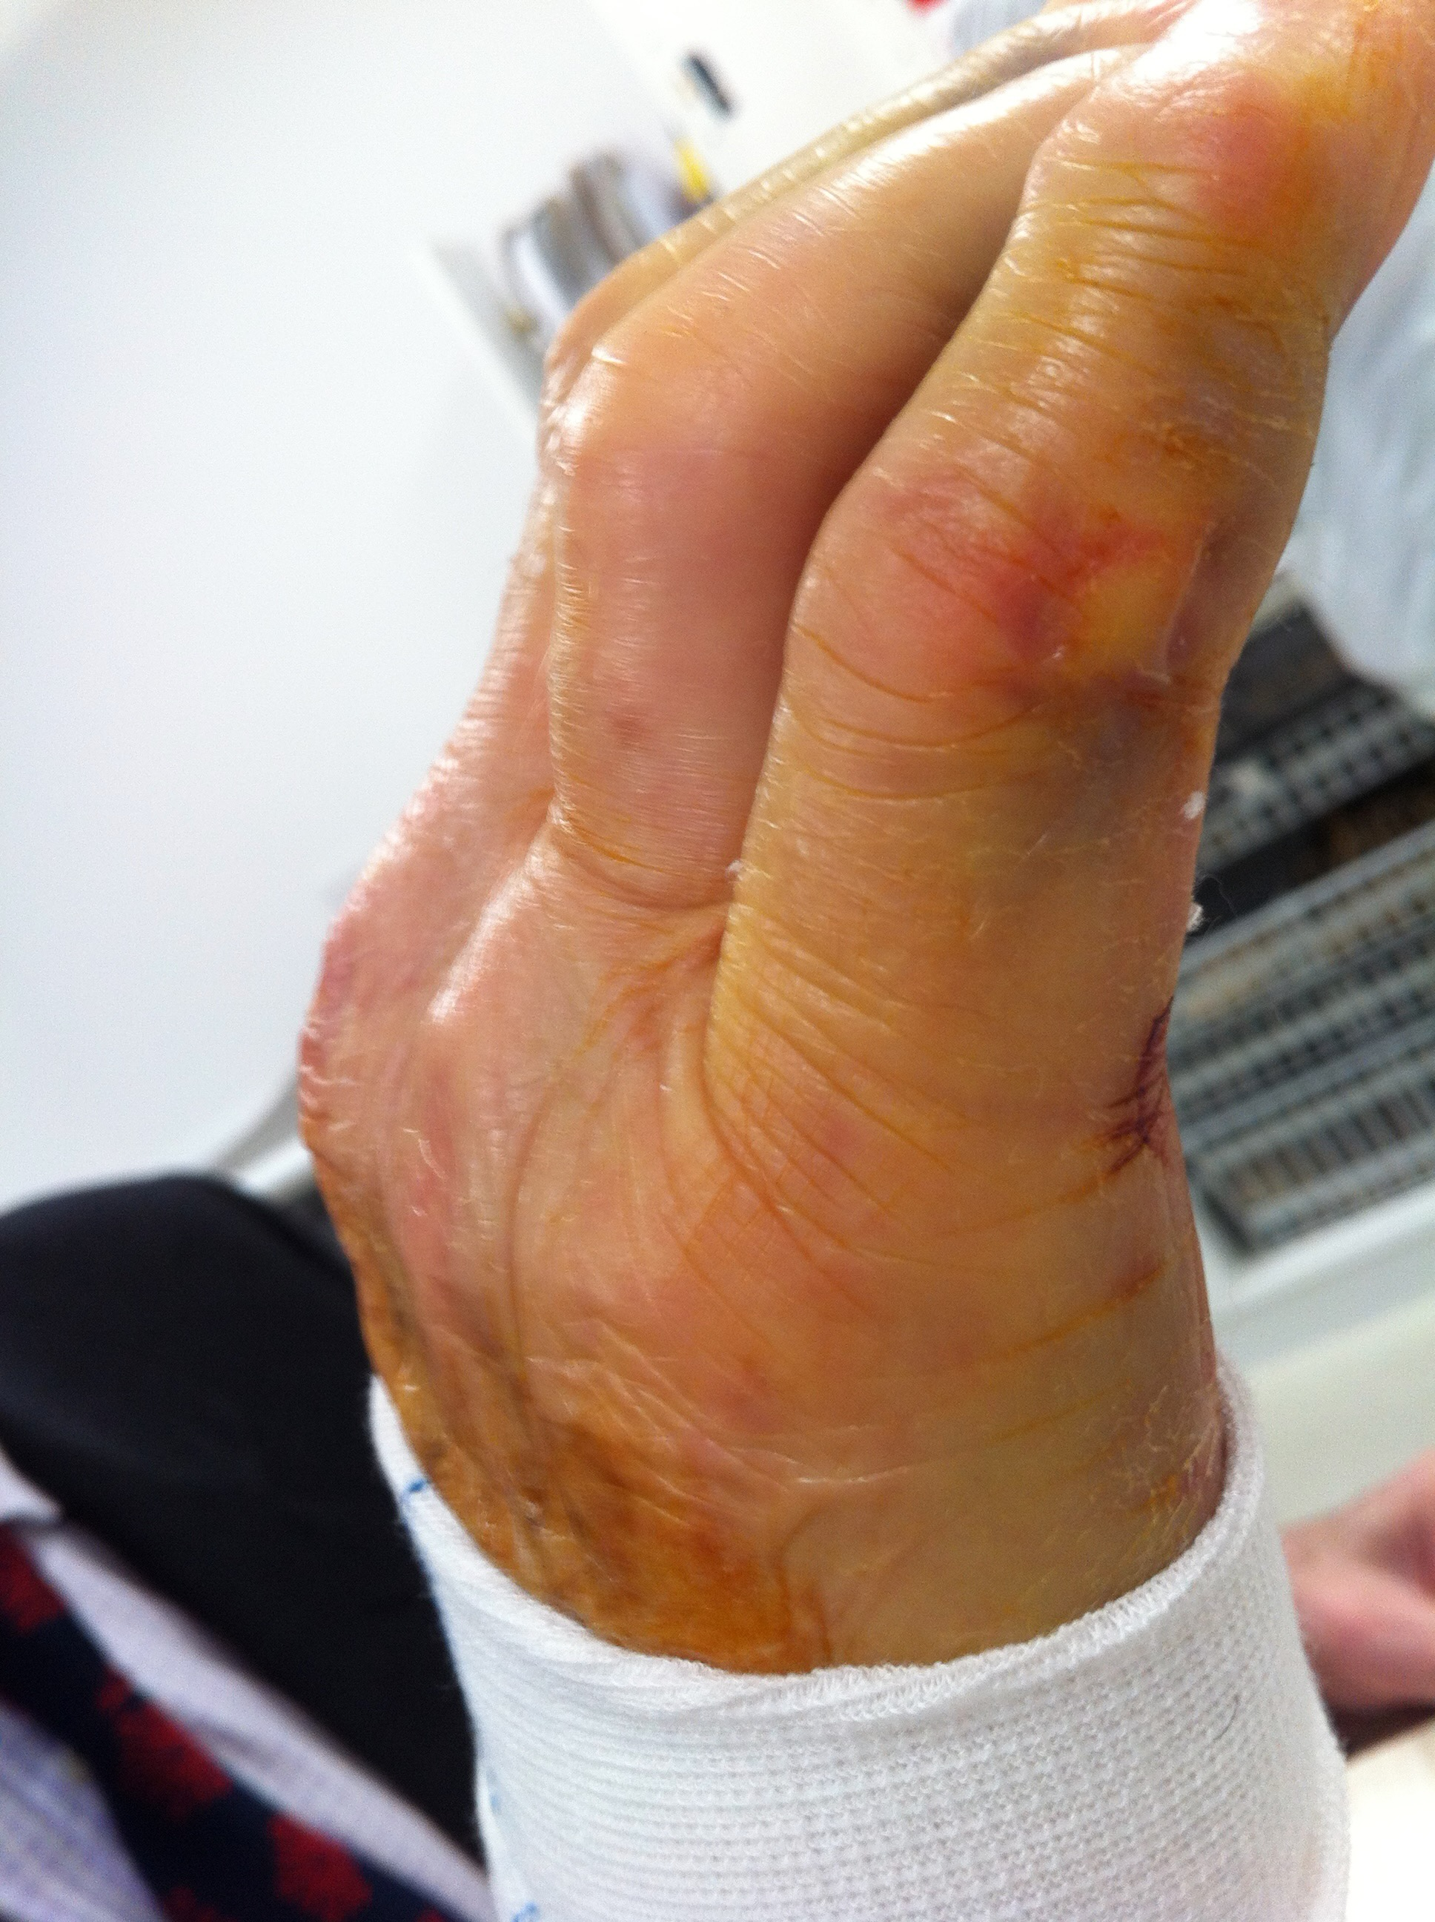
Case 2
He presents after suffering these proximal phalanx fractures to middle and ring fingers 3 days ago
Describe the features observed
Why would the deformity of the ring finger have occurred?
What aspects would you assess to help your clinical reasoning?
bssh.ac.uk

Slide 7
Case 2
The decision is to manage this patient non-operatively
What position of the MCPJ’s will help to stablise these fracture?
What splint might you make for this patient?
Would you give the patient exercises?
  Discuss which you might prioritise
bssh.ac.uk

Slide 8
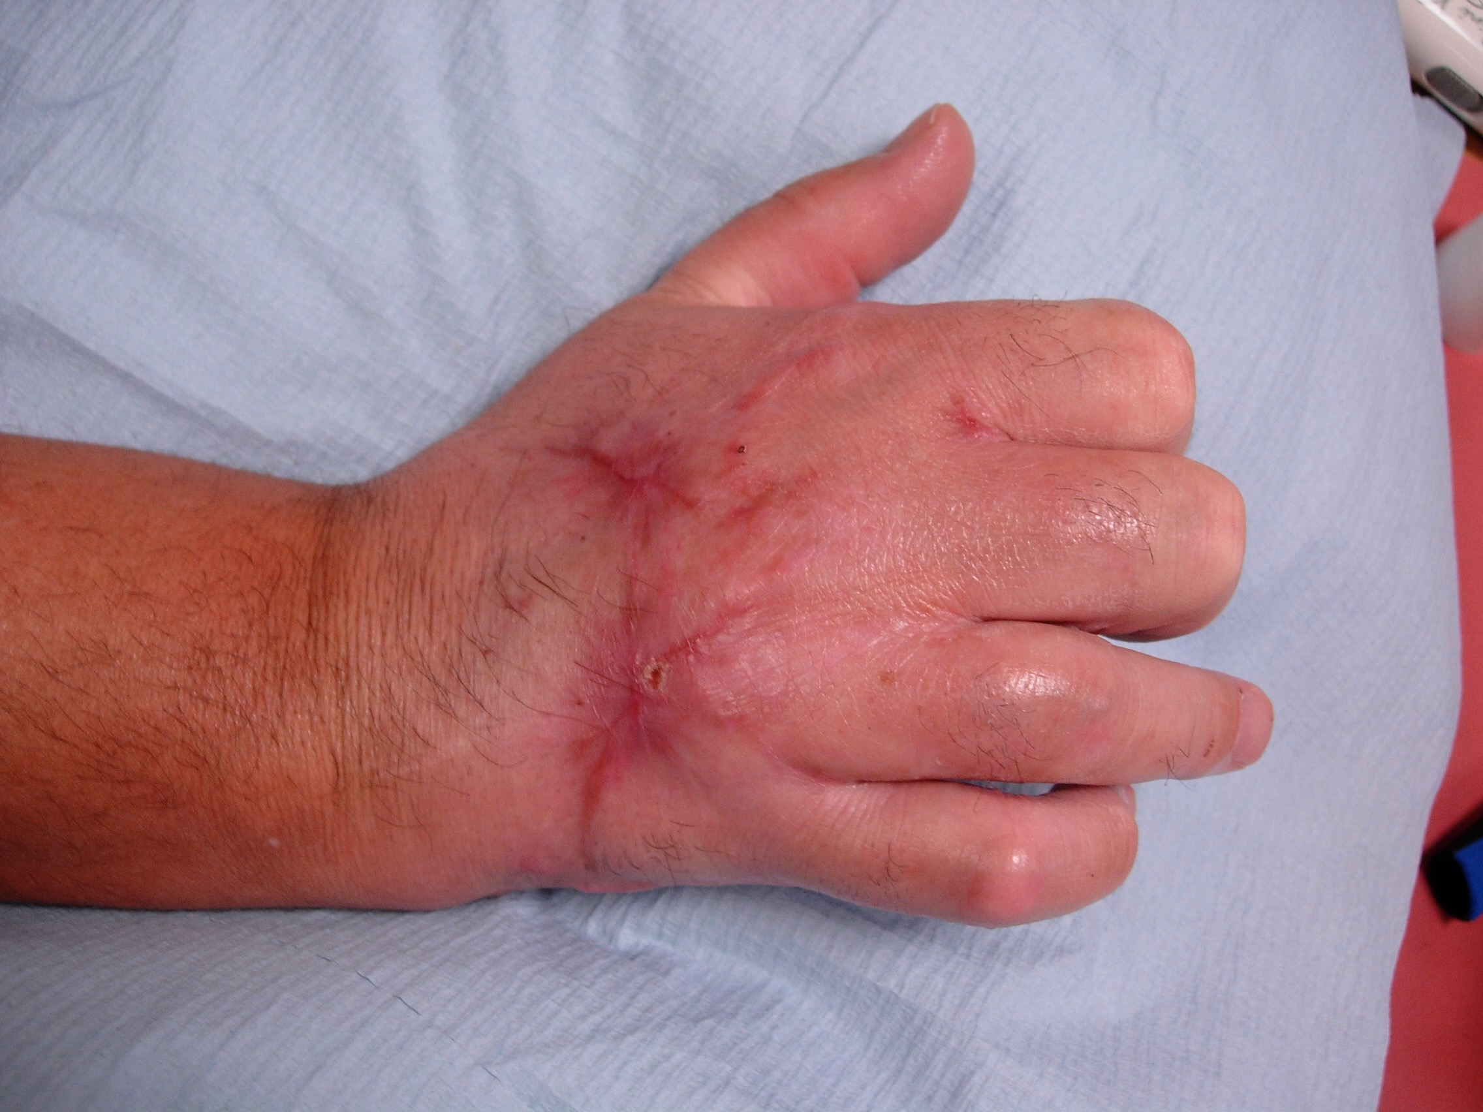
Case 3
48 year old man had a crush injury from a machine 8 weeks ago
He has healed metacarpal fractures to 3rd. 4th and 5th
He has a healed wound but marked scarring
What features do you observe?
What complications might he have?
bssh.ac.uk

Slide 9
Case 3
He has tethered extensors with very limited MCPJ flexion and limited finger extension / flexion
How would you treat the tethering to improve movement
How long would you keep working in the scars?
bssh.ac.uk

Slide 10
Case 1
He has stiff MCP joints with tight dorsal joint capsules
How would you treat the MCP joint tightness?
How would you gain flexion?
  Think about
    Splinting
    Exercises
    Activity
bssh.ac.uk

Slide 11
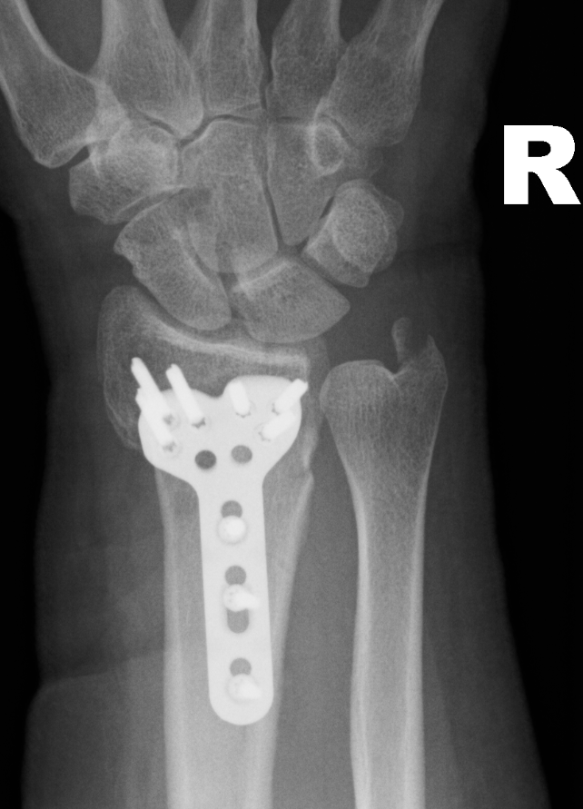
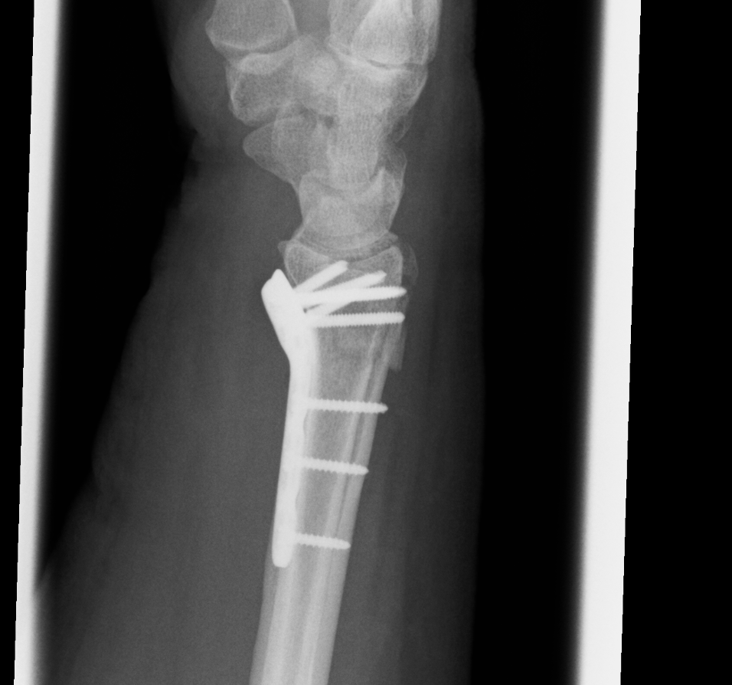
Case 4
55 year old lady who fell over on the pavement onto her right dominant hand
She has undergone a Volar plate and screws 5 days ago
Would you start moving this patient at this stage?
What exercises might you prioritise and why?
bssh.ac.uk

Slide 12
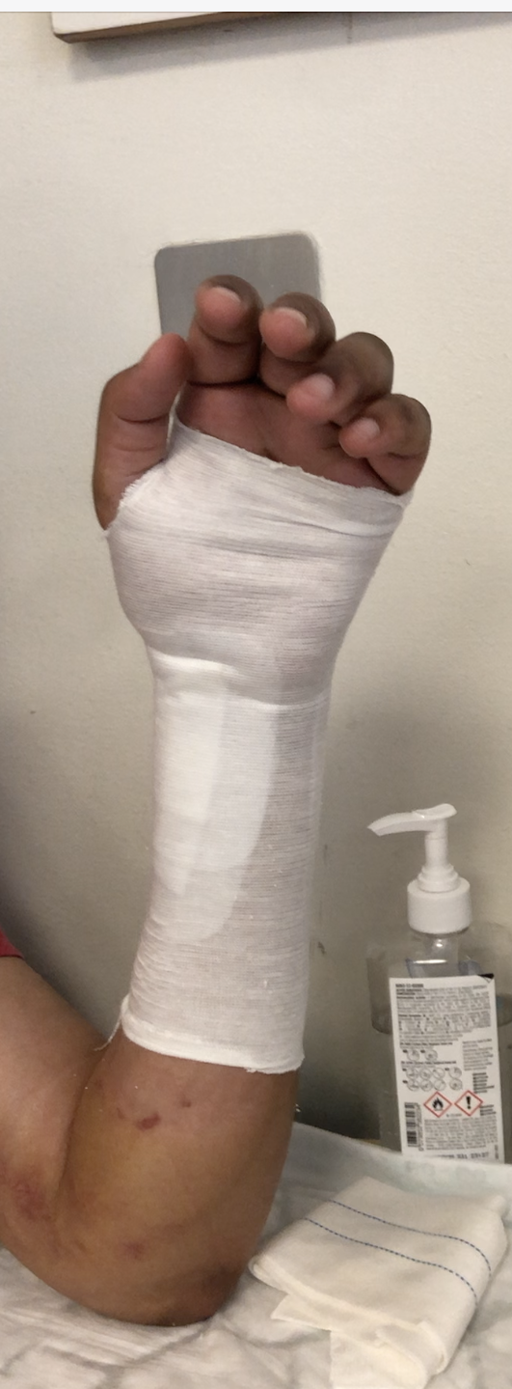
Case 4
You provided a splint and asked the patient to remove the splint
every 2 hours for exercises. Light function in the splint.
The patient returns 10 days later with:
  Limited finger and thumb range of motion
  Wrist extension 10 Wrist flexion 25
  Supination 10 Pronation 60
Which of these complications would you prioritise at this stage?
How would you treat them?
bssh.ac.uk

Slide 13
Case 4
6 weeks after ORIF:
Wrist and hand ROM has markedly improved apart from:
  Supination – now 40°
  Thumb composite flexion limited
She has a thick, sensitive scar volarly
She is struggling with weakness in function
What would you do in this session
What would you prescribe as a home programme
bssh.ac.uk

Slide 14
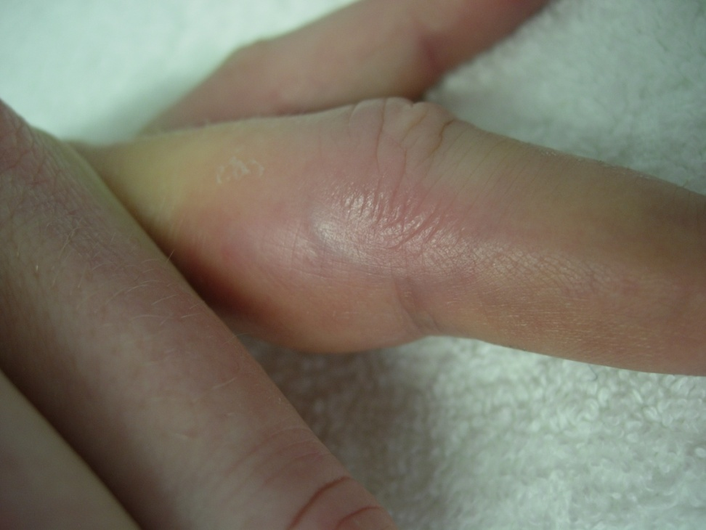
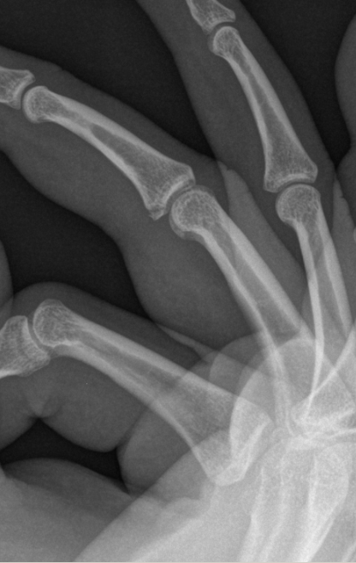
Case 5
23 year old woman dislocated her PIPJ 4 days ago
It has been relocated
What features do you observe?
Describe the grades of ligament injury
How would you treat each one differently in therapy?
bssh.ac.uk

Slide 15
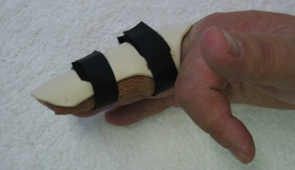
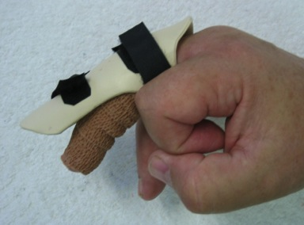
Case 5
What are the main complications following PIPJ dislocation?
How would you treat this patient at 4 days post injury
What would you modify at 3 weeks post injury?
  Think splint, exercises, function, advice
bssh.ac.uk

Slide 16
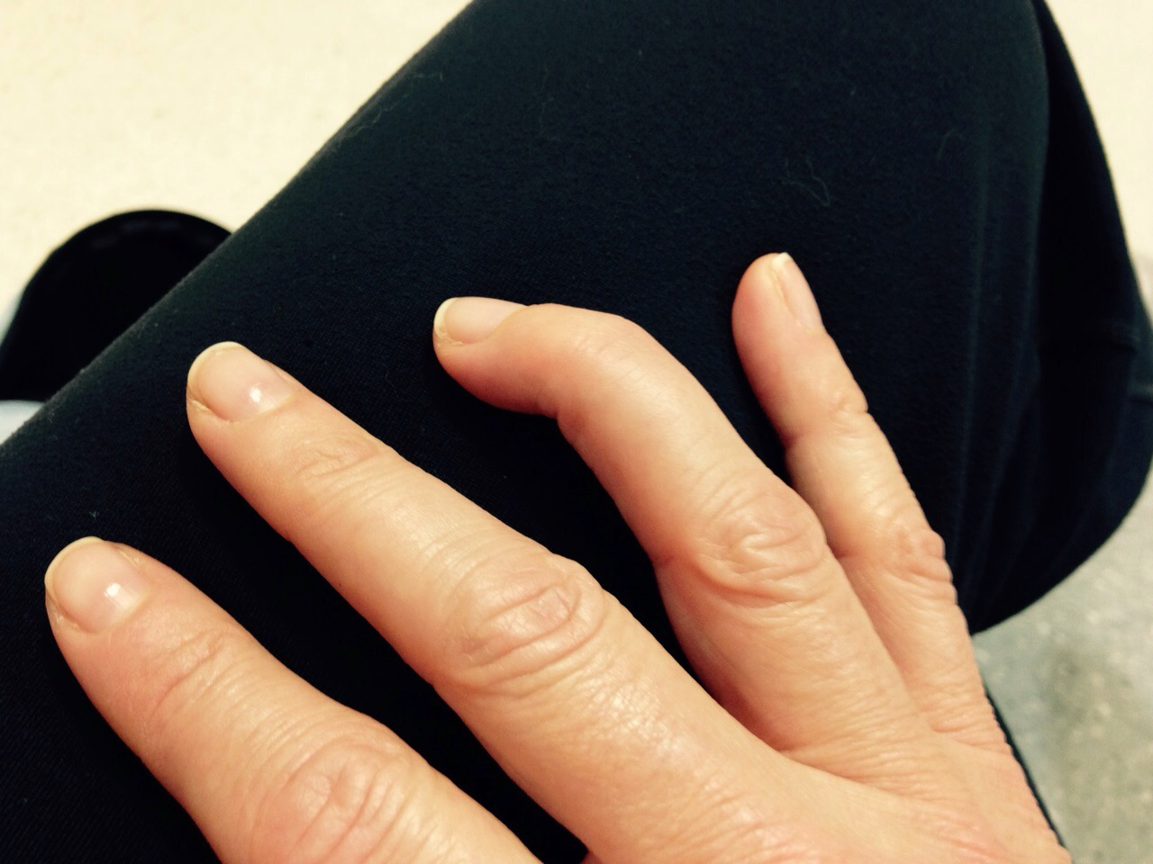
Case 6
What features do you observe?
What diagnosis would you give and why?
bssh.ac.uk

Slide 17
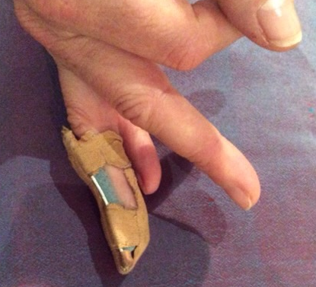
Case 6
How long would you immobilise for:
  Would you immobilise a bony and tendinous mallet for the same time?
How would you wean the patient after immobilisation
Discuss the expected results from mallet finger injuries
bssh.ac.uk

Slide 18
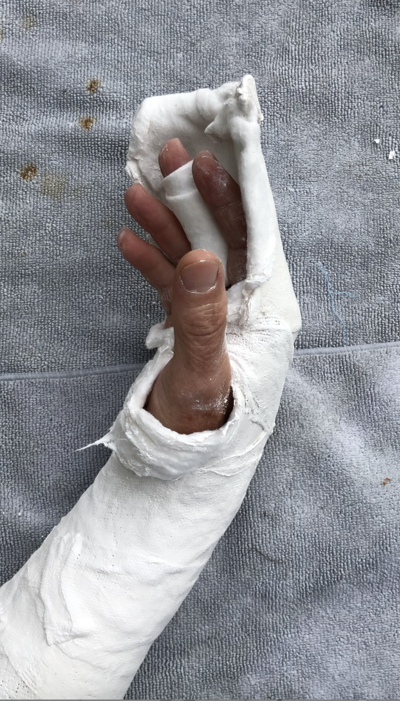
Case 7
32 year old woman with a repair of FDS/FDP zone 2 repair 4 days ago
What exercises would you give at this stage?
What other advice would you give?
bssh.ac.uk

Slide 19
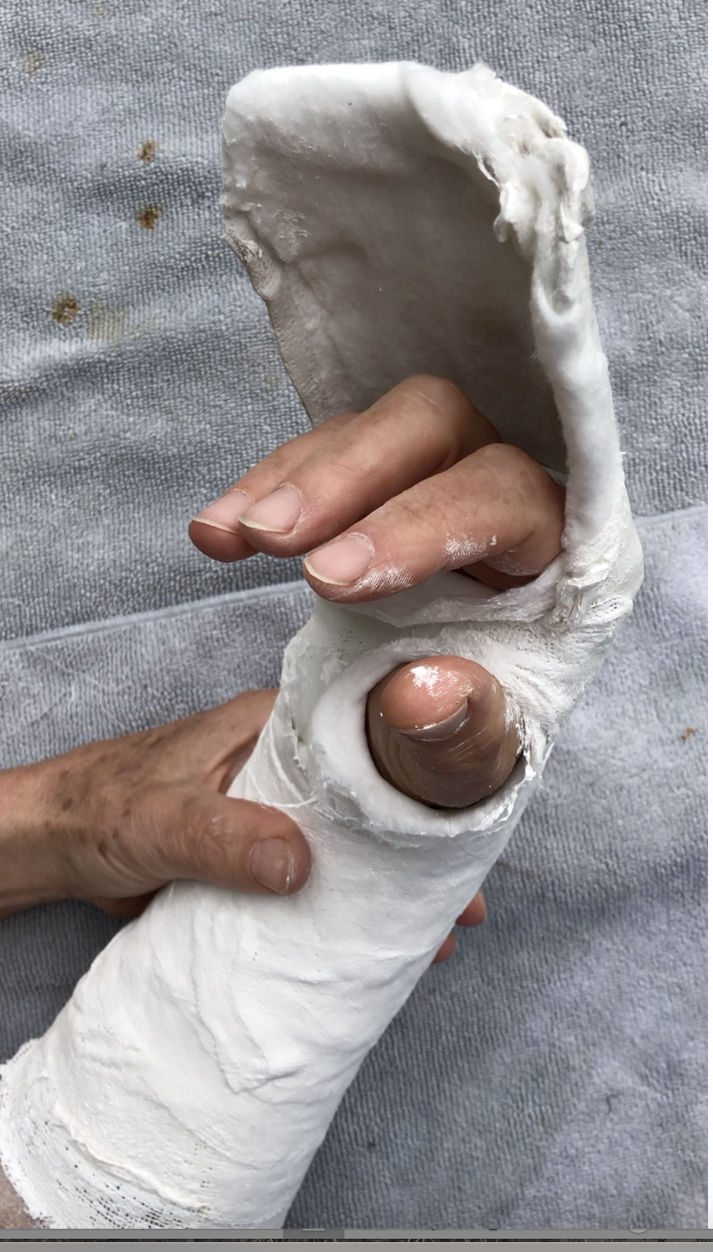
Case 7
What complications are most likely to be seen in the first 4 weeks in the splint for the zone 2 FDP/FDS?
Discuss how you might treat these and still keep the tendon repairs safe?
bssh.ac.uk

Slide 20
Case 7
How long would you keep the splint on for?
When would you start passive movement for PIPJ fixed flexion deformities?
When would you advise them to go back to:
  Driving
  Dressing
  Using a phone
  Carrying water buckets?
bssh.ac.uk

Slide 21

For further information please
get in touch via the channels below:

Slide 22
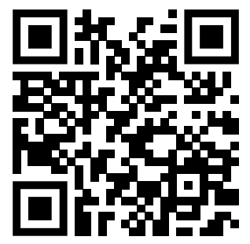
Teaching feedback link
https://s.surveyplanet.com/afx5henz

